Slide 1
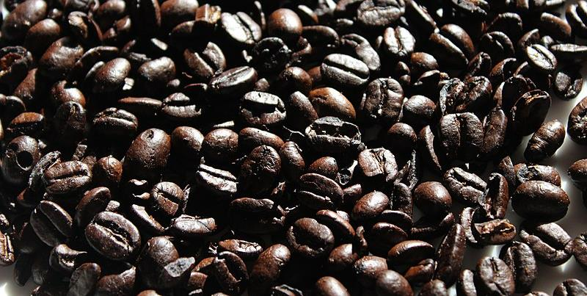
B1 b2 coffee
Picture credits and licenses: slide 23

Slide 2
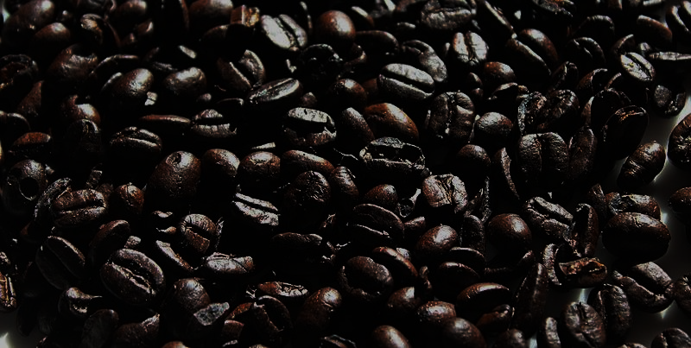
Do you drink coffee?
What are your coffee-drinking habits?
Talk about the different types of coffee available.
How does coffee go from the field to the cup? Describe the process.
Picture credits and licenses: slide 23

Slide 3



How much caffeine is in a cup of coffee?
(standard mug, around 230m, medium strength)
Click for answer
Instant coffee 60mg
Filter coffee 90mg
Americano 150mg
Expresso (30ml) 60mg
Black tea 45mg
Click for answer
Click for answer
Click for answer
Click for answer
What’s the maximum recommended intake of caffeine for a healthy adult? 400mg
Click for answer
Picture credits and licenses: slide 23

Slide 4
People use coffee to stay awake. Is it effective? How does it work?
What other ways can you make yourself more alert? What do YOU do?
Are there any drawbacks to caffeine use?
Should children be allowed caffeine?
What about a low dose (for example, in tea)?
Picture credits and licenses: slide 23

Slide 5
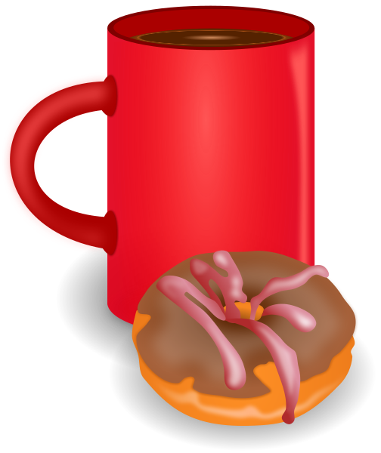
Watch this short explanation detailing how coffee stops you feeling tired.
Picture credits and licenses: slide 23

Slide 6


Explain how caffeine works.
Use these words.
(click to remove words and reveal meaning)
BIND
Caffeine binds to the receptors in the place of adenosine
6 hours
After 6 hours you will only feel half of caffeine’s effects
receptor
The receptors recognise caffeine as adenosine and allow them to bind
Adenosine
bloodstream
Is the compound which increases during the day and makes you feel tired
After coffee or a canned drink (soda) the caffeine is carried via the bloodstream to the brain
Watch again
Picture credits and licenses: slide 23

Slide 7
Can you tell the difference between cheap coffee and expensive coffee?
What is the difference?
What do you know about the most expensive coffee in the world?
(Clue: it involves poop)
Picture credits and licenses: slide 23

Slide 8
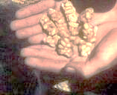
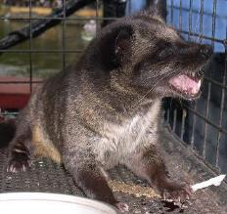
Kopi Luwak
Kopi Luwak coffee is one of the most exclusive and expensive non-alcoholic drinks in the world. The name refers to the method of its production and is not the name of the beans.
So, what’s so special about this coffee? You might not quite believe this, but the coffee beans are eaten in their raw state (they look like bright red berries, similar to rosehips) by an animal – usually the civet cat – and the partially digested beans are collected in the form of faeces (poop) after the animal has passed them. These beans (see picture below) are separated, have the outer shell removed, are cleaned and then roasted.
The high cost of the coffee is due to both the production process, which is labour-intensive and time-consuming, and the fact that demand is more than the supply, which pushes up the price. Even the cheaper brands of Kopi Luwak retail for more than 30 times the cost of regular coffee beans.
Lovers of coffee claim that this coffee has a special taste which can’t be experienced by drinking regular coffees. It is said to have a complex flavour which has no bitterness yet is smooth and earthy, with a hint of chocolate.
Picture credits and licenses: slide 23

Slide 9
In your own words, explain how is Kopi Luwak is produced.
Would you drink it? (Assume you are offered it for free).
Picture credits and licenses: slide 23

Slide 10
The following video answers these questions – read them first and see if you know any of the answers:
How much coffee is consumed daily worldwide?
Which country imports the most coffee?
Which country drinks the most coffee per head?
Where is coffee produced?
How many coffee beans does it take to make one expresso?
Why do the beans contain caffeine?
How much coffee could kill you? How many cups?
Which two religions do not approve of caffeine use?
How can caffeine help with migraines?
Picture credits and licenses: slide 23

Slide 11
Watch the video (link on the next slide).
The man speaks very quickly and you are not expected to understand it all.
See if you can catch the answer to the previous questions.
Picture credits and licenses: slide 23

Slide 12
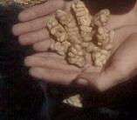
Watch the video
Up to 3 minutes (3’00”)
Picture credits and licenses: slide 23

Slide 13
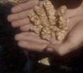
How much caffeine is consumed daily worldwide ?
Approx 1 cup of coffee per person – 300 tonnes a day
Which country imports the most coffee?
America
Which country drinks the most coffee per head?
Finland
Where is coffee produced?
The coffee belt – between tropics of Cancer and Capricorn
How many coffee beans does it take to make one expresso?
Approx 40
Page 1 of 2
Click for reveal
Click for reveal
Click for reveal
Click for reveal
Watch again
if necessary
Click for reveal
Picture credits and licenses: slide 23

Slide 14
Why do the beans contain caffeine?
They act as an insecticide – they kill bugs
How much coffee could kill you? How many cups?
Approx 1 cup per kilo of body weight (mass x 150mg)
Which two religions do not approve of caffeine use?
Mormons, Rastafarians
How can caffeine help with migraines?
Special tablet is inserted..into the body
Click for reveal
Click for reveal
Click for reveal
Watch again
if necessary
Click for reveal
Picture credits and licenses: slide 23

Slide 15
Would you drink Kopi Luwak coffee if it were offered to you?
If I were offered Kopi Luwak coffee, I wouldn’t drink it.
Picture credits and licenses: slide 23

Slide 16
Would you drink Kopi Luwak coffee if it were offered to you?
If I were offered Kopi Luwak coffee, I wouldn’t drink it.
The Second Conditional
We use the second conditional to say what we would do if a hypothetical - impossible or extremely unlikely – event happened first. The common example is:
If I won the lottery, I would buy a car.
(This event is possible but extremely unlikely).
Like all conditionals, this can be reversed:
I would buy a car if I won the lottery.
Picture credits and licenses: slide 23

Slide 17
The Second Conditional
It is made of two parts, with each part having two elements:
if + past + would/could + present
if I ate more vegetables + I would feel better.
(At this stage s/he doesn’t eat enough vegetables, so impossible)
if I were you + I would be rich.
(But I’m not, so impossible).
(Why ‘I were’ and not ‘I was’? The short answer is that it can be both; there are lots of reasons for this and this is not the time to explain it. Older-style grammar prefers ‘were’ so we will use that one here).
Picture credits and licenses: slide 23

Slide 18
Make second conditional sentences.
Use the given verbs.
Picture credits and licenses: slide 23

Slide 19
Model: If I were offered Kopi Luwak coffee, I wouldn’t drink it.
1 If I exercised more, I would feel fitter.
2 If my grandma were younger, she would go out more.
3 If aliens invaded tomorrow, we would all die.
4 You would look younger if you dyed your hair.
5 My friends would play football if I had my ball.
exercise
feel
Click me!
Click me!
is
go
Click me
Click me!
die
invade
Click me!
Click me!
dye
look
Click me!
Click me!
have
play
Click me!
Click me!
Picture credits and licenses: slide 23
Picture credits and licenses: slide 17

Slide 20
What other legal products are addictive? Do you use/consume any of them?
Have you ever drunk too much caffeine? How did you feel?
What’s your favourite – tea or coffee? Why?
What other products (apart from tea and coffee) contain caffeine?
Picture credits and licenses: slide 23

Slide 21
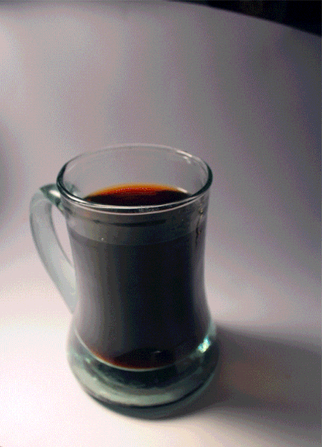
Bye bye!
Picture credits and licenses: slide 23

Slide 22

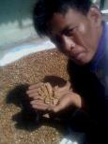
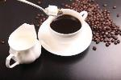
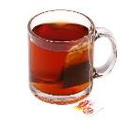

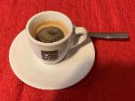

Picture licenses
All pictures in this presentation are copyright-free or in the public domain.
This file is made available under the Creative Commons CC0 1.0 Universal Public Domain Dedication.
Public domain.
This file is made available under the Creative Commons CC0 1.0 Universal Public Domain Dedication.
This file is made available under the Creative Commons CC0 1.0 Universal Public Domain Dedication.
This file is made available under the Creative Commons CC0 1.0 Universal Public Domain Dedication.
This file is made available under the Creative Commons CC0 1.0 Universal Public Domain Dedication.
This file is made available under the Creative Commons CC0 1.0 Universal Public Domain Dedication.
Parhamr (https://commons.wikimedia.org/wiki/File:Pouring_cream_into_drip_coffee.gif), „Pouring cream into drip coffee“, marked as public domain, more details on Wikimedia Commons: https://commons.wikimedia.org/wiki/Template:PD-self
Michelle Grewe from 'Murica (https://commons.wikimedia.org/wiki/File:Coffee_beans_(25953929733).jpg), „Coffee beans (25953929733)“, https://creativecommons.org/publicdomain/zero/1.0/legalcode
Public domain.
shixugang (https://commons.wikimedia.org/wiki/File:Coffee-563797.jpg), „Coffee-563797“, https://creativecommons.org/publicdomain/zero/1.0/legalcode
HaztechGuy at English Wikipedia (https://commons.wikimedia.org/wiki/File:Indonesian_farmer_shows_coffee_beans_already_digested_by_Asian_Palm_Civet,_but_before_cleaning_and_roasting.jpg), „Indonesian farmer shows coffee beans already digested by Asian Palm Civet, but before cleaning and roasting“, cropped by Alex Elwood, https://creativecommons.org/publicdomain/zero/1.0/legalcode
Evan-Amos (https://commons.wikimedia.org/wiki/File:Lipton-mug-tea.jpg), „Lipton-mug-tea“, marked as public domain, more details on Wikimedia Commons: https://commons.wikimedia.org/wiki/Template:PD-self
gnokii (https://commons.wikimedia.org/wiki/File:Coffee_and_doughnut.svg), „Coffee and doughnut“, https://creativecommons.org/publicdomain/zero/1.0/legalcode
Benoît Prieur creator QS:P170,Q42790984 (https://commons.wikimedia.org/wiki/File:Un_expresso_(L'Auberge_Rouge).jpg), „Un expresso (L'Auberge Rouge)“, https://creativecommons.org/publicdomain/zero/1.0/legalcode
Magalhães (https://commons.wikimedia.org/wiki/File:Paradoxurus_hermaphroditus_philippensis.jpg), „Paradoxurus hermaphroditus philippensis“, marked as public domain, more details on Wikimedia Commons: https://commons.wikimedia.org/wiki/Template:PD-self

Slide 23
www.b1b2englishresources.com

