Slide 1

B1 b2 A single life Speaking about life events and the future
Picture credits and licenses: slide 20

Slide 2

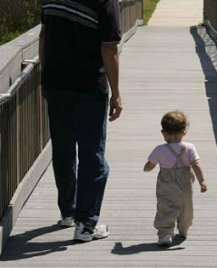
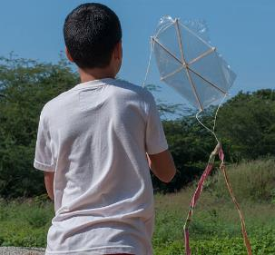
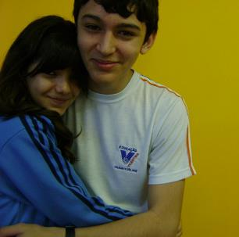
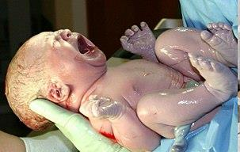
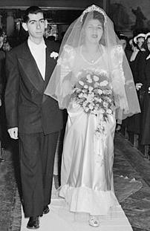
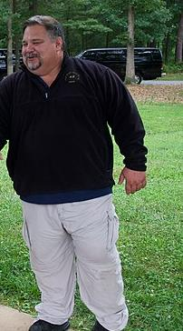
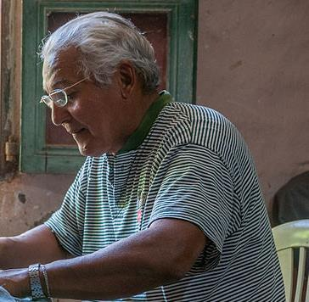
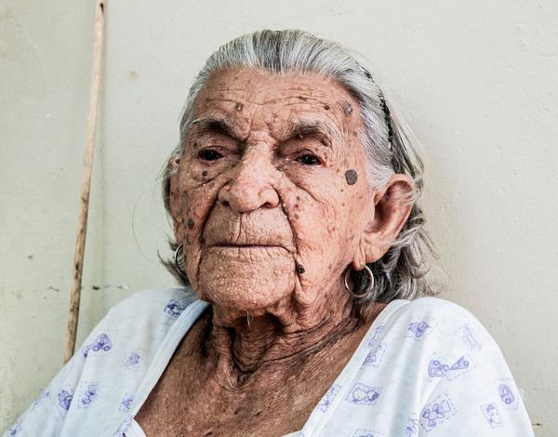
What are the different stages of life?
Start with ‘newborn’ and name as many as you can. (Click red boxes to reveal)
toddler
child
6 months old
18 months old
9 years old
16 years old
baby
teen /
adolescent
25 years old
46 years old
68 years old
99 years old
(young) adult
Middle aged
retired
elderly
Picture credits and licenses: slide 18

Slide 3
Fluency 1
Picture credits and licenses: slide 20

Slide 4

Talk about something that happened when you were young.
Speak for one minute. Try not to stop or pause.
Start with, ‘When I was…’. Use the past tense.
You can talk about anything, but here are some ideas:
Your first day at school / an early school memory
A time when you hurt yourself
A party or celebration
A holiday or trip somewhere
TIME’S UP
Picture credits and licenses: slide 18

Slide 5
Fluency 2
Picture credits and licenses: slide 20

Slide 6

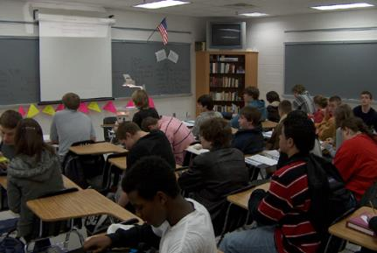
Talk about your school or education.
This could be now (the present tense) or in the past.
Speak for one minute. Try not to stop or pause.
You can talk about anything, but here are some ideas:
Your likes and dislikes at school / university
A typical school day
Do you enjoy school? What could be better?
Compare your school or university with others
Talk about private lessons – music, English, dance etc
TIME’S UP
Picture credits and licenses: slide 20

Slide 7
Fluency 3
Picture credits and licenses: slide 20

Slide 8

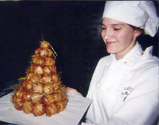
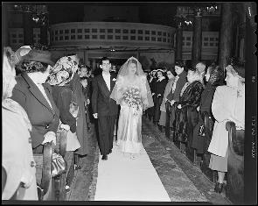
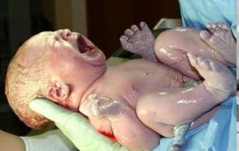

What important events happen when you are an adult?
Think of two or three.
If you are young :
talk about your ideas / dreams / hopes (weddings, for example). Perhaps you don’t want it to happen (have children for ex) – why?
If you are older, talk about important events in your life.
What happened? How did you feel?
Picture credits and licenses: slide 20
Picture credits and licenses: slide 19
Picture credits and licenses: slide 18

Slide 9
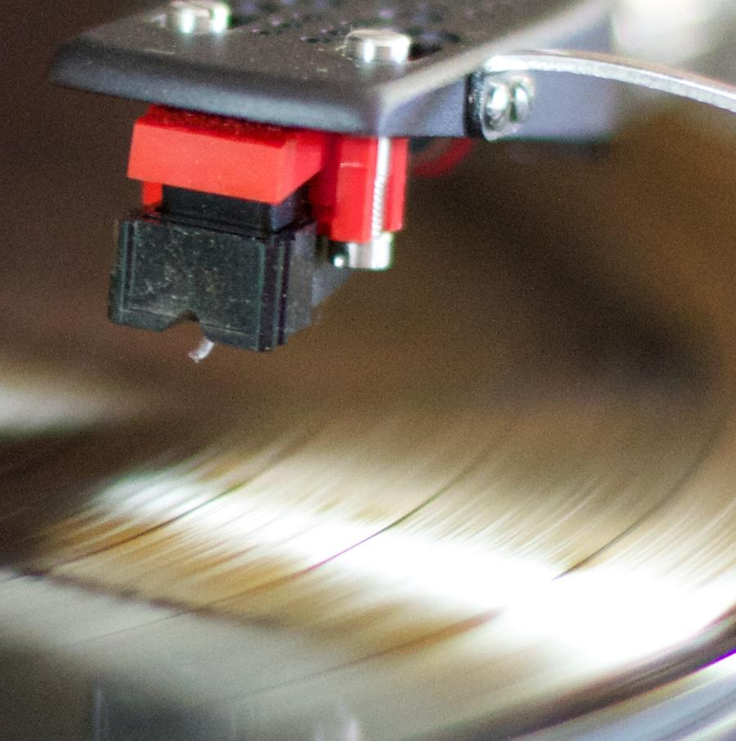

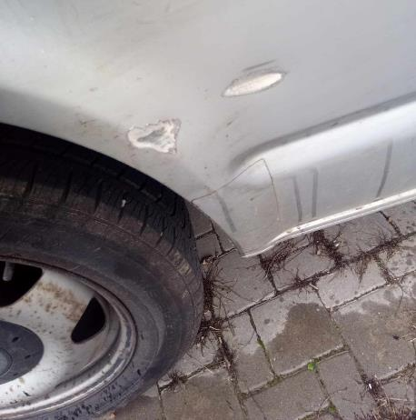

We’re going to watch a short animation about different times in a person’s life.
There is no speaking in the film, but you will need this vocabulary: click arrows for reveal:
scratch
stylus / needle
record / groove
record player /
(old) gramophone
wheelchair
Picture credits and licenses: slide 19

Slide 10
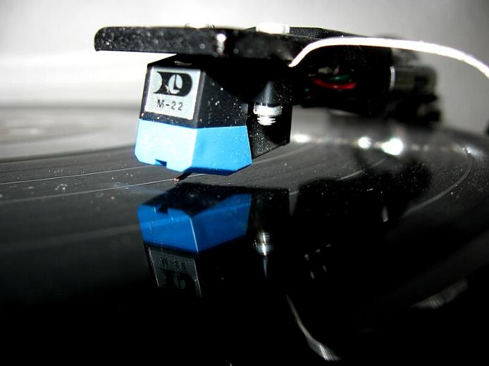
Watch the video ‘A Single Life’.
Remember the different stages of life and what happens to the woman.
https://www.youtube.com/watch?v=pzAZnOyMTI4
Picture credits and licenses: slide 19

Slide 11
How does the woman time-travel?
We see five periods of the woman’s life (including the beginning). Outline her situation in each.
What is the problem she has when she is a child?
What problem does she have in the last part of the film?

Slide 12
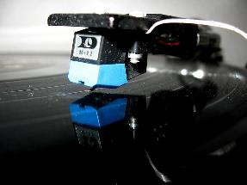
Watch again.
Pause the film (and answer these questions each time) at:
1’06” 1’26” 1’33” 1’46” 2’06”
What is happening?
What do we learn about the woman? (For example: she can play the guitar.)
Describe the rooms. What does the furniture and style say about the woman’s time of life?
Are there any items that are present in more than one time period?
https://www.youtube.com/watch?v=pzAZnOyMTI4
Picture credits and licenses: slide 19

Slide 13
What is the message of the film?

Slide 14
Talking about our own future
If an event or situation is planned, we can use ‘going to’:
‘I’m going to be an engineer’ (because I am studying it now at university).
If a situation is not certain – but desired – use ‘want + infinitive’ or ‘hope + infinitive:
‘I want to be an engineer’ (but I’m not studying it yet).
‘I want to live in Italy’ (but at the moment I’m here).
‘I hope to get promoted next year’.
‘I hope to finally get married when I finish building our house’.

Slide 15
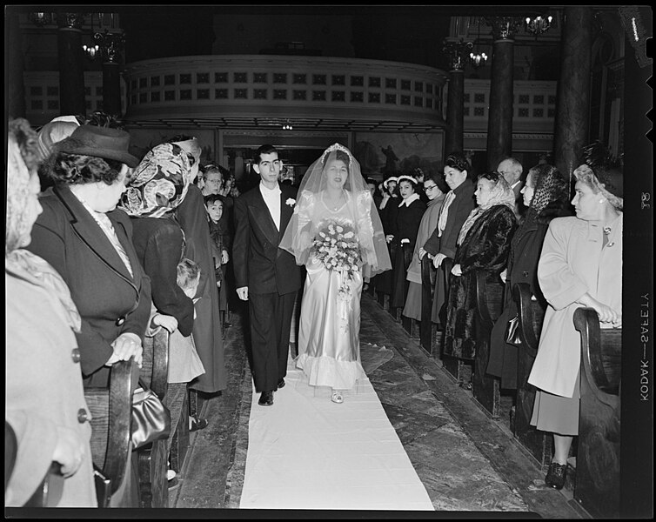
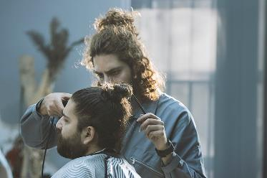

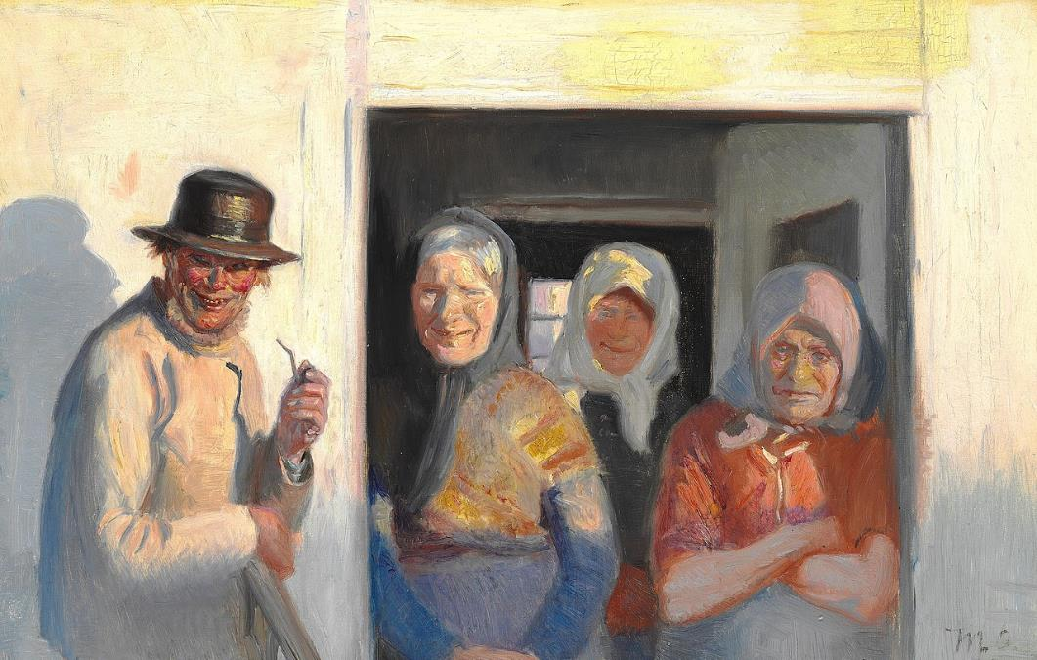
Talk about a future event that hasn’t happened. If you are not sure what to say you can invent the information
(perhaps you want to be a racing driver ☺).
career
relationships
retirement
Picture credits and licenses: slide 19

Slide 16
Bye Bye

Slide 18
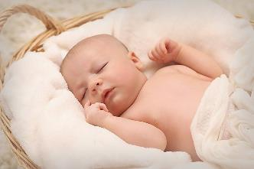
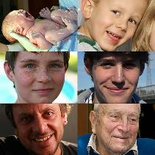
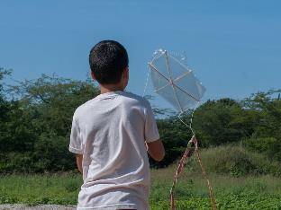
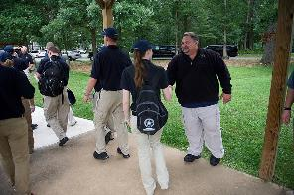
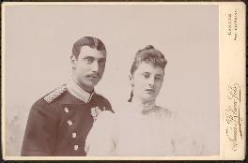
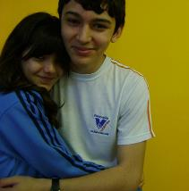
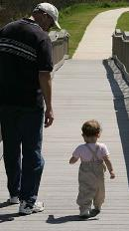

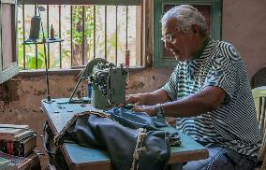
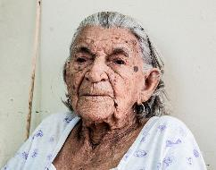
Picture licenses
All pictures in this presentation are copyright-free or in the public domain.
This work is in the public domain in the United States because it is a work prepared by an officer or employee of the United States Government as part of that person’s official duties under the terms of Title 17, Chapter 1, Section 105 of the US Code
This file is licensed under the Creative Commons Attribution-Share Alike 3.0 Unported, 2.5 Generic, 2.0 Generic and 1.0 Generic license.
This file is made available under the Creative Commons CC0 1.0 Universal Public Domain Dedication.
This media file is in the public domain in the United States. This applies to U.S. works where the copyright has expired, often because its first publication occurred prior to January 1, 1928, and if not then due to lack of notice or renewal. See this page for further explanation.
This file is made available under the Creative Commons CC0 1.0 Universal Public Domain Dedication.
Pixabay (https://commons.wikimedia.org/wiki/File:Newborn_baby_sleeps_in_a_basket.jpg), „Newborn baby sleeps in a basket“, https://creativecommons.org/publicdomain/zero/1.0/legalcode
anonymous (https://commons.wikimedia.org/wiki/File:Unidentified_man_and_woman_-_DPLA_-_61bfe8068cceb9bc5b595f7eb34311a9_(page_1).jpg), „Unidentified man and woman - DPLA - 61bfe8068cceb9bc5b595f7eb34311a9 (page 1)“, cropped by Alex Elwood, https://creativecommons.org/publicdomain/zero/1.0/legalcode
Shane T. McCoy (https://commons.wikimedia.org/wiki/File:Man_shakes_hands_with_a_law_enforcement_explorer_outside.jpg), „Man shakes hands with a law enforcement explorer outside“, cropped by Alex Elwood, https://creativecommons.org/publicdomain/zero/1.0/legalcode
Collective (https://commons.wikimedia.org/wiki/File:Human_development_stages_(collage).jpg), „Human development stages (collage)“, https://creativecommons.org/licenses/by-sa/3.0/legalcode
Wilfredor (https://commons.wikimedia.org/wiki/File:Child_playing_with_a_kite.jpg), „Child playing with a kite“, https://creativecommons.org/publicdomain/zero/1.0/legalcode
This image or recording is the work of a U.S. Fish and Wildlife Service employee, taken or made as part of that person's official duties. As a work of the U.S. federal government, the image is in the public domain
This file is made available under the Creative Commons CC0 1.0 Universal Public Domain Dedication.
This file is from Pixabay, where the creator has released it explicitly under the license Creative Commons Zero (see here). File ID: 3046491
This file is made available under the Creative Commons CC0 1.0 Universal Public Domain Dedication.
Public domain.
Andrebortoli (https://commons.wikimedia.org/wiki/File:Andrebortoliejuuh.jpg), „Andrebortoliejuuh“, cropped by Alex Elwood, https://creativecommons.org/publicdomain/zero/1.0/legalcode
Wilfredor (https://commons.wikimedia.org/wiki/File:People_of_Margarita_island_working.jpg), „People of Margarita island working“, cropped by Alex Elwood, https://creativecommons.org/publicdomain/zero/1.0/legalcode
Hillebrand Steve, U.S. Fish and Wildlife Service (https://commons.wikimedia.org/wiki/File:A_man_and_toddler_take_a_leisurely_walk_on_a_boardwalk.jpg), „A man and toddler take a leisurely walk on a boardwalk“, cropped by Alex Elwood, https://creativecommons.org/publicdomain/zero/1.0/legalcode
https://pixabay.com/en/users/2081671-2081671/ (https://commons.wikimedia.org/wiki/File:Babies_with_soft_books.jpg), „Babies with soft books“, https://creativecommons.org/publicdomain/zero/1.0/legalcode
Wilfredor (https://commons.wikimedia.org/wiki/File:Old_Woman_of_San_Juan_Bautísta.jpg), „Old Woman of San Juan Bautísta“, https://creativecommons.org/publicdomain/zero/1.0/legalcode

Slide 19


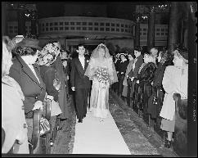
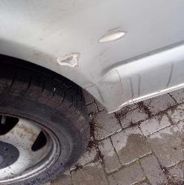
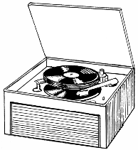
Picture licenses
All pictures in this presentation are copyright-free or in the public domain.
This work is in the public domain in the United States because it is a work prepared by an officer or employee of the United States Government as part of that person’s official duties under the terms of Title 17, Chapter 1, Section 105 of the US Code
Public Domain
This file is from Pixabay, where the creator has released it explicitly under the license Creative Commons Zero (see here). File ID: 3046491
This file is made available under the Creative Commons CC0 1.0 Universal Public Domain Dedication.
Public domain
Credited author is Harmanx (https://commons.wikimedia.org/wiki/File:Pastry_chef_ferguson.jpg), „Pastry chef ferguson“, marked as public domain, more details on Wikimedia Commons: https://commons.wikimedia.org/wiki/Template:PD-user
Mohamed Hassan (https://commons.wikimedia.org/wiki/File:Manual_self-propelled_folding_wheelchair_silhouette.png), „Manual self-propelled folding wheelchair silhouette“, https://creativecommons.org/publicdomain/zero/1.0/legalcode
U.S. Air Force photo/Trevor Cokley (https://commons.wikimedia.org/wiki/File:Air_Force_and_Space_Force_cadets_saluting.jpg), Air Force and Space Force cadets s„aluting“, marked as public domain, more details on Wikimedia Commons: https://commons.wikimedia.org/wiki/Template:PD-US
Mostafameraji (https://commons.wikimedia.org/wiki/File:Barbershop_In_Iran_-_Barber,_Hairdresser_11.jpg), „Barbershop In Iran - Barber, Hairdresser 11“, https://creativecommons.org/publicdomain/zero/1.0/legalcode
This media file is in the domain in the United States. This appublicplies to U.S. works where the copyright has expired, often because its first publication occurred prior to January 1, 1928, and if not then due to lack of notice or renewal. See this page for further explanation
Public domain.
This work has been released into the public domain by its author, Pearson Scott Foresman. This applies worldwide
Author’s own
Woody at de.wikipedia (https://commons.wikimedia.org/wiki/File:Pick-up_record_player.JPG), „Pick-up record player“, marked as public domain, more details on Wikimedia Commons: https://commons.wikimedia.org/wiki/Template:PD-user
Abdalian, Leon H., 1884-1967 (https://commons.wikimedia.org/wiki/File:Mr._Joseph_L._Sacco_married_to_Miss_Martha_Mahakian_-_DPLA_-_05f8648366936dc4da03a08636ca5e89.jpg), „Mr. Joseph L. Sacco married to Miss Martha Mahakian - DPLA - 05f8648366936dc4da03a08636ca5e89“, marked as public domain, more details on Wikimedia Commons: https://commons.wikimedia.org/wiki/Template:PD-US
Pearson Scott Foresman (https://commons.wikimedia.org/wiki/File:Phonograph_(PSF).png), „Phonograph (PSF)“, marked as public domain, more details on Wikimedia Commons: https://commons.wikimedia.org/wiki/Template:PD-author

Slide 20
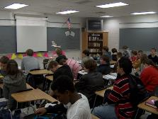



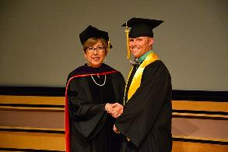
Picture licenses
All pictures in this presentation are copyright-free or in the public domain.
This work is in the public domain in the United States because it is a work prepared by an officer or employee of the United States Government as part of that person’s official duties under the terms of Title 17, Chapter 1, Section 105 of the US Code
Public Domain
This file is made available under the Creative Commons CC0 1.0 Universal Public Domain Dedication
This file is made available under the Creative Commons CC0 1.0 Universal Public Domain Dedication.
The author died in 1927, so this work is in the public domain in its country of origin and other countries and areas where the copyright term is the author's life plus 95 years or fewer.
Public domain.
Bhs_itrtUploads) (https://commons.wikimedia.org/wiki/File:Bhs_int_classroom_la.jpg), „Bhs int classroom la“, marked as public domain, more details on Wikimedia Commons: https://commons.wikimedia.org/wiki/Template:PD-self
Unknown author
simple wide-spread figures (https://commons.wikimedia.org/wiki/File:Ballot_Box_Silhouette.svg), „Ballot Box Silhouette“, https://creativecommons.org/publicdomain/zero/1.0/legalcode
Orion 8 (https://commons.wikimedia.org/wiki/File:Icon_talk.svg), “Icon talk”, marked as public domain, details on Wikimedia Commons: https://commons.wikimedia.org/wiki/Template: PD self
Brian MacIntosh (https://commons.wikimedia.org/wiki/File:Round_Landmark_Icon_House.svg), „Round Landmark Icon House“, https://creativecommons.org/publicdomain/zero/1.0/legalcode
Michael Peter Ancher artist QS:P170,Q468252 (https://commons.wikimedia.org/wiki/File:Michael_Ancher_-_Fru_Krøyer_går_forbi_Kristoffers_hus._Studie_-_1892.jpg), „Michael Ancher - Fru Krøyer går forbi Kristoffers hus. Studie - 1892“, marked as public domain, more details on Wikimedia Commons: https://commons.wikimedia.org/wiki/Template:PD-old
NCOL CoE Public Affairs (https://commons.wikimedia.org/wiki/File:Class_68_DSC_7196_(42874209052).jpg), „Class 68 DSC 7196 (42874209052)“, marked as public domain, more details on Wikimedia Commons: https://commons.wikimedia.org/wiki/Template:PD-US

Slide 21

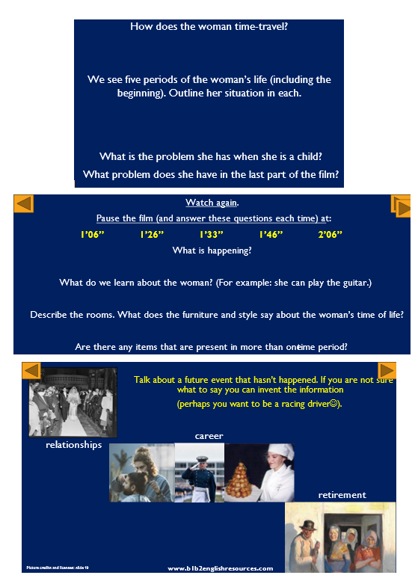
Class notes (copy into Word and print one per group – 2 pages)

Slide 22
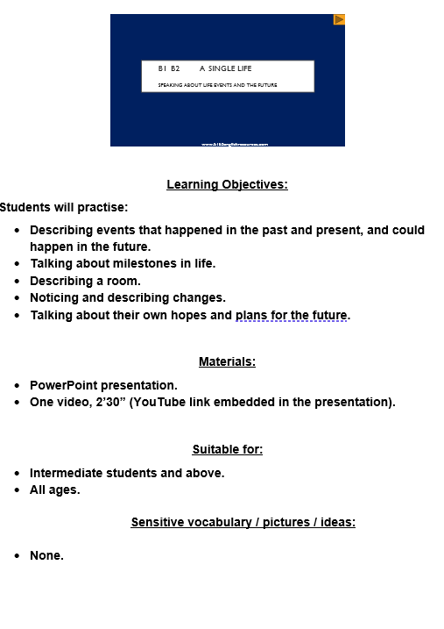
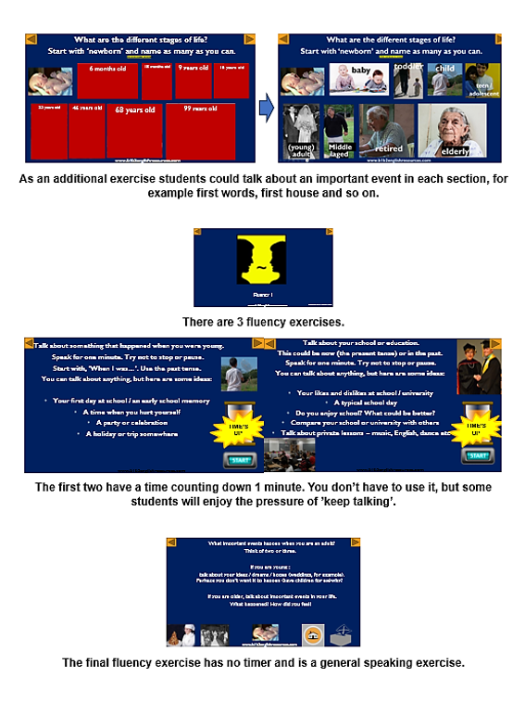
Teacher’s crib sheets
(copy into Word and print – 4 pages total)
Pages 1 & 2

Slide 23
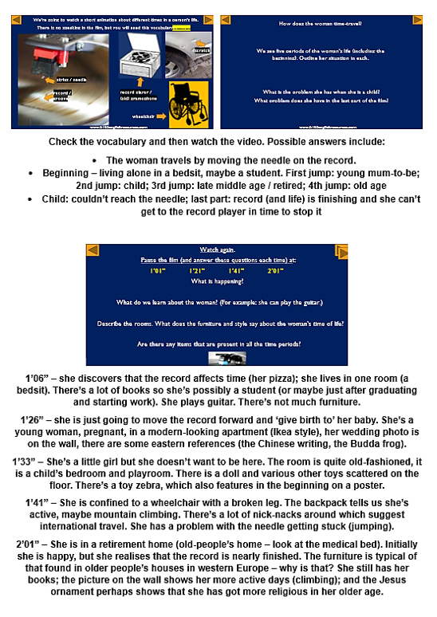
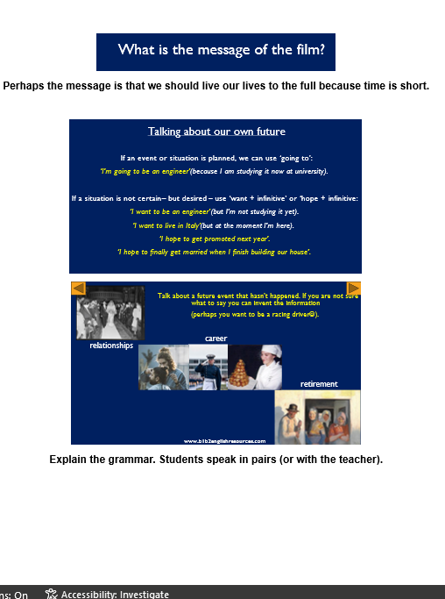
Teacher’s crib 2
(pages 3 and 4)

