Slide 1
b1 The boy who liked playing video games

Slide 2

Conversation
Picture credits and licenses: slide 20

Slide 3
Which devices can be used for gaming? Is one better than the others? Why?
Do/did you play games on a mobile phone, computer or console? Which games? What is the objective?
Say some positive and negative things about game-playing.
Is game-playing a waste of time?
How much time do you spend – daily – playing games?
How much time is a sensible limit for under-16s?

Slide 4
Questions for parents / harder questions
Before computers, how did young people spend their free time?
Was childhood better before computers?
Should parents be responsible for the amount of time their children spend on computers? Is it different for older children?
What can parents do to help addicted children?
Do you have rules? Do you keep/enforce them?

Slide 5
You are going to watch an animation called ‘GLUED’.
What does the title mean? What is the theme of the video?
There is no speech in the video.
Observe the following things – we will talk about them:
How the filmmakers change the mood of the video
The physical reaction of the mother
What is the message of the video?

Slide 6
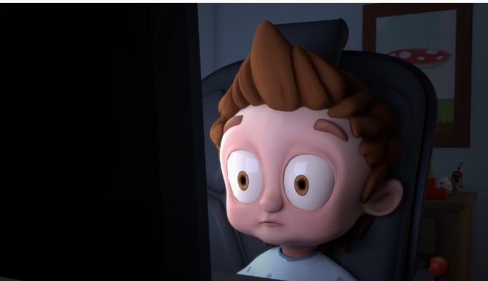
Click here to watch "Glued" on YouTube
Watch the video
(up to 3’36)
https://www.youtube.com/watch?v=rW2g5cwxrqQ

Slide 7
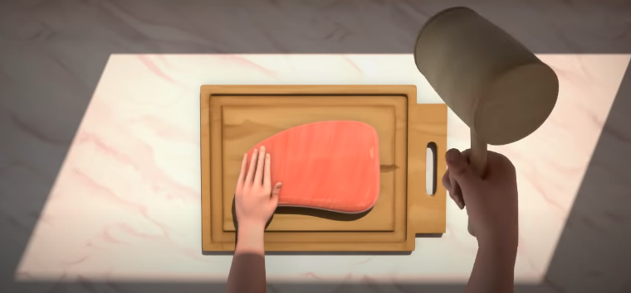
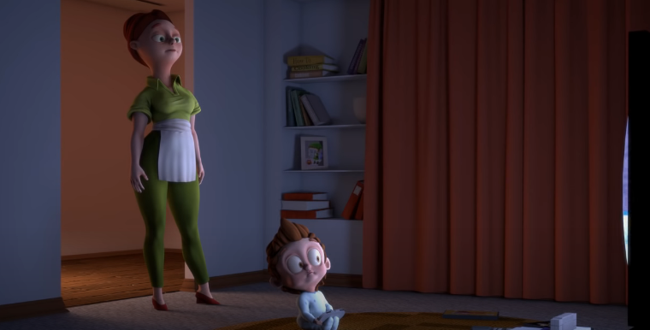
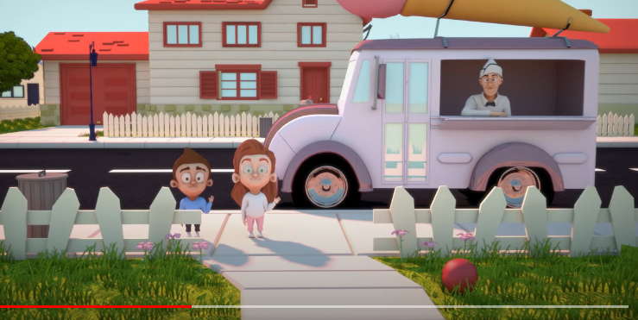
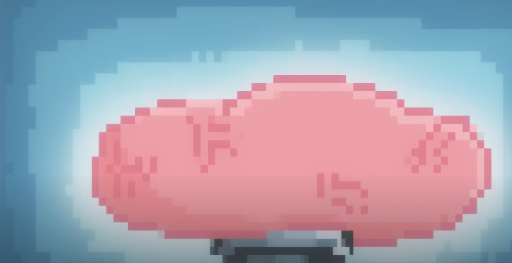
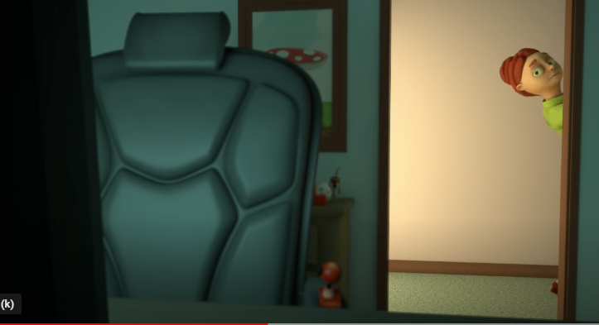
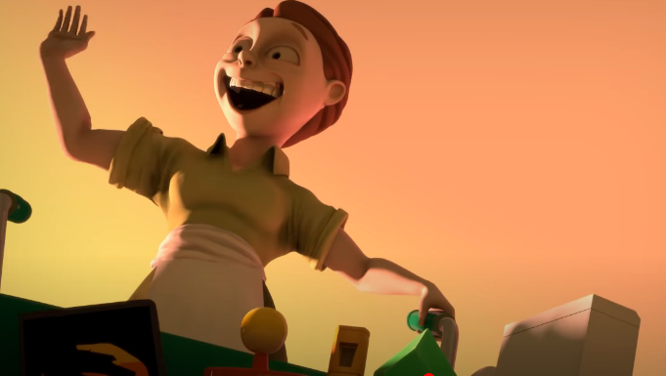
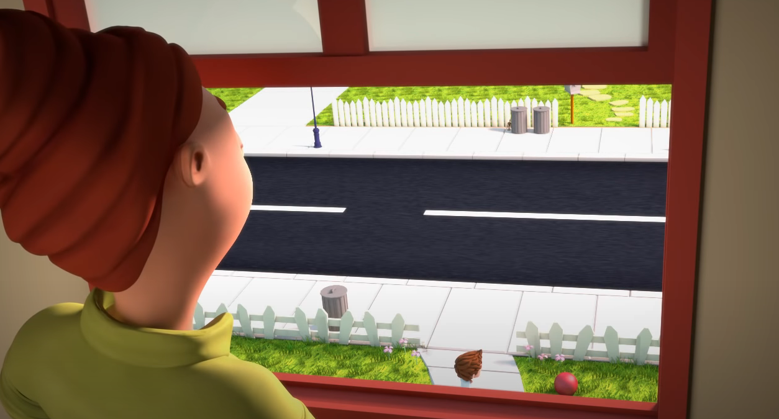
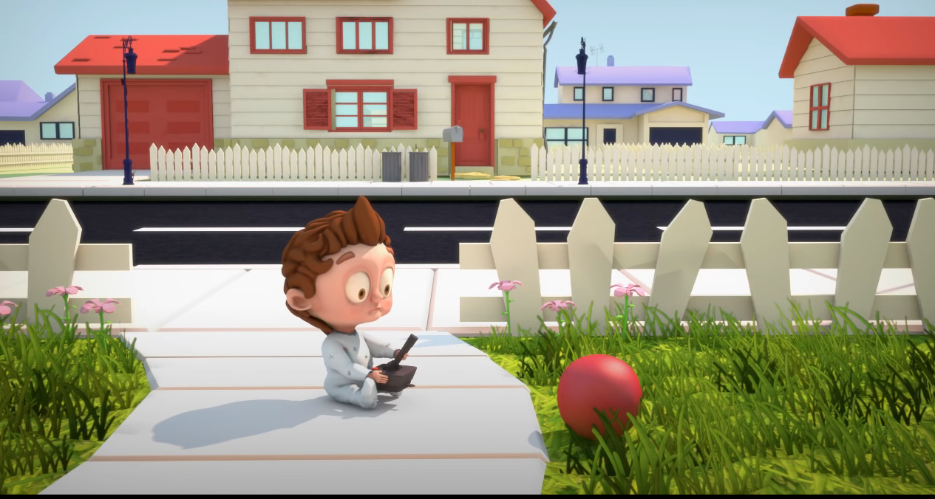
What’s happening? (Pres cont – 8 slides)

Slide 8
Retell the story.
(Can be pairwork – A:B / breakout rooms)
How did the filmmakers change the mood of the video?
How did the mother react?
What is the message of the video?
Are you addicted? Do you know anyone who is?

Slide 9

Grammar (B1 B2) –
continuous and non-continuous verbs
Picture credits and licenses: slide 20

Slide 10
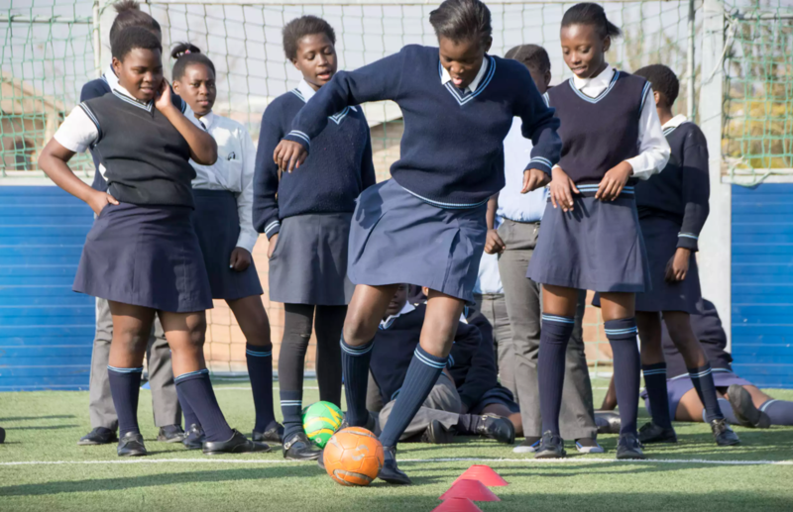
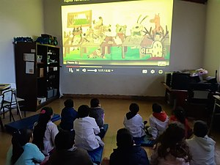
Most verbs have a continuous form; these are used to show an activity in motion at the present time, or at a specified time in the past:
John is eating (now).
Jane is helping her father (now).
Georgina was playing football yesterday afternoon.
They were all watching a film together last night
Picture credits and licenses: slide 20

Slide 11
Some verbs can’t be used – usually – in a continuous form. These "stative" verbs are about state, not action, and they can’t express the continuous aspect. Here are some of the most common :
I want a coffee | Not: I am wanting a coffee
I don’t believe you | Not: I am not believing you
Does this pen belong to you? | Not: Is this pen belonging to you?
It seemed wrong | Not: It was seeming wrong
I don’t hear anything | Not: I am not hearing anything

Slide 12
Dual Meaning Verbs
Some verbs have two different meanings or senses.
For example, the verb ‘think’ has two different meanings:
Ex 1: to believe, to have an opinion:
‘I think red is a warm colour.’
Ex 2: to reflect, to use your brain to solve a problem:
‘I am thinking about my homework.’
In Ex 1 there is no real action, no activity. This sense is called "stative".
In Ex 2 there is a kind of action, a kind of activity. This sense is called "dynamic".
Stative verbs do not usually have a continuous form. However, if the meaning is dynamic then both forms are possible, depending on the meaning.

Slide 13
Level One Questions
Add a verb. All answers are in the present tense.

Slide 14
Level One Questions
(answers fly in on click, in order)
is coming
Look! The bus ____________(come).
“Mmmm, this soup __________(taste) good”.
At this moment, I __________(take) my dog for a walk.
Adam is ordering a hotdog but I ________(prefer) a hamburger.
Winter is coming, I ________(need) some warm clothes.
Today I _______(go) to visit my grandparents.
“ Please teacher, I _______(think) I know the answer”.
It’s a hot day and the children __________(swim) in the lake.
Anna is reading a book about ghosts but I __________(no believe) in them.
“I _________(hear) your mum calling you – time to go”.
tastes
am taking
prefer
need
am going
think
are swimming
don’t believe
hear

Slide 15
Level Two Questions
Add the verbs. Each verb is used twice in the question;
one is stative and one is dynamic.

Slide 16
Level Two Questions
are thinking
We ______________________ of going on holiday next month. Where ____________________ (you) we should go? (think)
Dad _____________________ the soup. I’m sure it __________ very good. (taste)
He __________________ at the book now. It ________________ interesting. (look)
________________________ (he) the tomatoes now? How much _________________________ (they)? (weigh)
Our friends ________________________ a new swimming pool. They _______________________ a pool party this Sunday. (have)
do you think
is tasting
tastes
is looking
looks
Is he weighing
do they weigh
have
are having

Slide 17
Level Three Questions
Add the verbs.

Slide 18
Level Three Questions
are they smiling
Do we know
Why __________________ (they/ smile) at us? ______________ (we / know) them?
I _________________(enjoy) this holiday! I _______________ (not want) it to end.
On Sundays, many museums and shops ________________(stay) open all day.
My parents ________________ (let) me use the car all day tomorrow.
How much _____________________ (your dog / weigh)?
Elizabeth _____________ (know) where the new cinema __________ (be).
A: ____________________________ (this laptop / belong) to Jack?
B: No, I _______________(think) it _______________ (belong) to Debbie.
am enjoying
don’t want
stay
are letting
does your dog
knows
is
Does the laptop belong
think
belongs

Slide 19

Continue for picture credits and licenses
Picture credits and licenses: slide 20

Slide 20
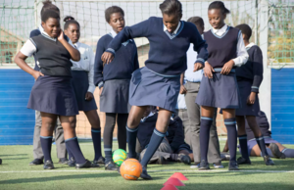
Picture licenses
All pictures in this presentation are copyright-free or in the public domain.
This image is a work of a United States Agency for International Development employee, taken or made as part of that person's official duties. As a work of the U.S. federal government, the image is in the public domain in the United States..
This file is licensed under the Creative Commons Attribution-Share Alike 4.0 International license.
Public domain.
Orion 8 (https://commons.wikimedia.org/wiki/File:Icon_talk.svg), “Icon talk”, marked as public domain, details on Wikimedia Commons: https://commons.wikimedia.org/wiki/Template: PD self
Ali Edith Córdoba (https://commons.wikimedia.org/wiki/File:Todos_estamos_atentamente_mirando_y_escuchando_el_cuento.jpg), https://creativecommons.org/licenses/by-sa/4.0/legalcode
USAID in Africa (https://commons.wikimedia.org/wiki/File:Playing_for_Life,_South_Africa_(39713761882).png), “Playing for Life, South Africa (39713761882)”, marked as public domain, details on Wikimedia Commons: https ://commons.wikimedia.org/wiki/Template:PD-US
Public domain.
This file is licensed under the Creative Commons Attribution 4.0 International license.
EWikist at English Wikipedia (https://commons.wikimedia.org/wiki/File:The_End_Book.png), „The End Book“, marked as public domain, more details on Wikimedia Commons: https://commons.wikimedia.org/wiki/Template:PD-user
Vincent Le Moign (https://commons.wikimedia.org/wiki/File:064-face-screaming-in-fear.svg), https://creativecommons.org/licenses/by/4.0/legalcode

