Slide 1
Best Practices in AP Statistics
David Hornbeck
rockdale magnet

Slide 2
Personal Resources
E-mail me or give me your e-mail for access to Google Drive folder! dhornbeck@rockdale.k12.ga.us
Included:
Guided Notes & filled-in version (most compatible with TPS6e)
Study Companion
AP Exam Review Packet
Exams & scoring materials
This presentation & miscellaneous other resources

Slide 3
College Board Resources
AP Teacher Community
Invaluable!!!
AP Classroom
Build your own quizzes
AP Daily Review Videos
Former/practice AP exams
Scoring Guidelines
Sample papers
Secure exams*

Slide 4
Teaching Practices: Opening Activities & Pacing
Airline Discrimination & Federalist Papers (first two days of school)
Strongly consider starting with Data Collection
Course Structure
Chapters: 4, 1, 2, 5, 6, 7, 8, 10, 9, 11, 3, 12

Slide 5
Teaching Practices: Pennies Activity
Pennies (Sampling Distributions)
Carry out during previous unit (maybe more, depending on pacing)
Have students select samples of sizes 2 for a week, 8 for a week, and 30 for a week (I’m using 32 this year)
Students record their sample mean on a dotplot each day as an $\overline{x}$
Final result: 3 separate dotplots
For smaller classes, have students take multiple samples a day

Slide 6
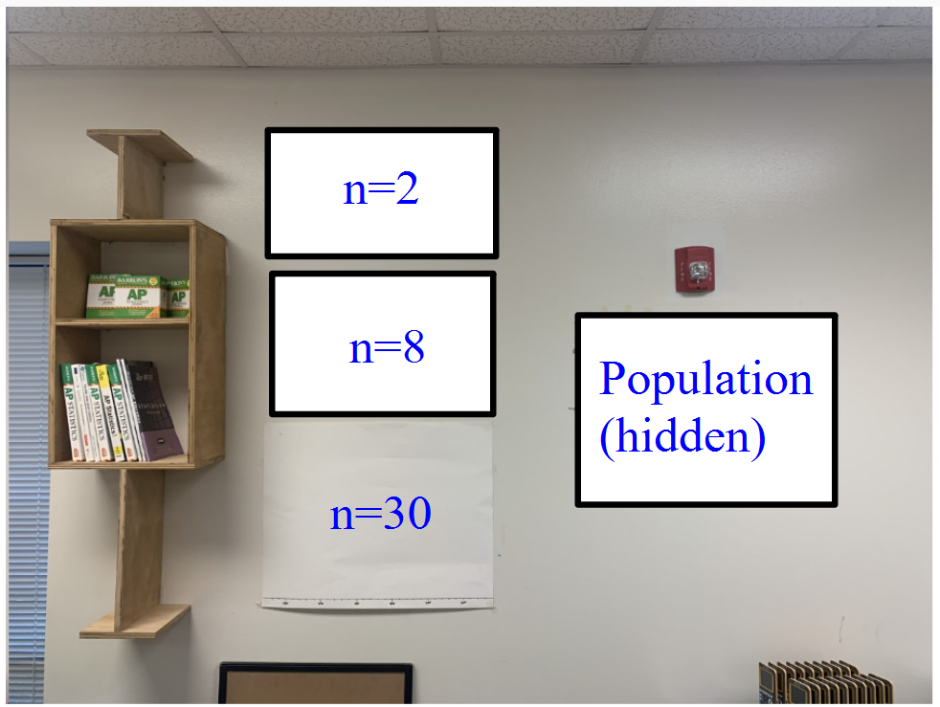
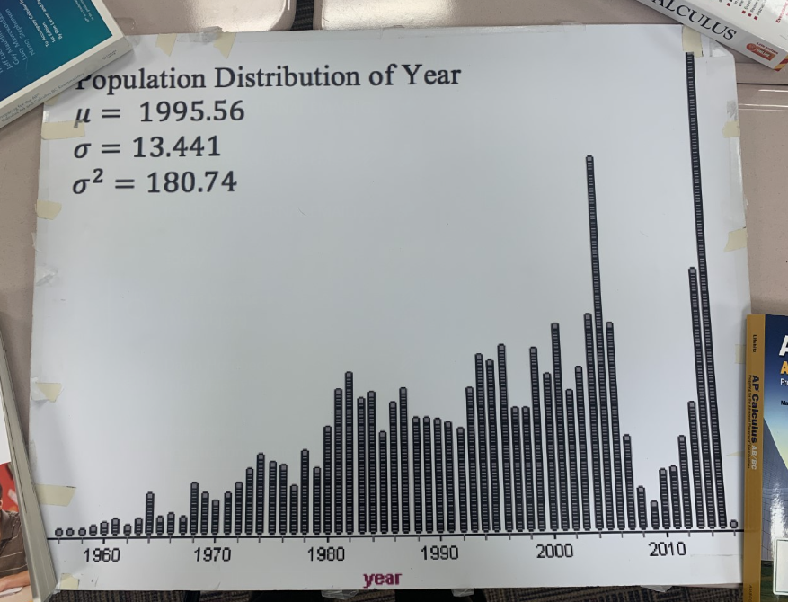
Pennies Setup

Slide 7
Teaching Practices: C.I. Activity
Airsoft Beads (Confidence Intervals)
My source for where to buy the physical materials: Dr. Jennifer Kaplan at UGA (jkaplan@uga.edu)
Make physical intervals on the wall

Slide 8
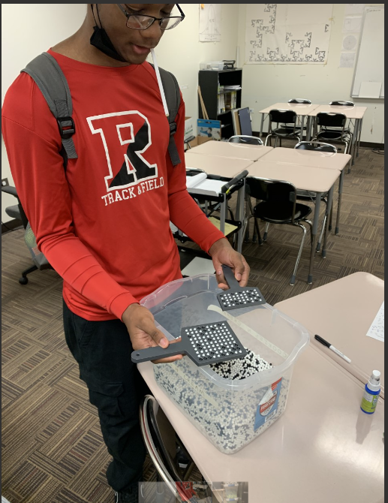
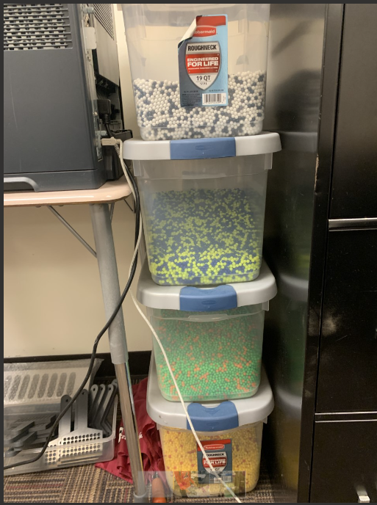
C.I. Beads

Slide 9
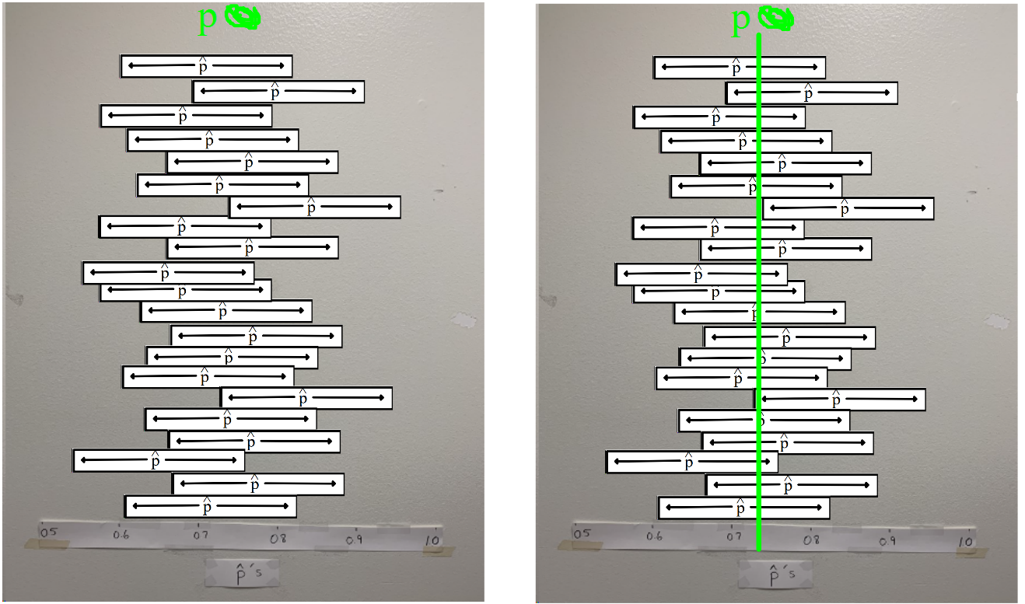
C.I. Wall Setup

Slide 10
Teaching Practices: Acronyms!
SCVU: Shape, Center, Variability, Unusual Features
SPDO: State, Plan, Do, Overall Conclusion
SDFU: Strength, Direction, Form, Unusual Features
LINER: Linear, Independent, Normal, Equal SD, Random

Slide 11
Teaching Practices: Applets
Rossman Chance: http://rossmanchance.com/applets/
Simpson’s Paradox: https://setosa.io/simpsons/
Error Types & Power: https://istats.shinyapps.io/power/
Sampling distributions (Central Limit Theorem): https://onlinestatbook.com/stat_sim/sampling_dist_java/index.html
LTCC Inference Procedures**: http://www.ltcconline.net/greenl/java/Statistics/catStatProb/categorizingStatProblemsJavaScript.html
My own one-prop z-interval: https://www.geogebra.org/m/x2eykhwc

Slide 12
Teaching Practices: Multiple Representations
Examples
Standard deviation = typical offness, etc.
Phrasing of error types and power
Multiple go-to examples (X + X v. 2X: apples, bets)
Derivations and even calculus can help!
Graphic organizers (example below)

Slide 13
Assessment Practices
Do real FRQs frequently
Have students score their own FRQs when time permits (FRAPPYs)
Use rigorous tests with AP exam questions (non-secure if you want to be able to pass them back)
Scoring tests
Give students scores from 1-5 (rule of thumb: ~80 = 5, ~70 = 4, ~60 = 3, ~45 = 2)
Depending on class size/s, give back z-scores!
Curving: I give ~90 for a 4, ~80 for a 3
Cumulative tests: ¼, ½, ¾ length AP exams

Slide 14
Questions?
CONTACT INFORMATION:
dhornbeck@rockdale.k12.ga.us
EVALUATION SURVEY: https://tinyurl.com/2022GMCsessions
Thank you!

