Slide 1
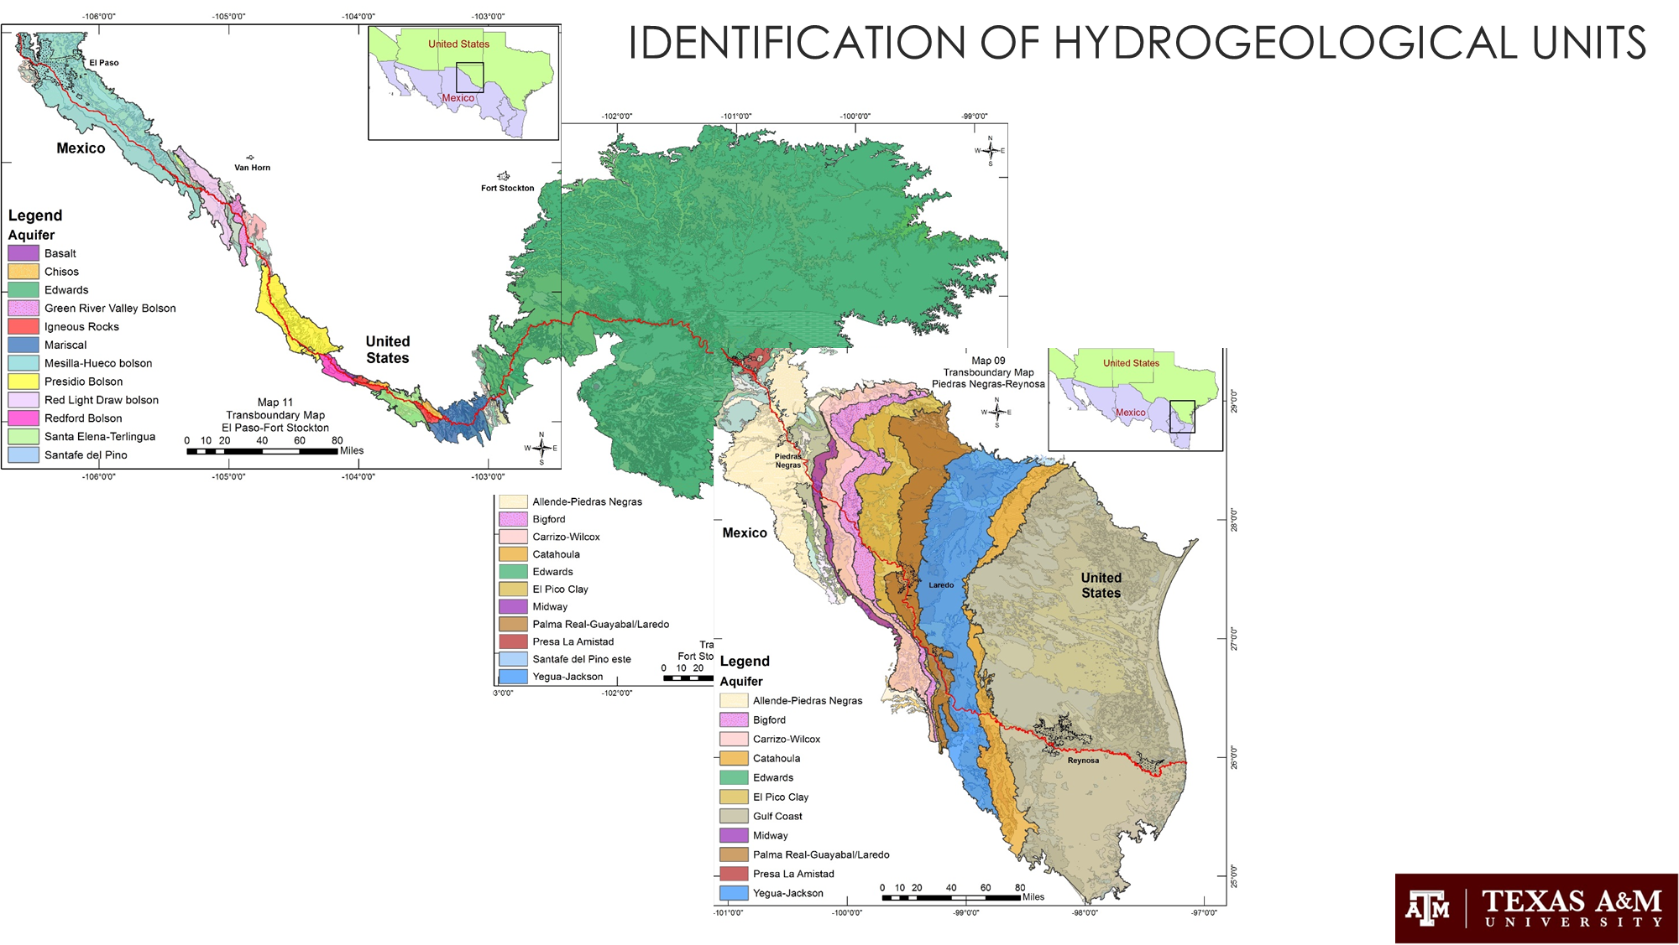
Sanchez, R., Rodriguez, L., and Tortajada, C. 2018. Transboundary Aquifers between Chihuahua, Coahuila, Nuevo Leon and Tamaulipas, Mexico, and Texas, USA: Identification and Categorization. Journal of Hydrology, Regional Studies, Special Edition on Transboundary Aquifers.

