Slide 1
Product Data
Sponsored Brands + Sponsored Brands Video

Slide 2
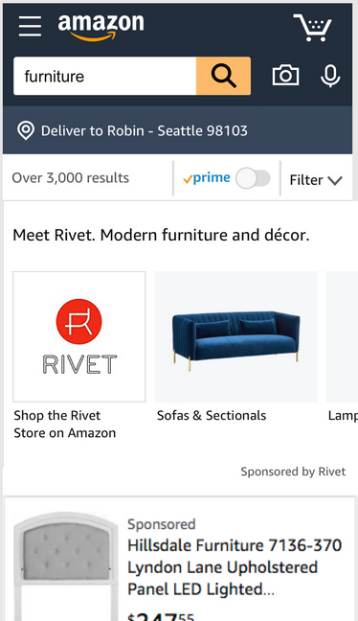
Stand out on mobile
Sponsored Brands’ rich mobile creative helps you engage these shoppers as they start and finish their research.
103M
monthly mobile-only shoppers on Amazon
Source: Comscore, August 2019
Notes:
Shoppers are using mobile devices more and more to shop, with 103 million using mobile exclusively.
Forrester “U.S. Cross-Channel Retail Forecast, 2015 to 2020.
Amazon has 90M monthly mobile-only users (Comscore, August 2019)

Slide 3
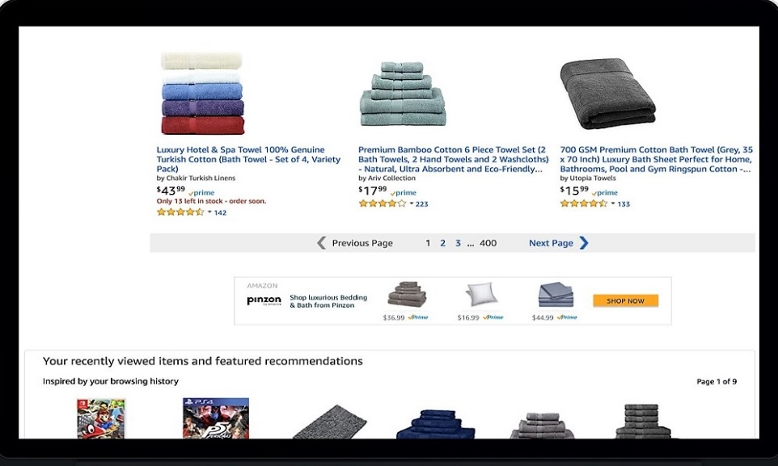
Increase your presence
Sponsored Brands offers you the ability to show in multiple prominent placements on the top and bottom of search results.
+30%
Advertisers who use both Sponsored Products and Sponsored Brands together
Source: Amazon 1p August 2019
Notes:
Some advertisers who use both Sponsored Products and Sponsored Brands together, can increase in category impression share by an average of 30% compared to advertisers who run Sponsored Products only.
If you are only using Sponsored Products, you are missing a completely new supply of placements
Source Amazon 1p August 2019: https://approvals.amazon.com/Approval/Details/516183

Slide 4
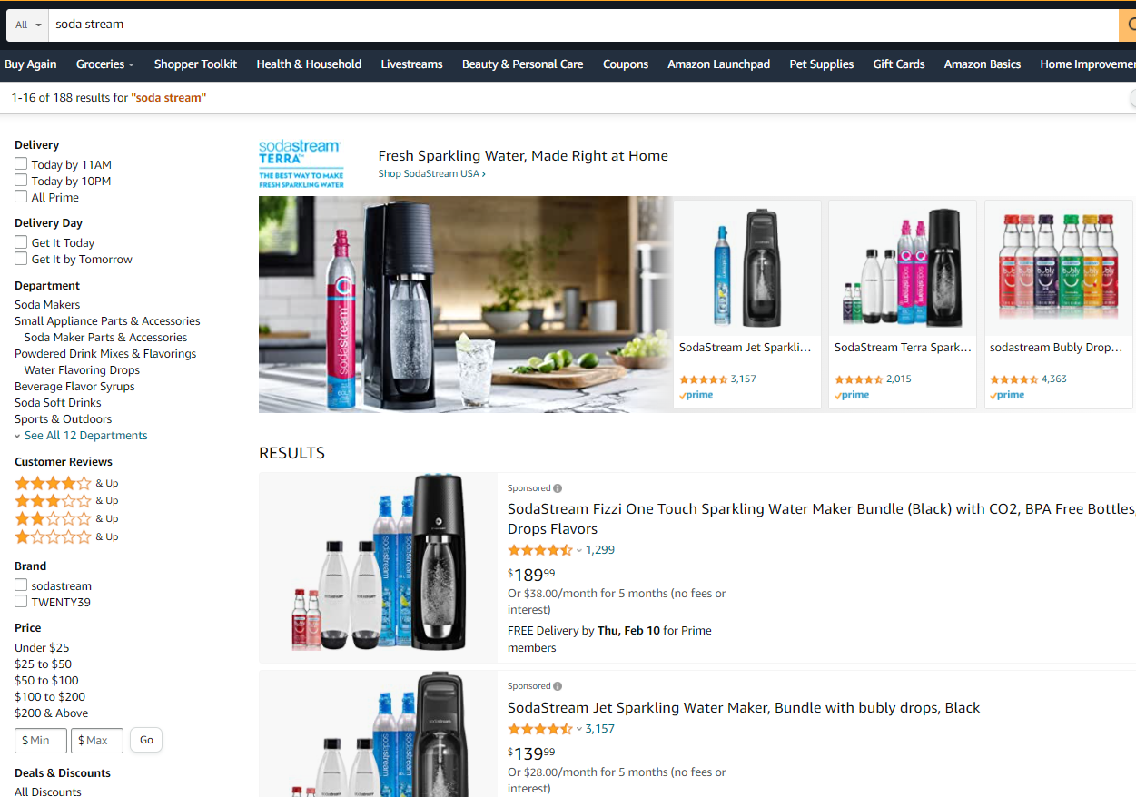
YOUR BRAND. THEIR WORLD.
Sponsored Brands supports Brand discovery
On average, advertisers who used Sponsored Brands ad campaigns
grew their Branded searches
by 116% YoY and
Detail Page View (DPV) by
153% YoY.
Notes:
A Branded Search is any query via a search engine that includes the name of your company, business or brand, such as ‘Wear Brims’ or ‘Wear Brims Luxury Hat’
A Detail Page View is the number of visits to an Amazon detail page
YoY means Year over Year

Slide 5
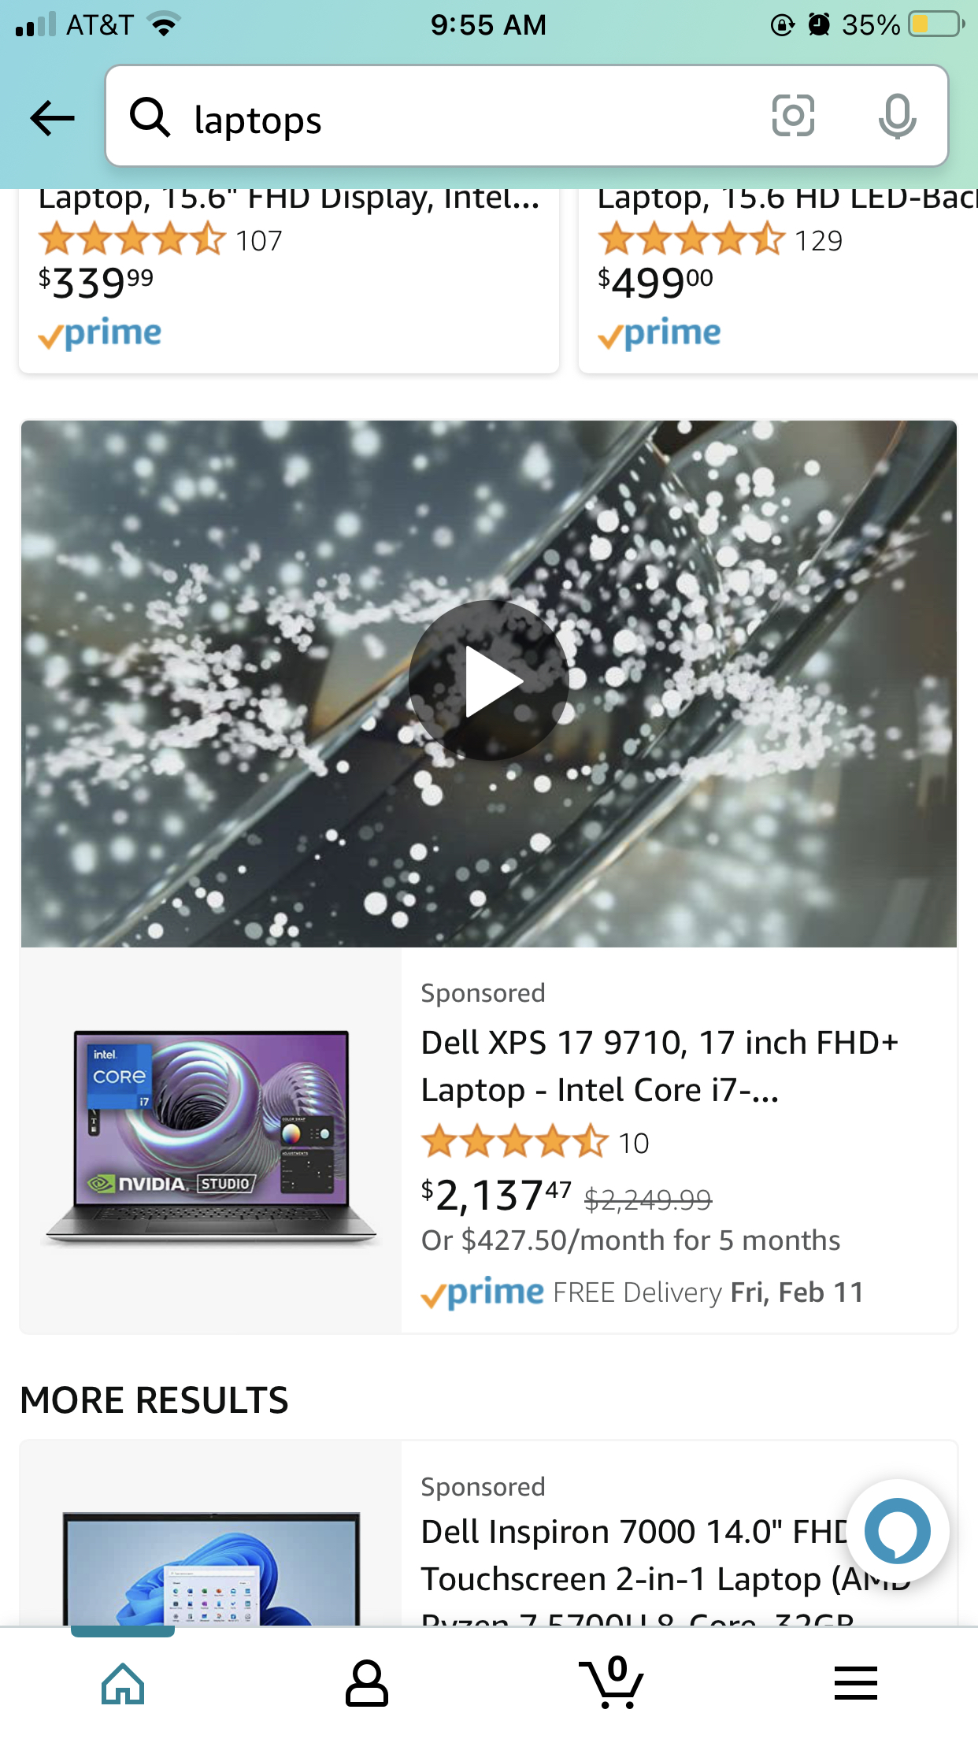
Sponsored Brands Video Engages Shoppers
Sponsored Brands
Video
+127% - 267%
CTR vs general
SB Campaigns
Source: Amazon Internal Data 2021
Notes:
Sponsored Brands Video campaigns have led to a 127-267% increase in Click-Thru-Rate (CTR) in comparison to general Sponsored Brand campaigns
Clickthrough rate (CTR) can be used to gauge how well your keywords and ads, and free listings, are performing. CTR is the number of clicks that your ad receives divided by the number of times your ad is shown: clicks ÷ impressions = CTR. For example, if you had 5 clicks and 100 impressions, then your CTR would be 5%.

Slide 6
Sponsored Brands Video Converts Shoppers
1 in 5
Amazon visitors have made a purchase as a result of watching a brand or product video¹
Source: Survey by Amazon conducted using Google Consumer Surveys, July 2018: “In the last 6 months did you make a purchasing decision as a result of watching a product or brand video?”
Notes:
A recent Amazon survey shows that 1 in 5 Amazon visitors have made a purchase as a result of watching a brand or product video^{1.}
Source: Survey by Amazon conducted using Google Consumer Surveys, July 2018: “In the last 6 months did you make a purchasing decision as a result of watching a product or brand video?”

Slide 7
Sales Tools

Slide 8
Wear Brims vs Peer-set: Total Ad Spend
Category: Hats
Notes:
This chart illustrates Wear Brims Total Ad Spend (Ad Investment) in comparison to their competitor peer-set in the Hats category
Wear Brims is shown in the light blue
The competitor peerset is shown with the navy blue, orange, green, and purple lines. The peerset is categorized by the competitor brands that fall into categories based upon their performance:
Top performing peer – this represents the highest spending competitor brands
Peer at the top 25th percentile – this represents the competitor brands that fall within the top 25th percentile in relation to their advertising investment
Peer at the 50th percentile – this represents the competitor brands that fall within the 50th percentile of advertising investment
Peer at the bottom 25th percentile – this represents the competitor brands that fall within the bottom 25th percentile in relation to their advertising investment

Slide 9
Wear Brims vs Peer-set: Total Sales
Category: Hats
Notes:
This chart illustrates Wear Brims Total Ad Spend (Ad Investment) in comparison to their competitor peer-set in the Hats category
Wear Brims is shown in the light blue
The competitor peerset is shown with the navy blue, orange, green, and purple lines. The peerset is categorized by the competitor brands that fall into categories based upon their performance:
Top performing peer – this represents the highest spending competitor brands
Peer at the top 25th percentile – this represents the competitor brands that fall within the top 25th percentile in relation to their advertising investment
Peer at the 50th percentile – this represents the competitor brands that fall within the 50th percentile of advertising investment
Peer at the bottom 25th percentile – this represents the competitor brands that fall within the bottom 25th percentile in relation to their advertising investment

Slide 10
Purchase Trends: Month of Year
Views
Purchases
Wear Brims
Brands Similar to Wear Brims
Wear Brims
Brands Similar to Wear Brims
Notes:
This chart shows trends within the last 12 months based upon customers that have purchased and viewed Wear Brims and similar brands

Slide 11
Ad Investment + Growth (Trailing 12 months )
Subcategory: Hats
100%
60%
YoY Growth: 10%
YoY Growth: 25%
Notes:
Within the last 12 months, Wear Brims has invested 100% of their budget into the Sponsored Products ad product
Competitor Brands have invested 25% in Sponsored Brands, 15% in Sponsored Display, and 60% in Sponsored Products
Thought starter – what is the value of leveraging multiple ad products?

