Slide 2
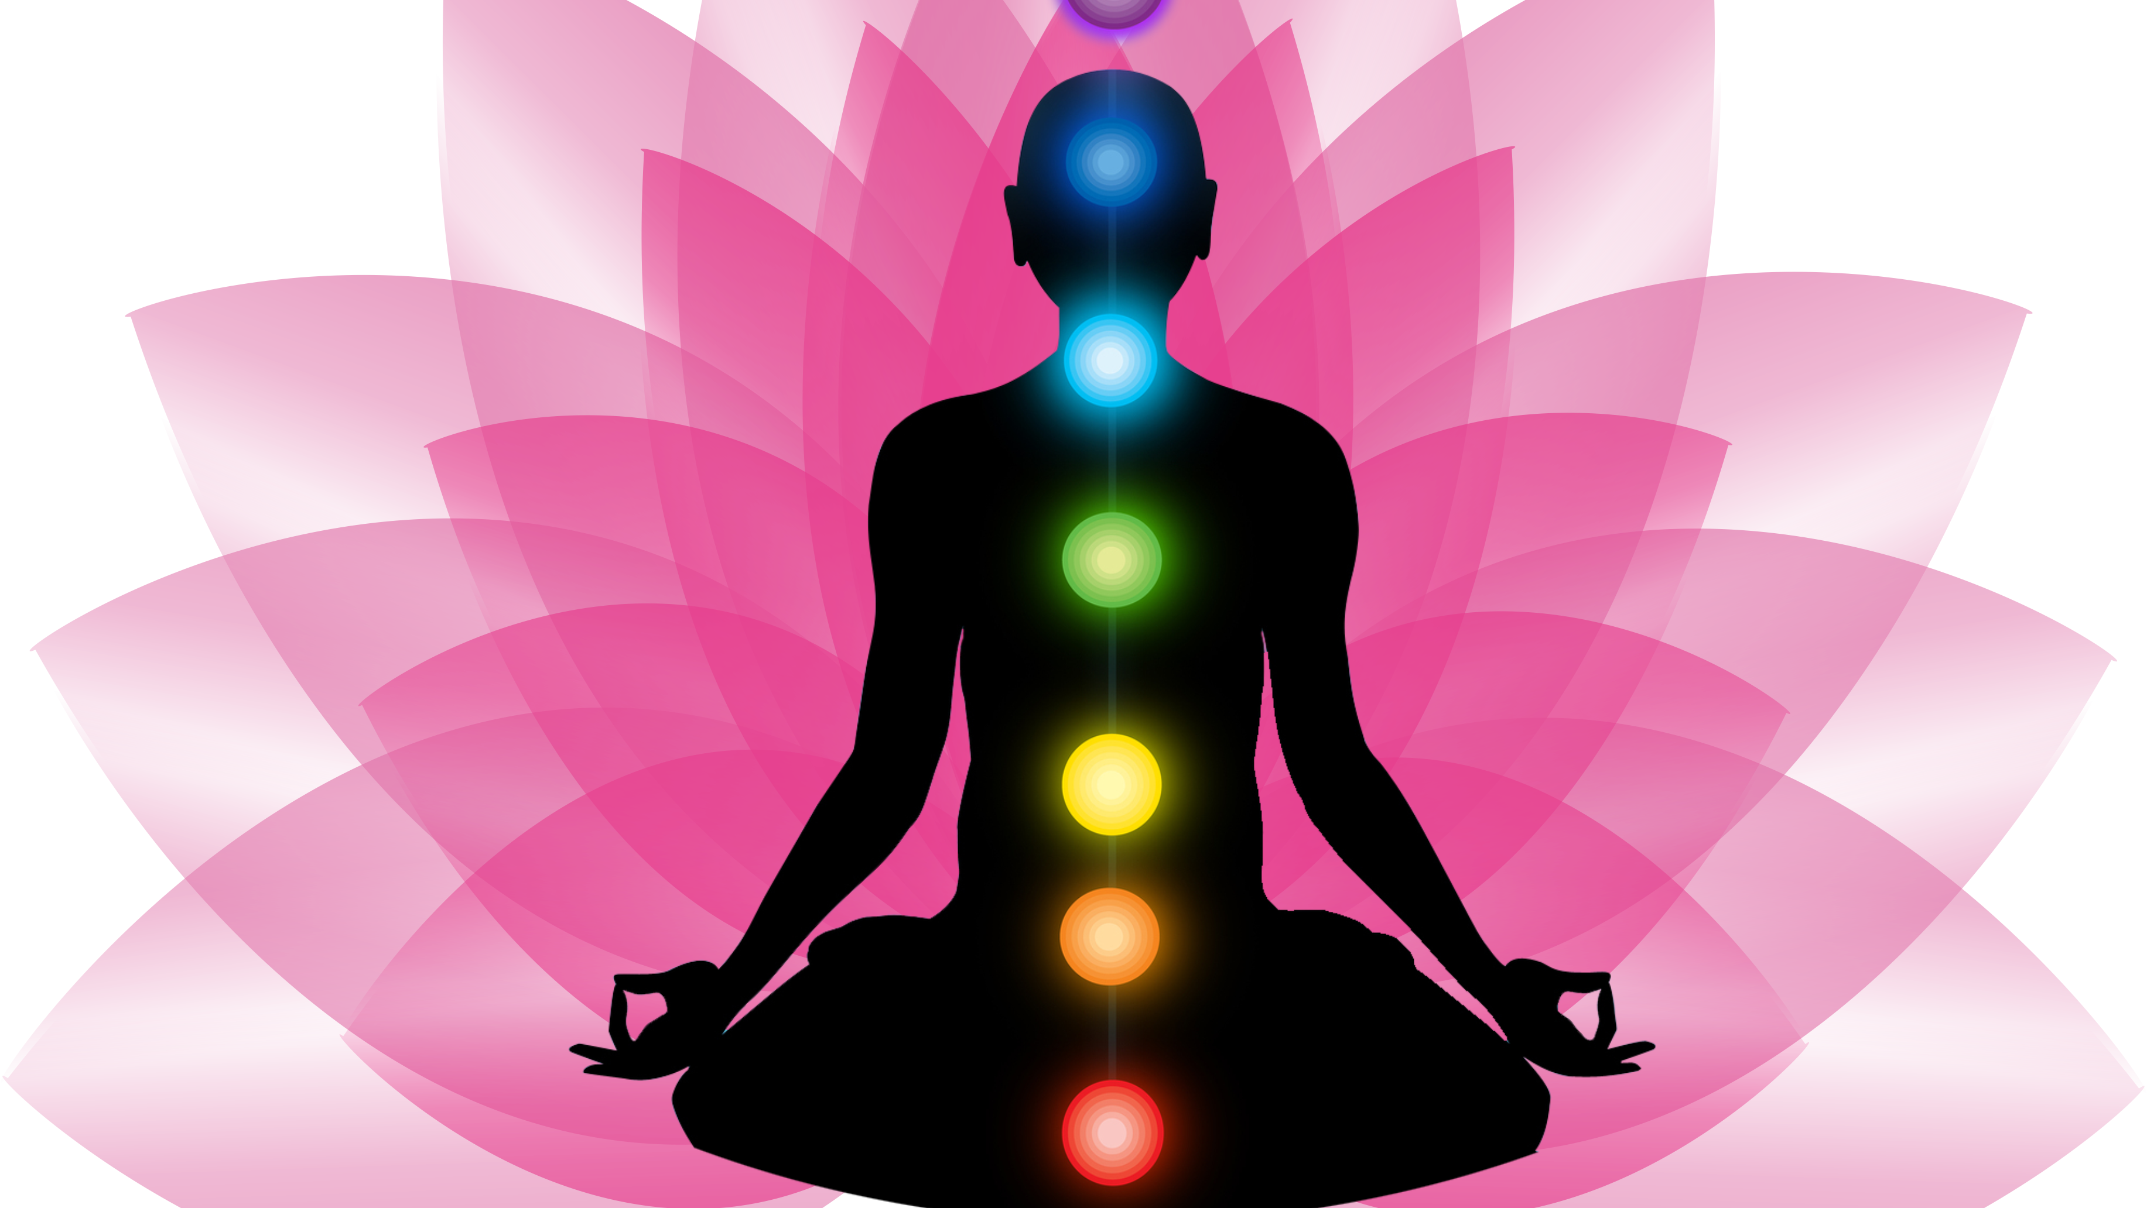
The Chakras presented by Christopher Loggains
A brief overview & review of these 7 vital energy centers

Slide 3
The Human Body is our vehicle & home while living on the 3D earth plane

Slide 4
All aspects of our physical being are connected with the 5 senses creating our life experiences.

Slide 5
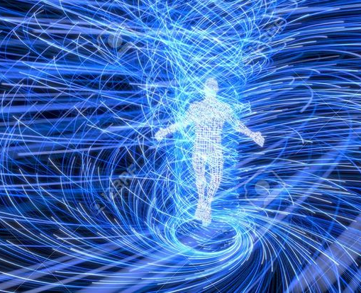
Everything is energy with its own vibrational frequency and everything is connected in the universe

Slide 6
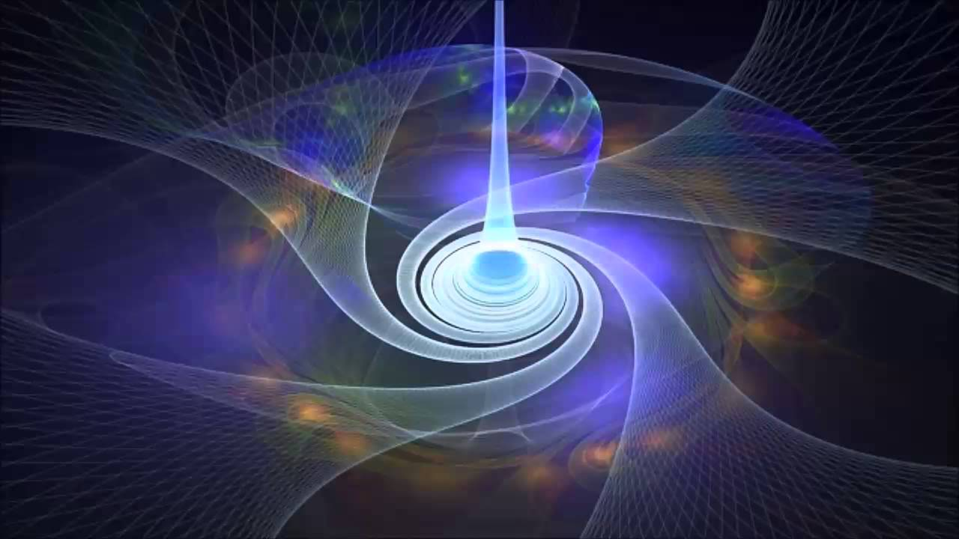
This energy has many names, for example: CHI,PRANA, LIFE FORCE etc.

Slide 7
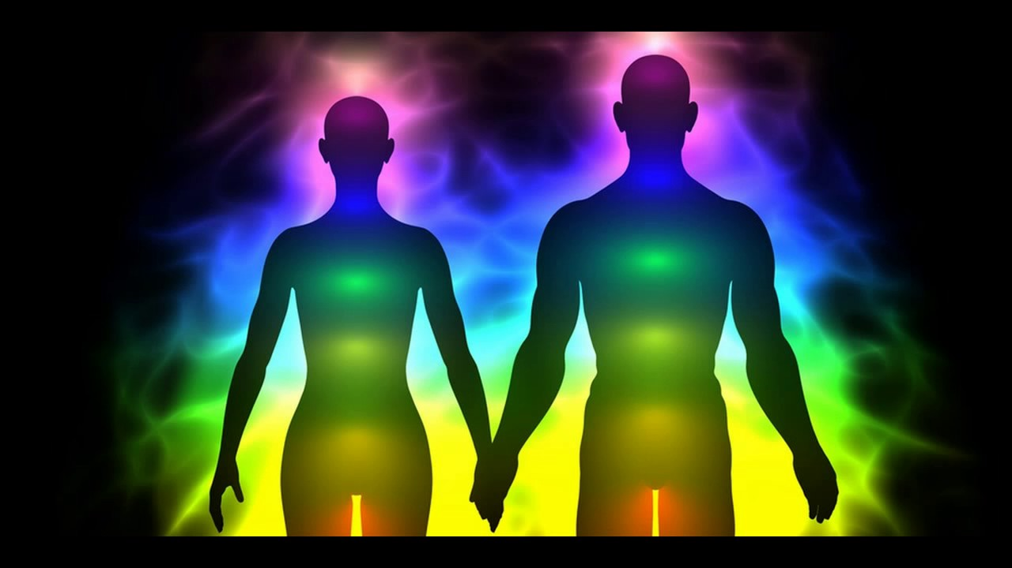
Our Aura-the layers of our human energy body

Slide 8
AURA
7 layers
Egg shaped
1-etheric body-5 senses-touch feeling
2-emotional body-either light or dirty clouds
3-mental body-rational world concepts-physical body
4-astral mental body-higher body, merge with others
5-spiritual/etheric body-associated with divine will
6-causal body-we experience the spirit world
7-ketheric body-higher truth, super consciousness

Slide 9
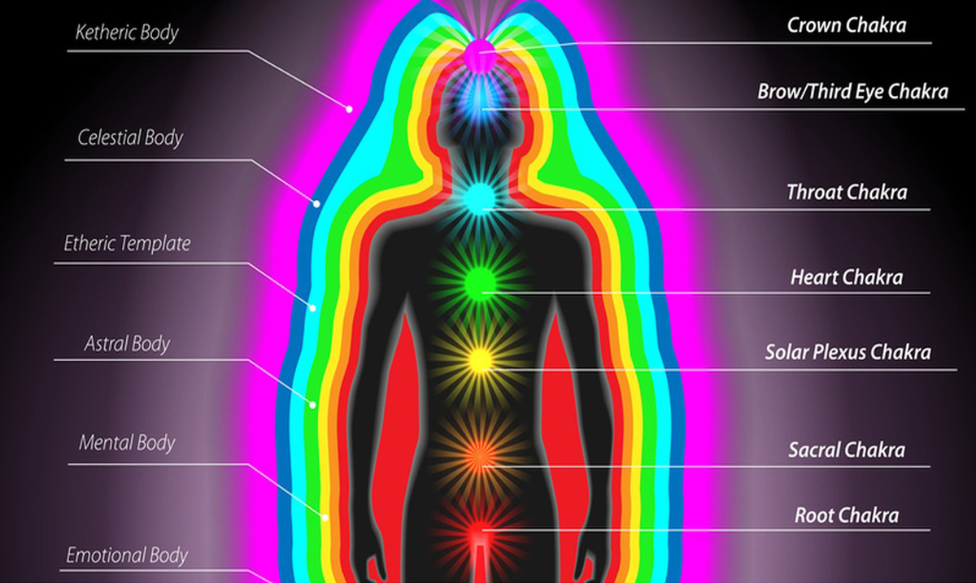

Slide 10
What is a Chakra???
This Photo by Unknown author is licensed under CC BY-NC.

Slide 11
Chakra means wheel . Chakras are energy vortexes within us that channel life energy, prana, chi etc.
Wheels of light

Slide 12
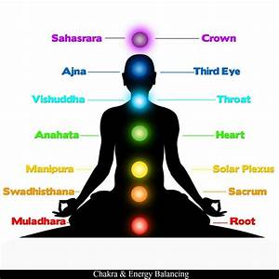

Slide 13
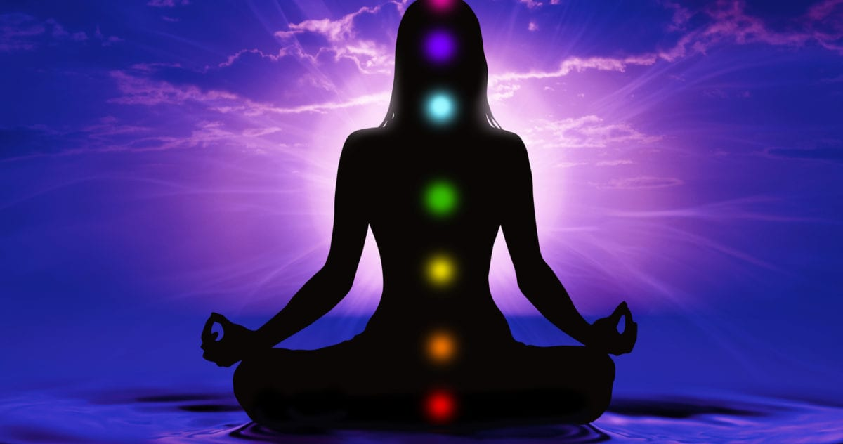
7-Chakras-Lets dive in!

Slide 14
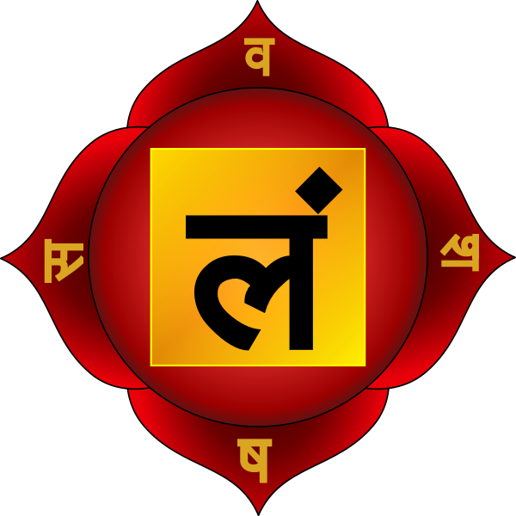
The Root chakra

Slide 15
The Root Chakra/Base Chakra
Largely responsible for how safe & secure we feel
Located at the perinium, base of the spine
Color- red
Element is Earth
Affirmation –" I AM"
Glands-Adrenals
Physical body areas affected- base of spine,legs,bone & feet.
Life lesson-To feel safe & secure in the physical plane to manifest our basic needs, to cultivate healthy (physical) sexuality
D.

Slide 16
The Root Chakra/Base Chakra
Physical Dysfunction –Chronic & lower back pain, Sciatica ,varicose veins, rectal issues.. Hemrroids,cancer,constipation,degenrative arthritis,knee problems,depression,immune related disorders, weight problems
Mental & emotional issues-physical family and group safety, security,ability to provide for life necessities,ability to stand up for ones self.
Energy Blocks-guilt, fear of being alive
Crystals-Ruby, Black tourmaline, Garnet, Blood Stone , Hematite, Obsidian, Onyx, Red Jasper, Smokey Quartz, Fire Agate to name a few
Essential Oils-Myrrh,Vetiver,Sandalwood,Patchouli,Spikenard
Note: Use a carrier oil when working with Essential oils
Y-ND.

Slide 17
The Root/Base Chakra
The first two chakras transform negative energy into power light & returns toxic waste to the earth to maintain the rainbow purity of the aura.
Root Chakra Mantra-LAM pronounced LARM
-ND.

Slide 18
The Root/Base Chakra
Root Chakra out of Harmony-feel ungrounded. Don't trust nature.
Disconnected from mother earth
Family wounds, tribal issues
Feel unsafe
Function from a place of fear
Insecure about primal needs

Slide 19
The Root /Base Chakra
When the Root Chakra is in harmony-grounded, profoundly connected to nature, trust and move with the Eb & flow of life
Trust natural law
We feel safe & secure that our primal needs are met
Healthy family /tribal connections
Feel balanced and grounded to mother earth-Gaia

Slide 20
The Sacral Chakra

Slide 21
The Sacral Chakra
Other Names-Second Chakra, Pelvic Chakra, Naval Chakra
Location-2 inches below the navel
Color-orange
Element-Water
Affirmation-I Feel
Glands-Ovaries,Testicles
Physical body-Womb,genitals,lower
vertabrae,pelvis,appendix,bladder,hip,kidneys
Y-NC.

Slide 22
The Sacral Chakra
Life lesson- to use emotions to connect with others without losing our identity, and to freely express creativity and healthy and emotional sexuality
Physical dysfunction-chronic lower back pain,sciatica,gynecological problems, pelvic pain,impotence,frigidity,uterine/bladder/kidney problems
Mental/Emotional issues-Guilt,blame,money and sex, power & control, creativity, honor in ethics, honor in relationships
Possible causes of energy blocks-Sexual abuse or trauma,rape,gender issues
Crystals-Carnelian,amber,moonstone,coral,orange tourmaline, sunstone
Essential oils-Ylang,lemon,patchouli,rosewood,sandalwood

Slide 23
The Sacral Chakra
Out of hamony-difficulty expressing our feelings,out of touch with pleasure,hold unprocessed anger. Resentful for lack of creativity,relationship issues. Repoductive issues,unstable sexually,Shameful feelings, issues with money & abundance
In Harmony & Balanced-We are in the flow of our ctreative expression,in touch with pleasure, able to share & express in healthy ways, create & maintain healthy relationships,connected to emotional aspects of sexuality. We feel at peace with abundance, may function in clairsentience-taking information intuitivly through feeling
Healthy relationship with money

Slide 24
The Sacral Chakra
Mantra for the 2nd Chakra is Vam pronounced Varm
Often referred to as the center of self-expression & Joy
Friendship-our ability to relate to others on a deeper level
We can fully express ourselves when balanced & in harmony

Slide 25
The Solar Plexus Chakra
Corresponds to our self-esteem, sense of worth and our personality
Also known as Third Chakra and Power Chakra
Location two inches above navel
Color-yellow
Element-Fire
Affirmation-I can
Glands-Pancreas and adrenals
Physical Body-Abdomen,stomach,upper intestines,liver,gallbladder and spleen. Middle Spine.
Life Lesson-To experience the depth of who we are with self-empowerment and self-esteem, to live our Souls purpose.

Slide 26
The Solar Plexus Chakra
Physical Dysfunction-Arthritis,ulcers,gastrointestinal issues,pancreatitis and diabetes. Indegistion ,eating disorders,liver/adrenal dysfunction,hepatitis,fatigue.
Mental and Emotional issues-Trust,fear,imtimidation,self esteem, self confidence, self respect, care of self and others,responsibility of decision making, Sensitvity to critiscm,personal honor.
Possible causes of energy blocks-Repressed anger,issues with control especially to power.
Crystals-Yellow Citrine, Yellow topaz, amber,Yellow Tigers eye, Yellow Agate, Rutilated Quartz.
Essential oils-Lemon,lavender,rosewood,rose mary

Slide 27
The Solar Plexus Chakra
When out of balance and harmony in the Solar Plexus Chakra-We have a big need for control, to dominate, need for prestige, and keeping up appearances. We function with feelings deep in inadequacy and have self-hatred. We may even give away our power to others, having no sense of self.
When the Solar Plexus Chakra is in Balance and Harmony-We feel whole, Centered, know our self-worth, cultivate our self-power in healthier ways, in touch with our inner warrior.
There is a balance between the inner & outer worlds, we are tolerant of ourselves and others. Feel inner peace and calm

Slide 28
The Solar Plexus Chakra
The Mantra for the power chakra is RAM pronounced Rarm
you can think of this chakra as a radiant, yellow sun that will radiate through the middle of the body. It will also rule all the facets of your personal power.
Like a ray of sunshine, the glow of the solar plexus chakra lights your path and warms your body with the glow of self-confidence. The solar plexus chakra empowers you to follow and not be distracted from your true path.
This Photo by Unknown author is licensed under CC BY-NC-ND.

Slide 29
The Heart Chakra

Slide 30
The Heart Chakra
Connects both the physical & spiritual aspects of ourselves.
Fourth Chakra
Located center of the chest
Color -green
Element -air
Affirmation-I Love
Thymus gland
Physical body-Heart,pericardium,lungs,circulatory system,shoulders arms,breast,diaphragm
Pysical dysfunction-CHF,heart attack, heart issues,lung issues,lung cancer,breast cancer, high BP
Mental/Emotional issues-Love & hatred, resintment,grief,self-centeredness,lonliness,forgiveness,compassion,hope,trust
Possible causes of energy Blocks-Repressed heartache or grief
Crystals-Emerald, rose quartz,green tourmaline,jade, green calcite,green kyanite,peridot
Essential oils-Rose,geranium,neroli,palmarosa to name a few

Slide 31
The Heart Chakra
Out of Balance & Harmony-We are disconnected from ourselves, have difficulty loving ourselves, difficultly genuinely giving love, do not feel deserving of love and difficulty receiving love, depressed and out of touch with our true self.
Balanced and in Harmony-We are fully connected to ourselves, love and accept ourselves, joyful, give and receive love genuinely, very compassionate

Slide 32
The Heart Chakra
Mantra for the fourth chakra is YAM pronounced Yarm
It provides compassion and empathy and is responsible for your ability to accept and forgive others and yourself
An activated heart chakra makes you more compassionate and loving towards others. You do not expect anything in return and just give kindness and love away. A healthy heart chakra will provide you an immense sense of gratitude

Slide 33
The Throat Chakra
Life Lesson
To know & speak your truth

Slide 34
The Throat Chakra
First of the Spiritual Chakras
Authentic voice, speak your truth
Located –front base of the neck, at the hollow of the collarbone
Color light blue
Element –Sound
Affirmation I speak
Glands-Thyroid/parathyroid
Physical body parts-throat, trachea,neck,vertabrae,mouth,teeth,gums,
esophagus,hypothalamus,shoulders,arms,hands

Slide 35
The Throat Chakra
Physical dysfunction- Raspy/sore throat,ulcers,gum disease,TMJ,stiff neck,scoliosis,swollen glands,thyroid problems
Mental /Emotional issues-addiction,judgement,crticism,faith,strength of will,personal expression
Possible energy blocks-difficulty expressing oneself,witholding words,supressing hidden talents
Crystals-turquois,blue kyanite,aguamarine,lapis lazuli to name a few
Essential oils-lavender,rosemary,frankencense to name a few

Slide 36
The Throat Chakra
Out Balance-difficulty expressing ourselves, feel silenced and judged, out of alignment, feel out of touch.
In Harmony-Strong will to live and follow our dreams. We speak our truth with confidence, listen to inner guidance and maintain a balance between silence and speech

Slide 37
The Throat Chakra
The mantra for this chakra is Ham pronounced Harm
I am open, honest, and clear in my communications with others.

Slide 38
The Brow Chakra/Third Eye
Mantra for the third eye is OM
Pronounced AUM/OM
This chakra plays an important role in making you see things clearly, not only physically, but also morally, and even intuitively.
signifies the spiritual nature of life, and is associated with wisdom, vision, foresight, clairvoyance, inspiration and intuition.

Slide 39
The Brow Chakra/Third eye
The sixth Chakra, located between eyebrows
Color –indigo
Element-light
Affirmation-I see
Pineal gland
Physical body –brain, eyes, ears,nose, nervous system
Life Lesson-utilize insight and intuition, to see the past the physical

Slide 40
The Brow Chakra/Third eye
Physical Dysfunction-Brain tumor, hemorrhage
Stroke, neurological disturbances,blindness,deafness,headaches,
seizures to name a few
Mental and emotional issues-self-evaluation and truth for example
Possible cause of energy block-
lack of trust in one's intuition

Slide 41
The Brow Chakra/Third eye
Crystals-Lapis lazuli,amethyst,fluorite,lepidolite,
Clear quartz, star sapphire, kyanite
Essential oils-Lavender,Frankincense,sandlewood

Slide 42
The Brow Chakra/Third eye
Out of balance-Rejecting all spiritual aspects of ourselves, we focus only on intellect. No trust in our inner intuition
Balanced & in Harmony-We invite intuition and Awareness into daily life. Trust our inner vision. Deep knowing beyond our physical reality

Slide 43
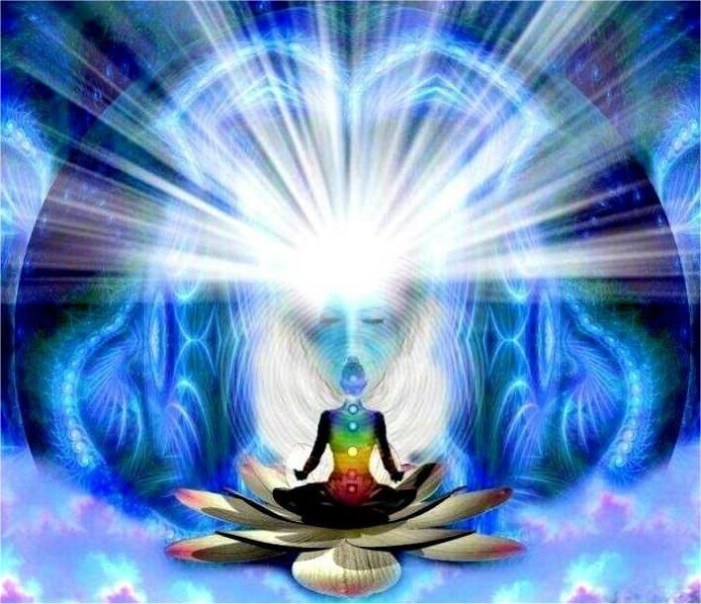
The Crown Chakra
Connection to our higher self and the divine/Source
Mantra for the 7th Chakra is OM.
Located top & center of head
Color-Purple, white and gold
Affirmation I know
Element –thought
Gland-Pituitary
Body –CNS, Cerbrial Cortex,musuclar skeletal system,the skin

Slide 44
The Crown Chakra
Physical Dysfunction-energetic disorders, depression, extreme exhaustion not related to a physical disorder, extreme sensitivity to light & sound/environment
Mental/Emotional-values, ethics, courage,selfishssness, ability to see bigger picture,inspiration,spiritual connection
Crystals-Amethyst , clear quartz, Herkimer diamond, white topaz, labradorite,moonstone,selenite & more

Slide 45
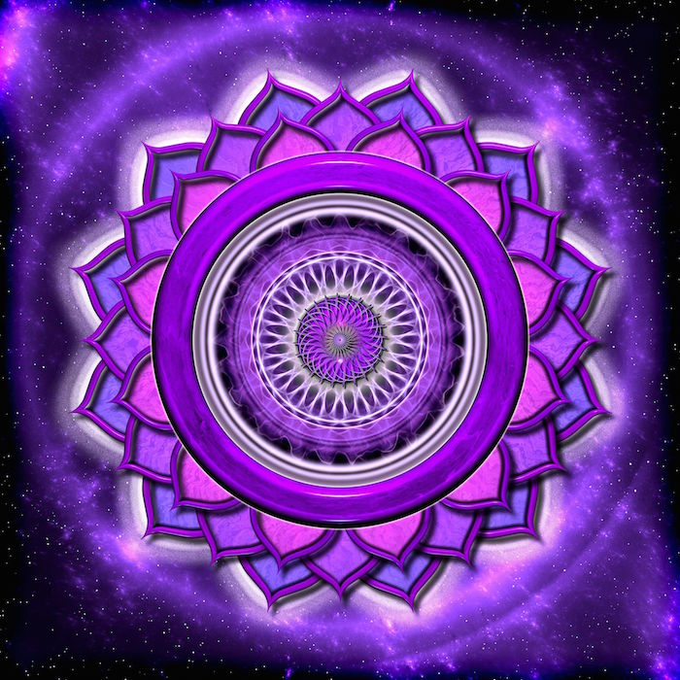
The Crown Chakra
When the Crown chakra is out of balance we will feel total complete disconnection from Source/Divine/Universe
Could have anger directed at God/Source or others
Difficulty trusting anything in life
Depressed, unable to let go fear & grief
Lead an unsatisfying life

Slide 46
Healing/Balancing/Activating
Yoga
Mantra
Meditation
Essential oils
Crystals
Sound frequencies
Food/diet
& more
What works for you?
What methods haven't you tried?
How do you feel when you have blocakages?
How do you feel when in chakras balanced?
It is imperative that each of us take responsibility for our regular Maintenace and healing of our chakra system
Healing comes from within

Slide 47
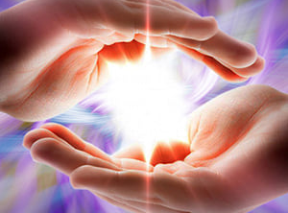
Thank You

Slide 48
Let's Discuss

