Slide 1
Vi Är Kyrka - Sverige
Colm Holmes
We Are Church International
27 April 2022

Slide 2
Notes:
Cardinal Walter Kasper: The Church was not yet “mature enough” for women’s ordination. Does the ban on discussing WO still exist?

Slide 3
“Last Supper”

Slide 4
5 Aims of WAC
1. Shared Decision Making
2. Women in all ministries 3. Primacy of Conscience
4. Optional celibacy
5. Welcome for all

Slide 5
Abuse scandals
USA: Cardinal Law: Spotlight: Legal route
Ireland: State investigations:
Australia: Royal Commission: Plenary Council
Chile: Bishop Barros appointment:
Germany: MHG study
France: Sauvé Report:
Africa? Asia? South America? Resistance

Slide 6
Reform: Macro level
VERY POOR: Global Synod: Consultation with laity only in Phase 1: all subsequent phases bishops only:
POOR: Australia: Plenary Council: <50% lay: Bishops rule
BETTER: Amazon Synod: 40% lay; wide listening; support from bishops for reforms;
BEST: German Synodal Path: All issues on table; bishops open to reforms: 2/3’s majority x 2 required for resolutions

Slide 7
Reform: Micro level
Root and Branch Synod (UK)
FutureChurch (USA)
Nun’s support group (India)
Roman Catholic Women Priests
WAC ZOOM Eucharists
Pride March (Ireland)

Slide 9
WAC Ireland
Registered Charity; AGM; 3 + 3 Core Group
Monthly ZOOM talks
Monthly Eucharists
Quarterly Newsletter (online)
Website; Facebook Page; Twitter
Press Releases
Surveys of each diocese (26)
Links with other groups (WAC; GNRC; WOW; CWC; ACP; ACI)
Public witnessing (NO WOMAN NO CHURCH)

Slide 10
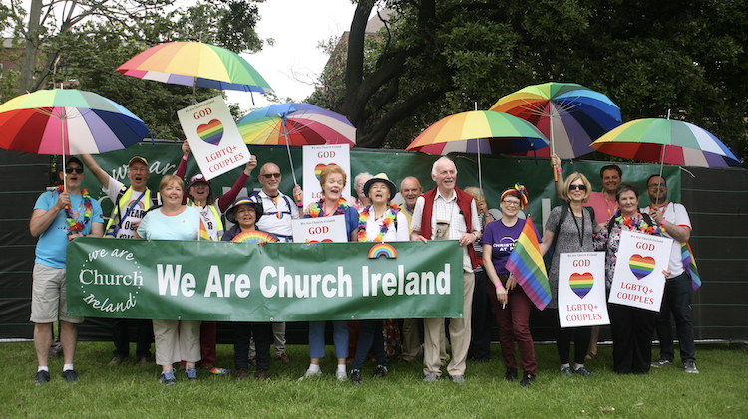

Slide 11
Catholic Church Hierarchy
Notes:
Pyramid structure of Command and control

Slide 12
Pope Francis’ Inverted Pyramid
Notes:
Pope Francis has proposed an “inverted pyramid” where the pose and bishops serve the people of God. We need to find new structures for this inverted opyramid.

Slide 13
9 Year scorecard for Pope Francis
Heading Score Maximum
1. A Church for the Poor & Marginalised 5 10
2. Climate & Environment 7 10
3. New Structures with Lay Leadership 1 10
4. Women in all Ministries 0 10
5. Effective Clerical Abuse Processes in all countries 2 5
6. Clerical abuse cover ups brought to justice 1 5
7. Contraception for Family Planning 1 5
8. Welcome for LGBT people 1 10
9. Transparent Financial reporting 2 10
10. Welcome for divorced and remarried 1 5
11. Intercommunion with Christian churches 1 10
12. Married Priests 4 10
___________________________________________________________
TOTALS 26 100
===========================================================
Notes:
When I drew this up in 2028 after 5 years of Pope Francis his score was 21%

Slide 14
80 – 20 Rule
We Are Church has promoted our 5 Goals for reform in our church for 25 years.
I see the best way to continue to promote reforms is to BE THE CHURCH WE WANT TO SEE.
That means democratic structures and all ministries open to all. So we should give 80% of our efforts to this and only 20% to trying to persuade our hierarchy to introduce reforms.

Slide 15
Why only 20% to persuade the hierarchy to reform?
The current patriarchal and autocratic system has been built up over centuries
Those who have power and privileges are very slow to share them
Pope Francis has encountered huge resistance to even small reform steps
Conservative Latin rite seminaries are reinforcing clericalism
Notes:
Example: Acolytes and Lectors formally approved many decades after they became widespread in many countries. Amazon Synod – tiny steps forward.

Slide 16
What do we do with 80% for BEING THE CHURCH WE WANT TO SEE?
Have democratic structures
Practice Christ’s call to love our neighbours
All ministries open to all (especially women & LGBTQ+)
Support House and ZOOM Eucharists
Be transparent and accountable

Slide 17
Finding our voice
Notes:
Our bishops remain princes of the church

