Slide 1
Welcome
to
Uruguay

Slide 2
This is the Uruguay Flag

Slide 3
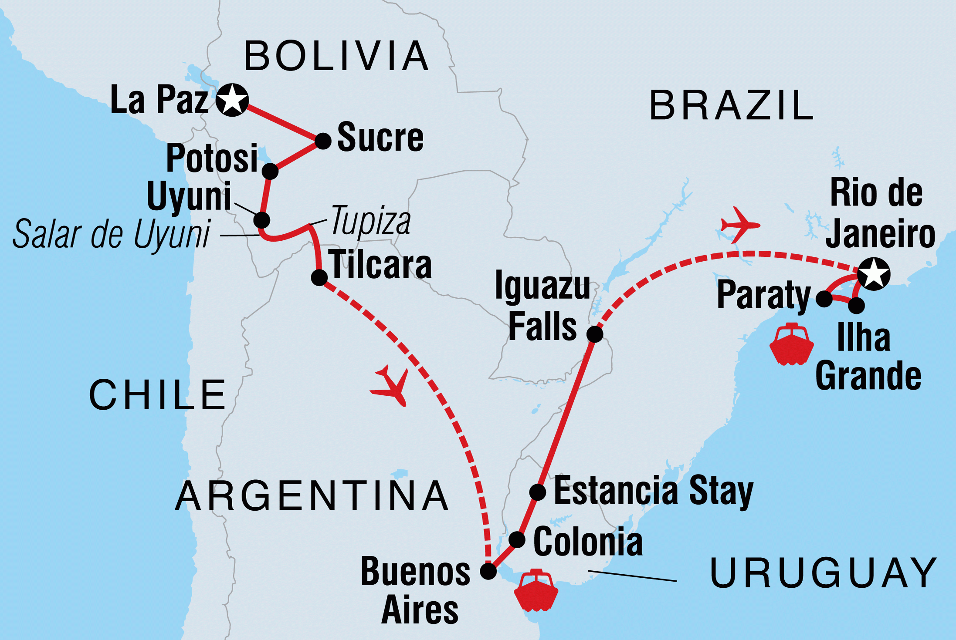
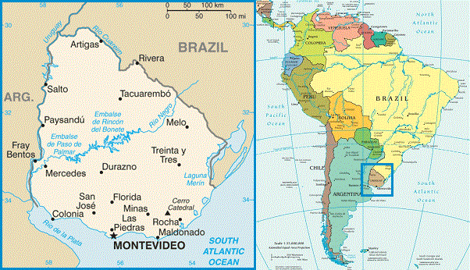
The map of Uruguay

Slide 4
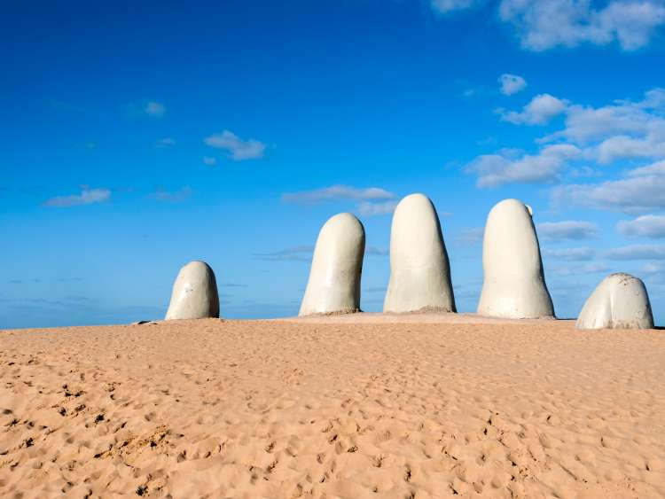
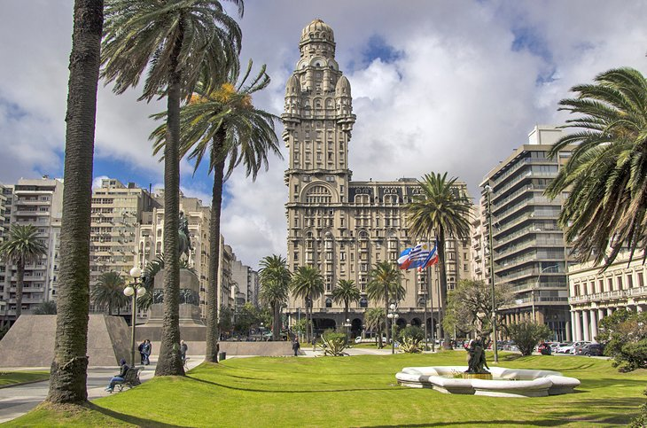
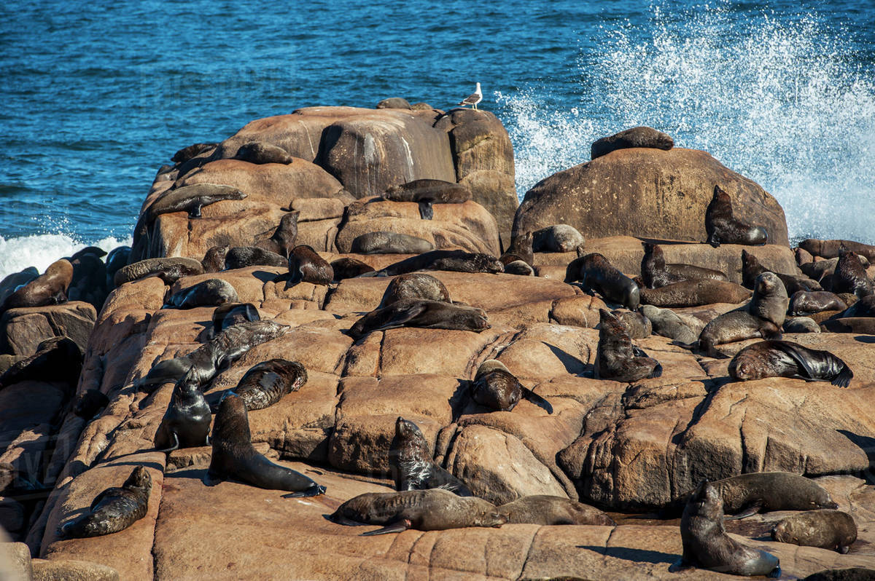
Visit the beautiful places in Uruguay
Explore Montevideo
Jet set in
Punta del Este
Spot Sea lions in
Calos Polonio
And many more…

Slide 5
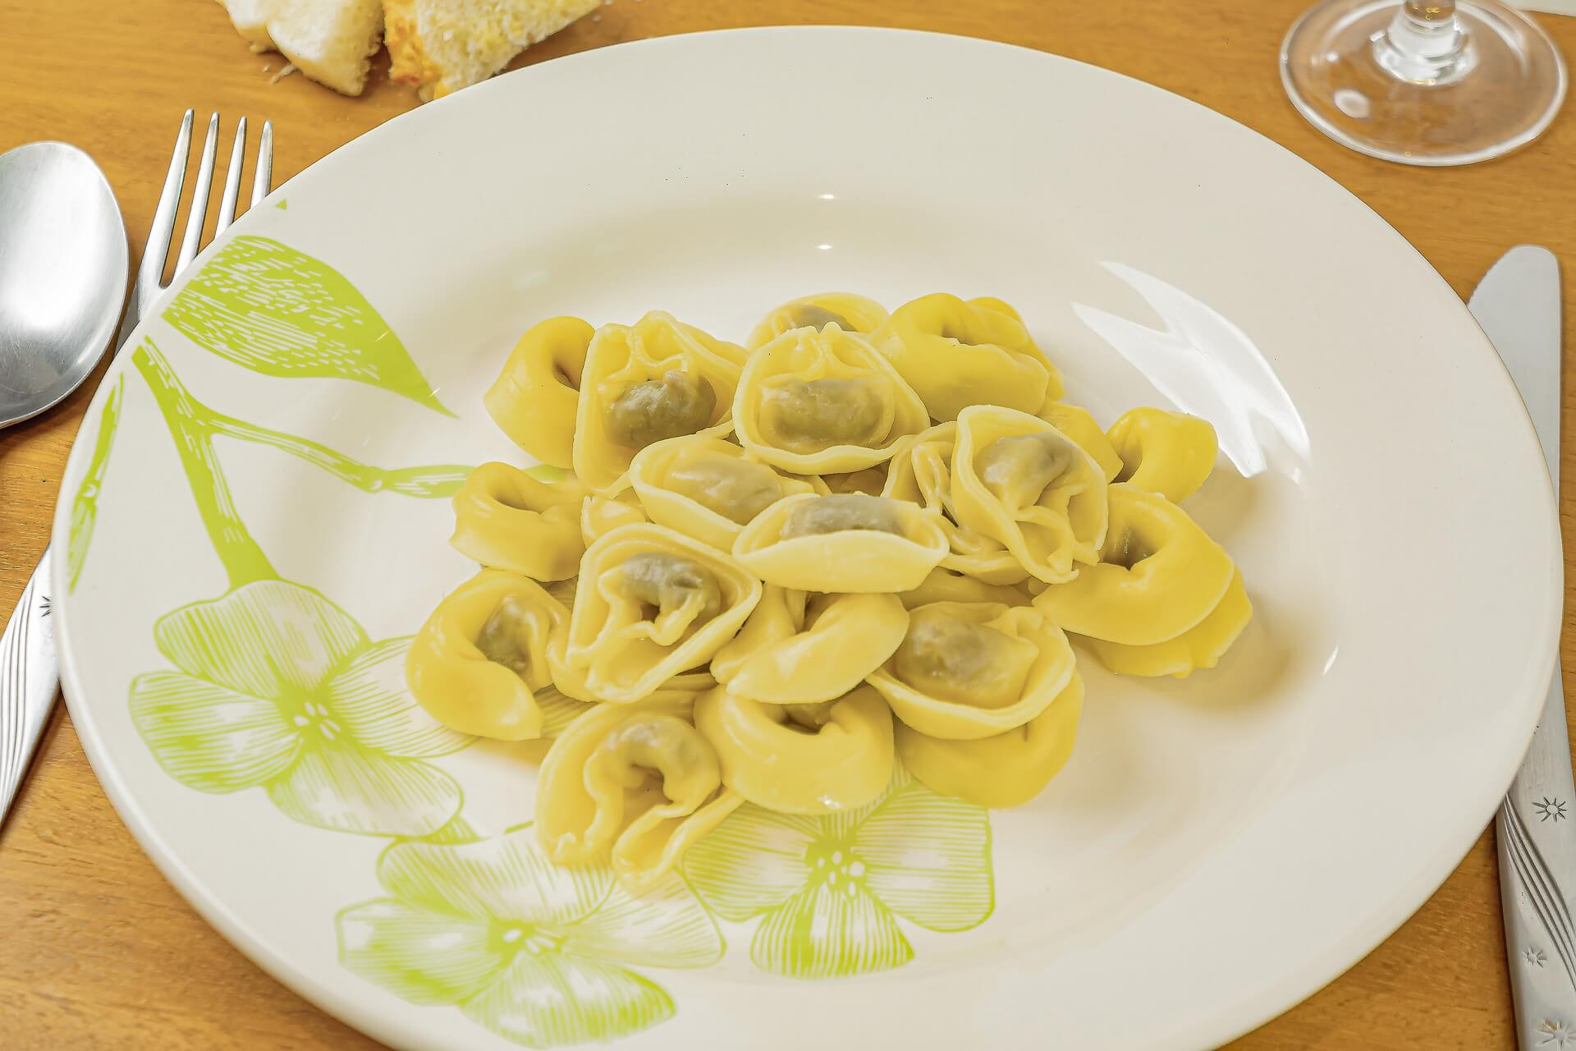
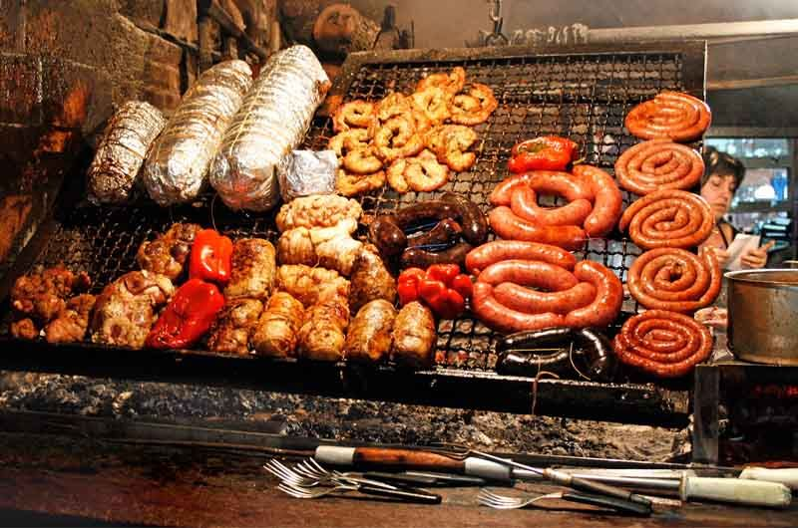
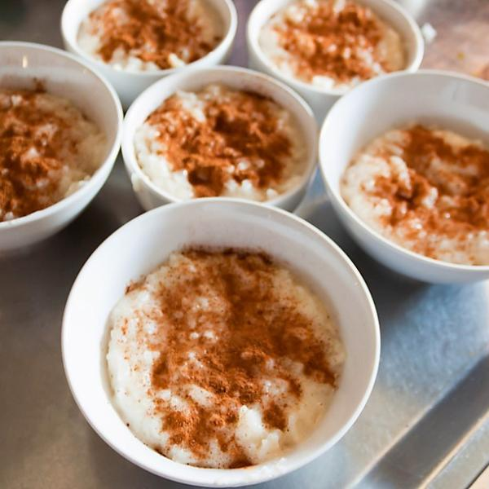
Asado (grilled meat – beef, chicken or pork)
A must try Uruguayan Food
Capeletis a la Caruso (Uruguayan Pasta)
Arroz con leche (rice with milk)
And many more…

Slide 6
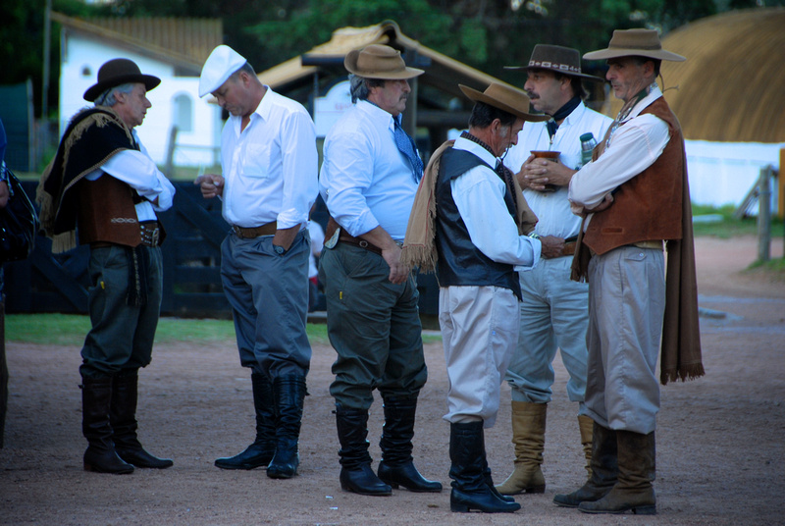
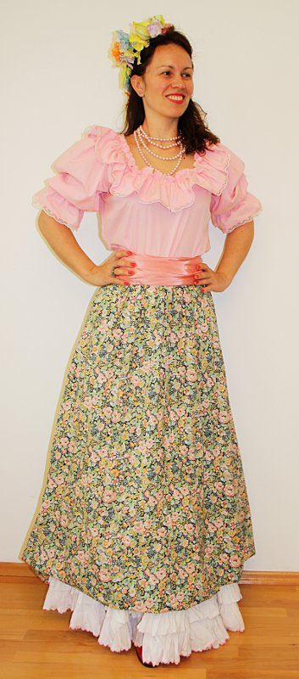
Gauchos is the traditional clothes in Uruguay. It’s with colorful ponchos, broad brimmed straw hats, brightly patterned scarfs and traditional berets.

Slide 7
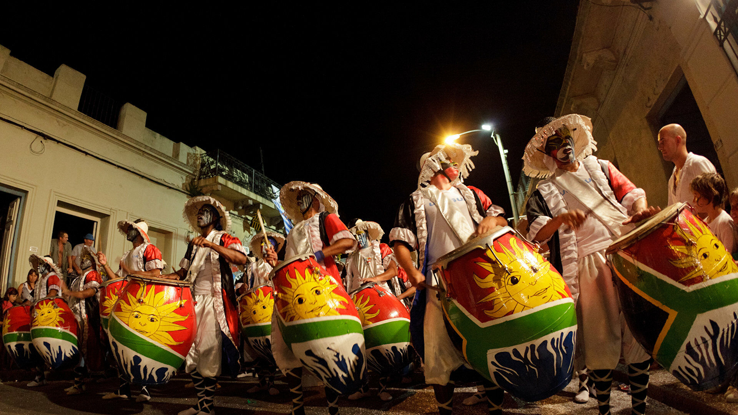
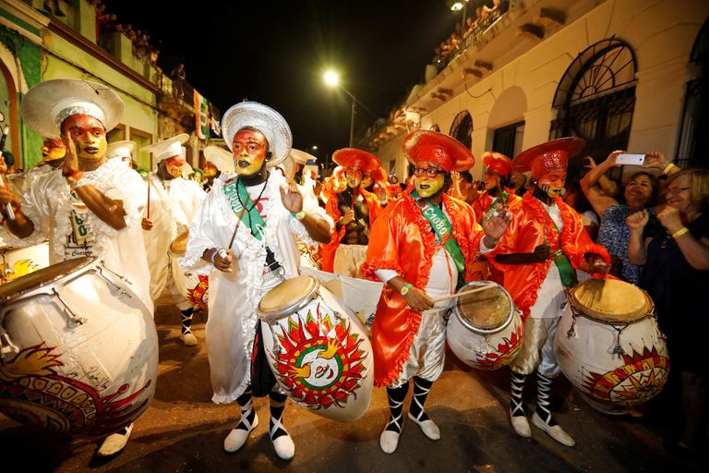
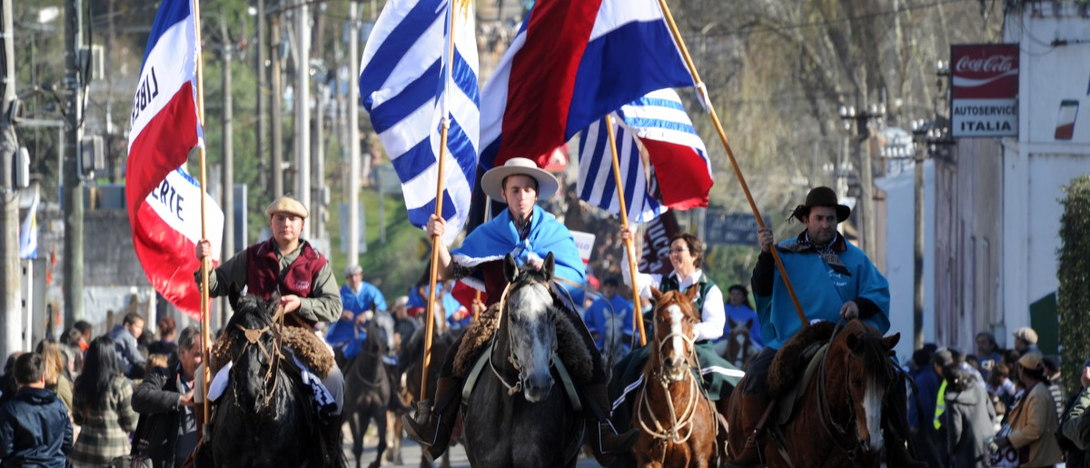
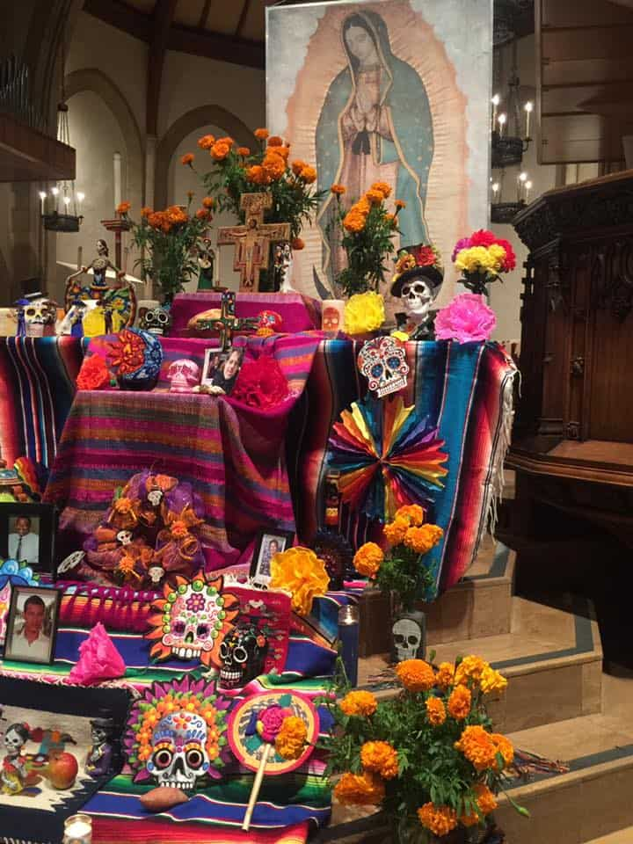
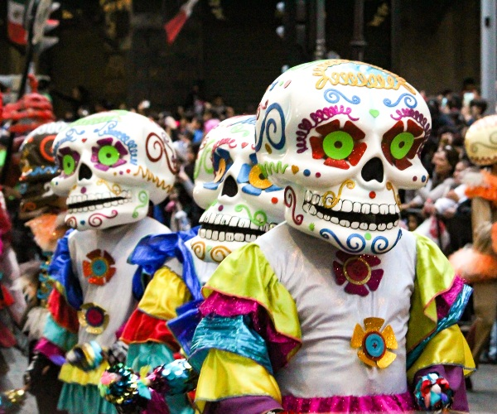
There are famous celebrations in Uruguay like…
Carnaval and
Las Llamadas
Natalicio de Artigas
All Saints’ Day/Day of the Dead (Día de Todos los Santos/Día de Muertos)
And many more…

Slide 8
I hope you enjoyed our visit to Uruguay!
Nine P5/1

