Slide 1
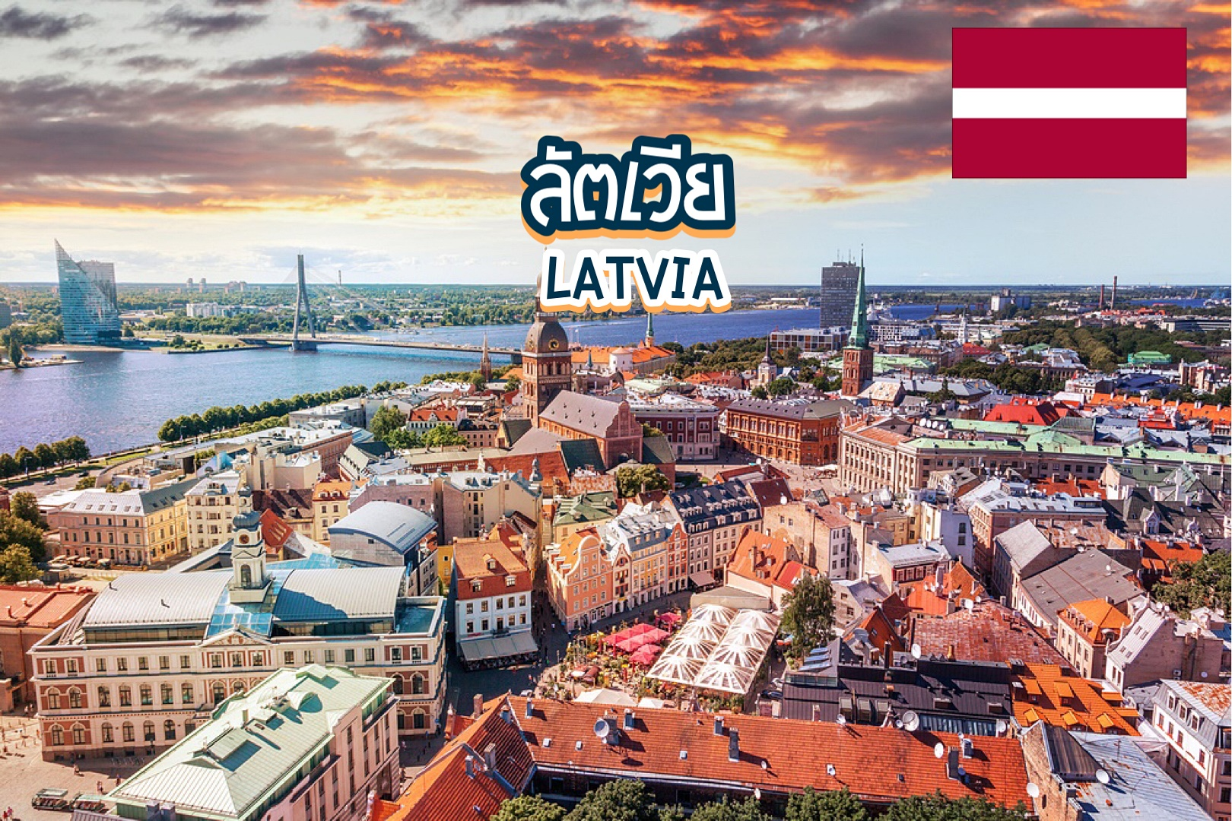
This is my project about
We’ve learned many things about Latvia.

Slide 2
This is the flag of Latvia.

Slide 3
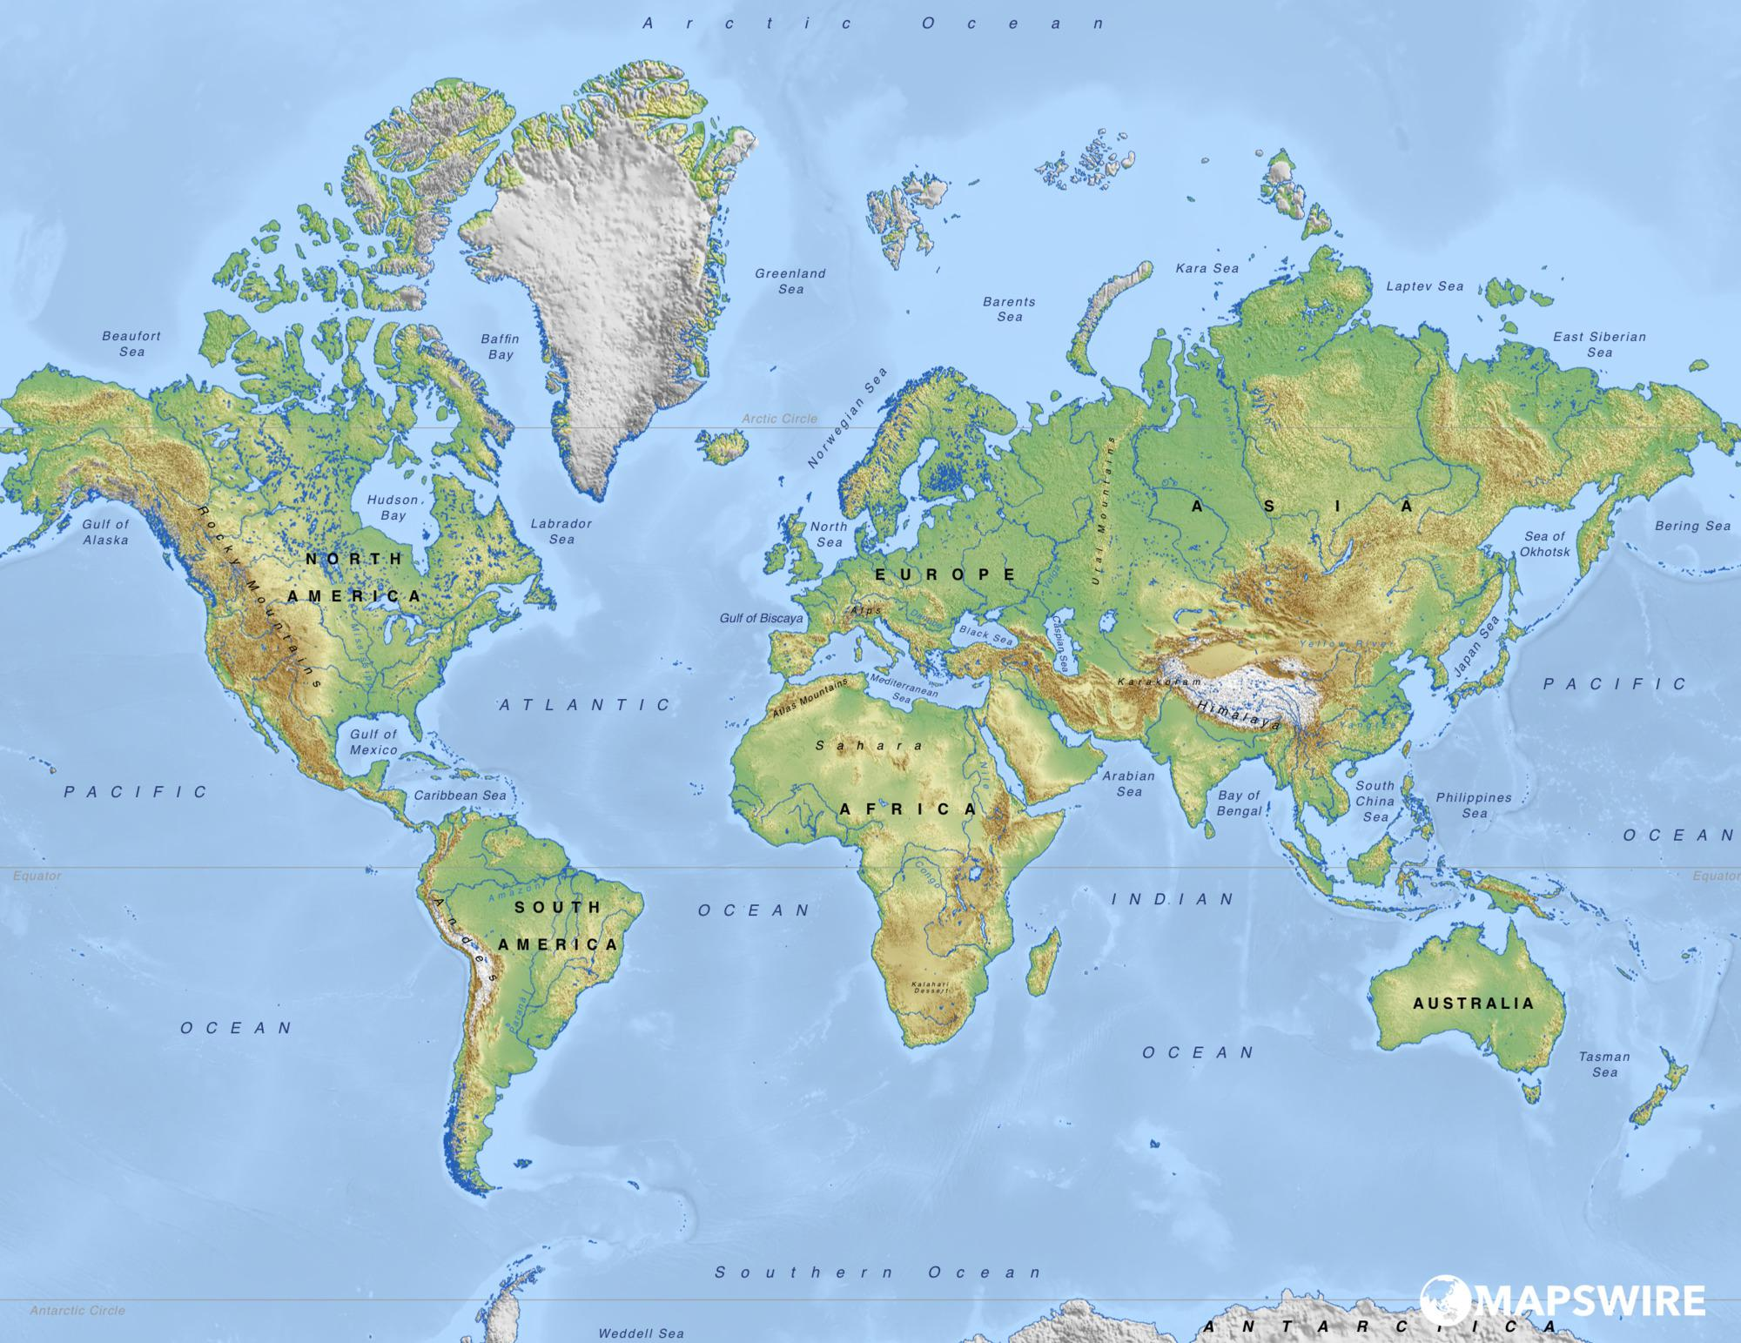
This is the map of Latvia
Latvia is in Europe.

Slide 4
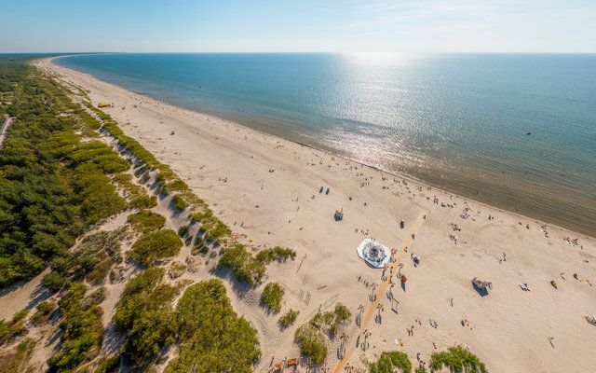
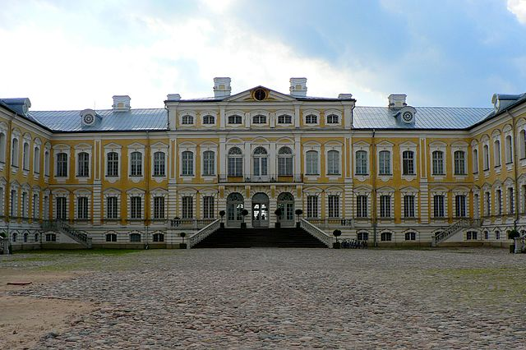
When you go to Latvia, you can visit
Liepaja beach in Liepaja.
Rundale Palace Museum in Pilsrundale.

Slide 5
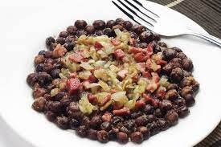
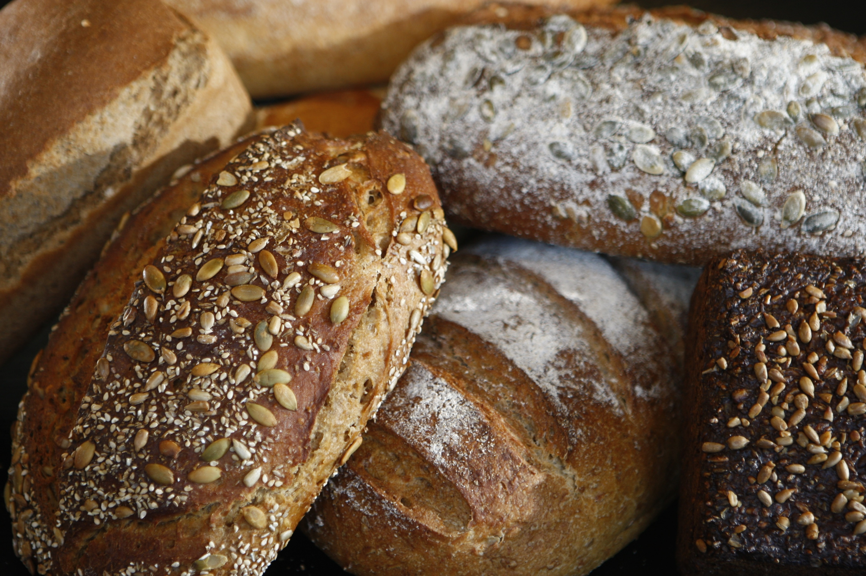
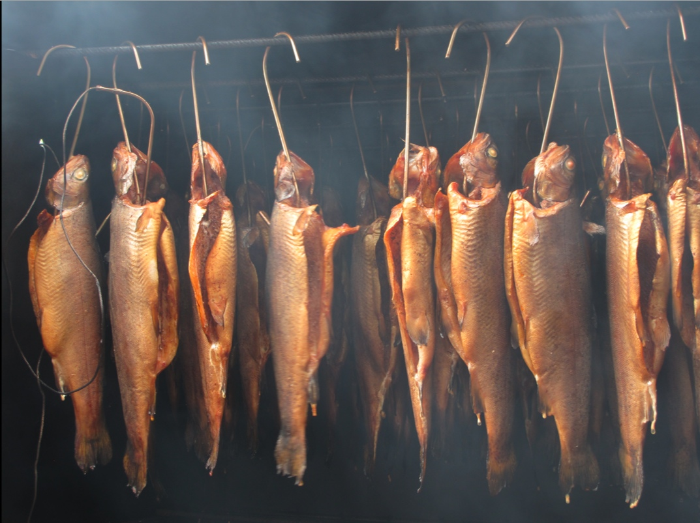
When you go to Latvia, you can eat
Grey peas and bacon
Rye bread
Smoked fish
and many more

Slide 6
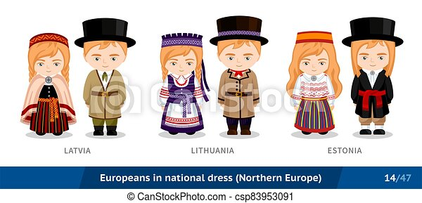
These are the traditional clothes of Latvia

Slide 7
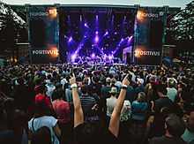
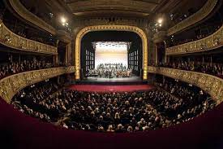
These are famous celebrations in Latvia
Positivus Festiva July 15-16
Riga City Festival
in Aug 16-18
Riga Opera Festival
In June 5 - 18

Slide 8
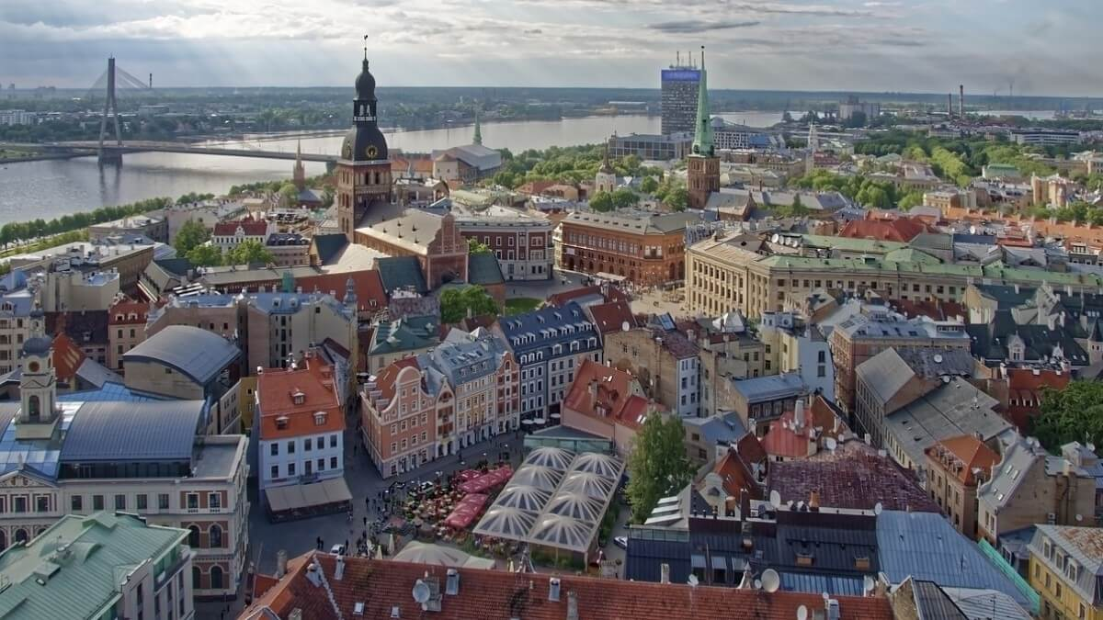
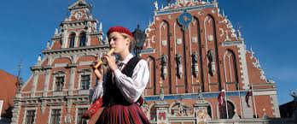
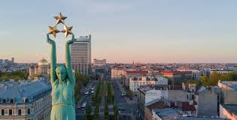
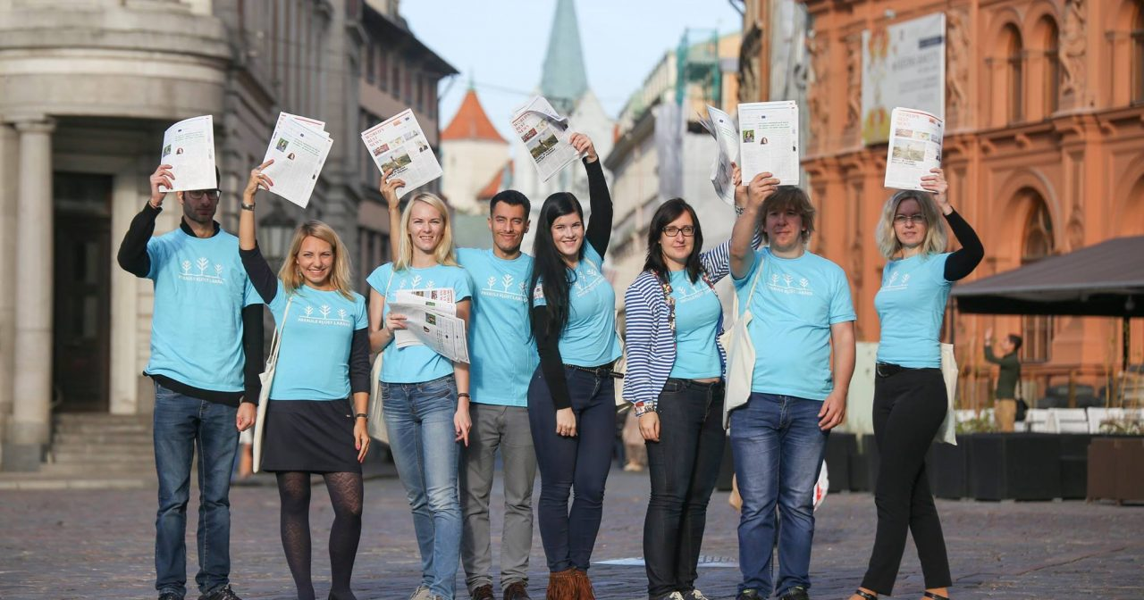
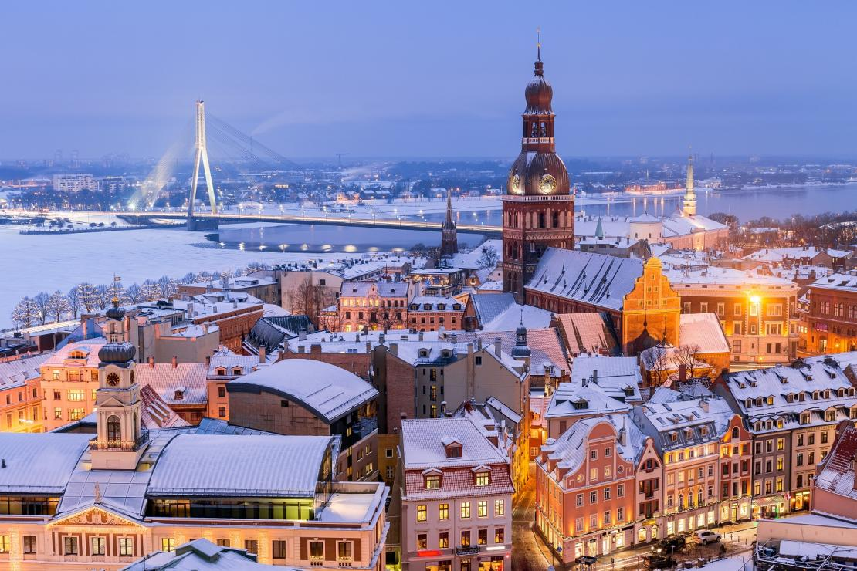
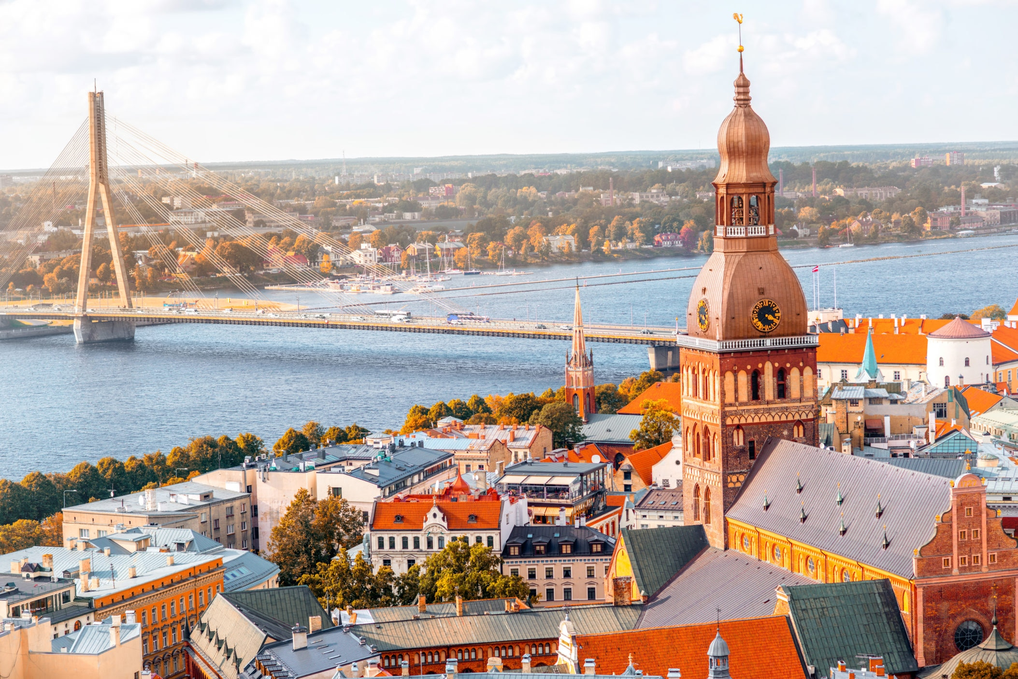
We hope you enjoyed our visit to Latvia

Slide 9
Thank you

