Slide 1
הגנה על IP ככלי להעברת ידע מאקדמיה לתעשייה: נקודת המבט של ה-TTO
Feb 2, 2020
Dr. Shulamit Hirsch
Owner of WIPA – Wholistic IP Approach
Head of IP at the Technion Tech Transfer (T3)
shulamit.hirsch@wipa.co.il
shhirsch@trdf.technion.ac.il

Slide 2
TOPICS
TTO Structure, Duties and Achievements
Regulations
Activities and Services provided by a TTO Patent Department
The Invention Disclosure Form
Patent Committee
Managing and Budgeting the Patent Portfolio
Inter-Institutional Agreements
Generation of Revenues

Slide 3
A few words about myself
Owner of WIPA – Wholistic IP Approach
Head of the IP department at T3, the Technion Tech Transfer Office
Listed by IAM Strategy 300 –Leading IP Strategist in 2017 - 2019
Israeli Patent Attorney since 1998
Examiner of patent attorney candidates at the IL PTO
Reviewer of ERC POC grants under Horizon 2020
IP Consultant for Investment Funds e.g. Momentum Fund, UniFund, La Caixa fund
IP Consultant for Kornit Digital (Nasdaq: KRNT), a worldwide market leader in digital textile printing
PhD in Chemistry from the Tel Aviv University

Slide 4
TECHNOLOGY TRANSFER (Wikipedia definition)
Tech Transfer is the process of transferring technology from the places and groups of its origination to wider distribution among more people and places
It occurs along various axes: among universities, from universities to businesses, from large businesses to smaller ones, etc.

Slide 5
How universities can exploit IP
R&D
Licence agreement
Invention disclosure
IP management
Assignment
(sale)
Exploitation
Evaluation
IP protection
Spin-out
5
Notes:
This slide shows the processes involved in IP management. As you can see, exploitation options play a central role.
The process begins after R&D with the disclosure of an invention.
Then a full evaluation is carried out of the technology, the potential for strong IP and the commercial opportunities. If the evaluation is positive, an application for the appropriate form of IP protection is filed.
Before the technology can be promoted to the business community, it may sometimes be necessary to carry out some refinements, for example to construct a prototype.
At each stage in the cycle, it is necessary to reaffirm the commercial relevance before proceeding further.
Eventually, the TTO will make the initial contact with the partners and commence negotiations for transfer of the technology to them. A licence may be granted to a company for a specific application of the technology relevant to the sector in which the company operates. Sometimes a company may be interested in acquiring ownership of a specific patent, and if the deal is good and there is no reason to retain ownership, the TTO may sell the IP outright.
Another option is to support the formation of university spin-out companies by staff members and to transfer technology into these companies under a licence or by way of assignment of the associated IP.

Slide 6
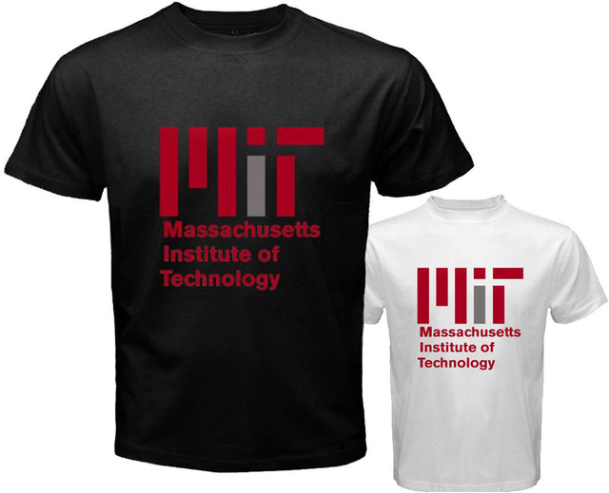
Hard truth ….
According to AUTM (Association of University Technology Managers) only 12% of TTOs are profitable (72% lose money, 16 break even).
The top 5% of TTOs make 50% of all TTO revenues, top 10% make 70% of all revenues
MIT makes more money from selling T-shirts than from licensing deals
Out of 10,000 patents of Stanford only 77 made more than 1 million$ over the total patent life (don’t feel sorry for them Google is one of them..)

Slide 7
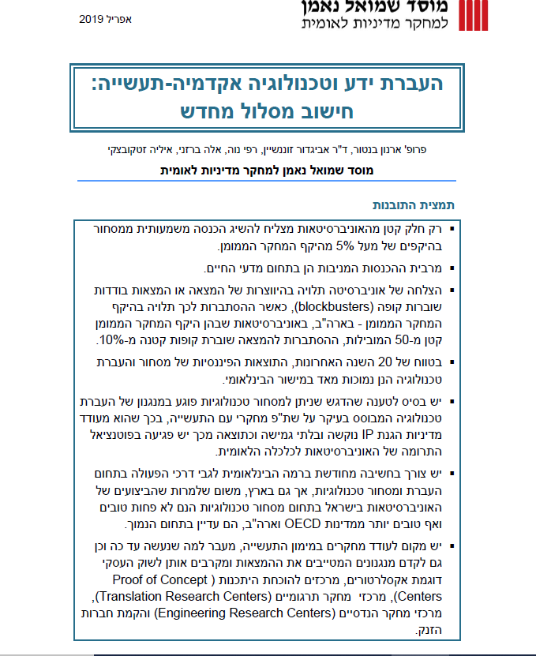
[כותרת]

Slide 8
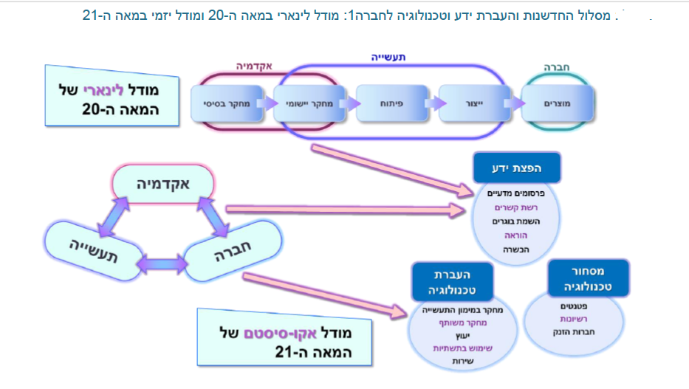
[כותרת]
[טקסט]

Slide 9
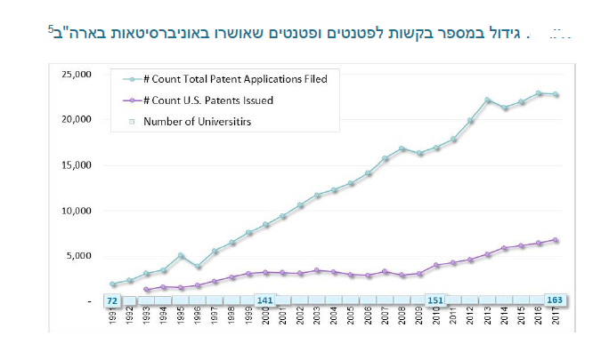
[כותרת]
[טקסט]

Slide 10
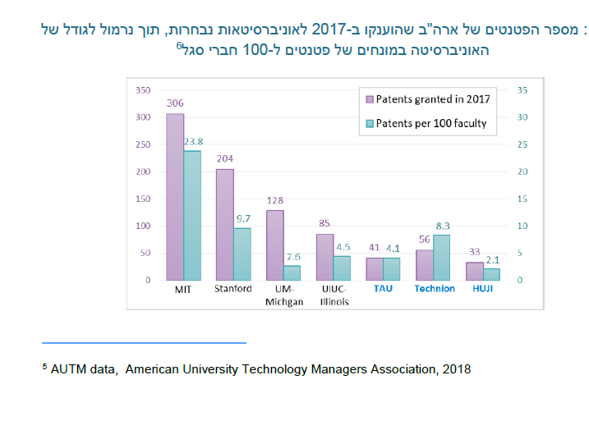
[כותרת]
[טקסט]

Slide 11
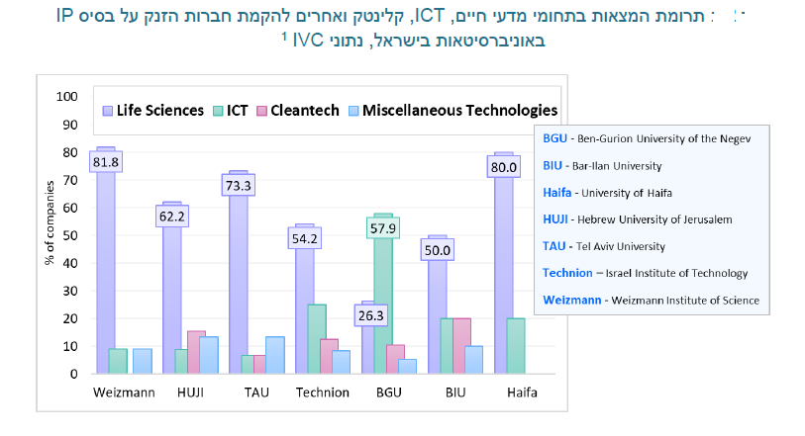

Slide 12
GENERAL SCHEME OF TTO
12
Notes:
In the first part of this presentation I will introduce you to the most important aspects of managing IP as it applies to you.
In the second part I will explain important patenting strategies for IP developers and how companies use IP strategies to commercialise IP. You will find out about some "good practice" tools and procedures you can use to help you capture, document and protect IP arising from your work.
Finally, I will explain the steps taken by universities to transfer technology to industry, and how companies use IP commercially to support their business objectives.
I will finish on a practical note with an interesting case study which illustrates how a casual approach to IP Management can lead to serious consequences in the commercialisation of IP.

Slide 13
TECHNOLOGY TRANSFER ORGANIZATIONS
Most universities and governmental organizations in Israel have a Technology Transfer Company/Office dedicated to:
identify research and IP which may have commercial potential
building strategies for how to enhance value to commercialize
commercialize
Technology transfer organizations are often multidisciplinary, including economists, BDs, lawyers, patent attorneys, marketers and scientists.

Slide 14
LEGAL AND BUSINESS FRAME FOR TECH TRANSFER ACTIVITIES
14
Notes:
In the first part of this presentation I will introduce you to the most important aspects of managing IP as it applies to you.
In the second part I will explain important patenting strategies for IP developers and how companies use IP strategies to commercialise IP. You will find out about some "good practice" tools and procedures you can use to help you capture, document and protect IP arising from your work.
Finally, I will explain the steps taken by universities to transfer technology to industry, and how companies use IP commercially to support their business objectives.
I will finish on a practical note with an interesting case study which illustrates how a casual approach to IP Management can lead to serious consequences in the commercialisation of IP.

Slide 15
IP Regulations
TTO Legal Position
Commercialization of the University IP
Protection of the University’s IP
The University assigns all its title and ownership in Service Inventions to TTO
Ownership of an Invention which is a Non- Service Invention is granted to the Inventor/s
for the benefit of society
to obtain sources of financing for advancing University research
to reward the inventors with fair remuneration
the sole entity to file patent applications with respect to Service Inventions
the sole entity to commercialize Service Inventions

Slide 16
Profit Sharing at TAU/Ramot When IP is Commercialized
IP Regulations
All patent and commercialization expenses are supported by TTO
40% of the Total Net Receipts are paid to the Relevant Inventor/s
each Relevant Inventors' share is calculated according to his contribution to the Relevant Inventions
60% of the Total Net Receipts are transferred by TTO to the University
Inventor’s lab 10%

Slide 17
PROFIT SHARING TRDF/Technion
(Technion IP bylaws – 1999)
Active case –
TRDF manages
Released case –
Inventor manages
Exempt case –
Inventor manages
Released cases – how many are maintained by inventors?
Sampling of 30 cases in 2017 – 0 out of 30 released cases were maintained.

Slide 18
IP MANAGEMENT in TTO
18
Notes:
In the first part of this presentation I will introduce you to the most important aspects of managing IP as it applies to you.
In the second part I will explain important patenting strategies for IP developers and how companies use IP strategies to commercialise IP. You will find out about some "good practice" tools and procedures you can use to help you capture, document and protect IP arising from your work.
Finally, I will explain the steps taken by universities to transfer technology to industry, and how companies use IP commercially to support their business objectives.
I will finish on a practical note with an interesting case study which illustrates how a casual approach to IP Management can lead to serious consequences in the commercialisation of IP.

Slide 19
Identify and Protect the Golden Eggs
EVALUATION

Slide 20
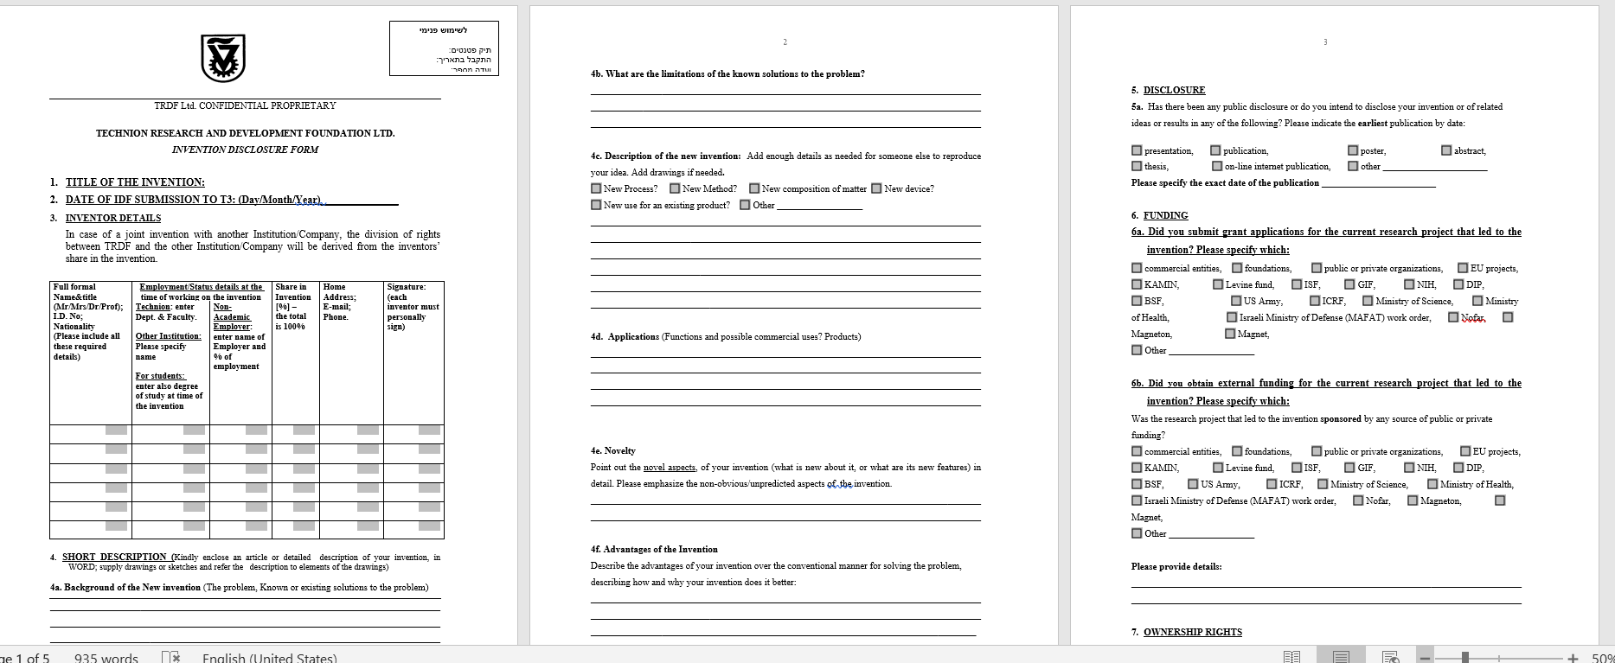
The Invention Disclosure Form (IDF)

Slide 21
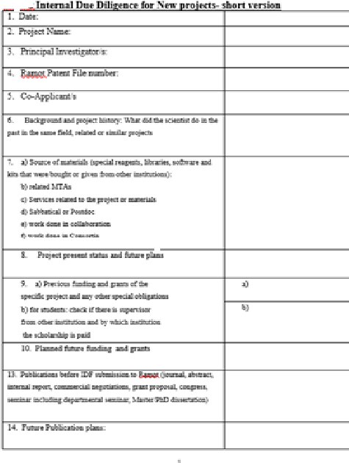
“AIRPORT-TYPE” DD INTERVIEW
Meet Inventors in each new IDF submission and major patent decisions
Identify (or at least try …) potentially patentable invention and commercial asset
“Airport-type” DD Interview
Background history …What and Where the scientists have done in the past in the same field or similar projects
Source of materials (MTAs, Sabbatical, consortia, collaborations)
Research funding and any other obligations to third parties (e.g. governmental, Horizon, NIH, etc.)
Planned future funding and grant submissions
Publications before IDF submissions (journal, abstract, internal, seminars, poster, MSc/PhD thesis, lecture, internet, etc.)
Future Publications Plans
Co-inventors from other Institutions/Labs/Companies/Independent
SEPARATE DD PROCESS IS CARRIED BEFORE EACH COMMERCIALIZATION

Slide 22
New Patent File is Born …… Administrative Procedures
assignments, power of attorney, declarations, patent agreements, IDF information and signatures, etc.)
Novelty Searches in scientific (SciFinder, Google Scholar, PubMed), patents (PatBase, free data bases e.g. uspto.gov, Google Patents) and general (Google) data bases
Review self publications by inventors
Inventors tend to forget ☹ self publications before IDF submissions
Monitor deadlines and follow the internal Patent Committee’s decisions
Prepare files to be discussed at the Patent Committee: New Inventions, One Year (PCT) filings; National filings, Renewals, Various subjects

Slide 23
MONTHLY PATENT COMMITTEE
23
Notes:
In the first part of this presentation I will introduce you to the most important aspects of managing IP as it applies to you.
In the second part I will explain important patenting strategies for IP developers and how companies use IP strategies to commercialise IP. You will find out about some "good practice" tools and procedures you can use to help you capture, document and protect IP arising from your work.
Finally, I will explain the steps taken by universities to transfer technology to industry, and how companies use IP commercially to support their business objectives.
I will finish on a practical note with an interesting case study which illustrates how a casual approach to IP Management can lead to serious consequences in the commercialisation of IP.

Slide 24
MONTHLY PATCOM FOLLOWS THE PATENT APPLICATION AND MAINTENANCE TIME LINE:
Provisional Application
PCT Application
National Phase Filing
Office Actions
Patent Allowed
Priority date Time 0
Convention date
12 months
US patent
publication date
18 months
Issue date
Variable
Patent decisions are mainly driven by Commercial considerations

Slide 25
New Inventions - Questions to deal with
Is it worth filing – which problem is solved, how it is solved by others, what is our edge?
Can we file – is it patentable?
Shall we file – is it enforceable? Can it be easily worked around? Can we commercialize? Are there geographical constrains?
Shall we release?
When to file – correct timing, publication by the inventors and consultation with industry players are main triggers ….
How to file (takes into consideration commercial prospects and time line) – US provisional or Israeli application; full/semi drafting, pros and cons …Which patent attorneys firm
Relevant funding schemes to increase value – government, industry, Momentum fund, others

Slide 26
Patent Committee on Existing Patent Applications and Patents
End of priority – PCT or US only or both PCT + US at the same time
National phase – in which countries we want to obtain monopoly, based on BD recommendations
US only? Which technologies?
US, Europe, China – golden tier?
For validation in Europe – UK, France, Germany – is this enough?
Renewals – in Europe every year, in US every 4 years after grant; etc.
Release of non-commercialized IP – after how many years? Life Sciences and medicine-related IP take much more time to commercialize than Exact Sciences and Engineering-related IP

Slide 27
REMEMBER - PATENTABLE SUBJECT MATTER MAY DIFFER FROM COUNTRY TO COUNTRY*
Methods of Treating Humans
Eligible in US, Australia, Russia
Ineligible in Europe, Israel, Japan, etc., unless when drafted as second medical “Swiss-style type”
Diagnostic Methods performed on humans
Eligible subject matter in Australia, Russia, Japan
Ineligible subject matter in India, Europe (unless tests performed on samples obtained from a human body), China, US (unless recites also an administration step)
Plants and Animals
Eligible subject matter in Australia and Japan
Ineligible subject matter in US (unless non-naturally occurring), Europe, Canada, China, South Korea, India, Russia
Software
Patent ineligible subject matter in Russia, Argentina, Brazil (copyrightable protection allowed), China (except for computer-related inventions, which recite a computer program as part of an apparatus)
Eligible subject matter in Canada, Australia, US (claims directed to an improvement in the way computers operate or define a technical innovation), Japan, Europe and South Korea (as combination of software and hardware that has new technical aspects), India (Indian examiners are allowing descriptions of technical solutions in the form of programs to be patented)
Business Methods
Ineligible subject matter in Europe, Japan, Russia, US, CN (unless they recite physical technical features)
Eligible subject matter in Canada, Australia, and South Korea (if presented as a specific technology in combination with computer technology)
*The information should not be construed as a legal opinion or as legal advice! Always consult a patent attorney.

Slide 28
Activities Following the PatCom Decisions
Patent attorneys are assigned to each new case
Supervise the drafting of new patent applications
Dictate claims strategy according to commercial prospects, research maturity, funding, publication plans
The broader the patent claims, the more valuable is the patent?
Sometimes YES – example on delivery system for drugs
Sometimes NO – biological glue example
Proactive Prosecution in e.g. US and EP
All Patent decisions must be aligned with the business
When and where to file
Submit response to PCT Written Opinion – Yes/No
At Restriction Requirement Office Action – what subject matter to elect
At grant – whether to file a divisional or continuation
Sign Inter Institutional Agreements (IIA) in joint Inventions
Do we file if the patent is joint with a “real” company? e.g. joint with Facebook, Google, IBM

Slide 29
JOINT INVENTIONS - IIAs between Institutions

Slide 30
Important Elements of IIAs
Who leads?
Usually the one with the bigger part, but not necessarily so
The one that has a clear advantage in the management and commercialization of the patent (tasks may be split)
Administration fees for leading party?
Mechanisms for easy decision making during the patent and commercialization processes

Slide 31
Patent Portfolio
31
Notes:
In the first part of this presentation I will introduce you to the most important aspects of managing IP as it applies to you.
In the second part I will explain important patenting strategies for IP developers and how companies use IP strategies to commercialise IP. You will find out about some "good practice" tools and procedures you can use to help you capture, document and protect IP arising from your work.
Finally, I will explain the steps taken by universities to transfer technology to industry, and how companies use IP commercially to support their business objectives.
I will finish on a practical note with an interesting case study which illustrates how a casual approach to IP Management can lead to serious consequences in the commercialisation of IP.

Slide 32
Patent Portfolio at Ramot 2010-2019
 | 2019 | 2018 | 2017 | 2016 | 2015 | 2014 | 2013 | 2012 | 2011 | 2010
IDF Received | 93 | 113 | 101 | 103 | 107 | 112 | 123 | 118 | 103 | 113
Priority Filed | 89 | 88 | 80 | 83 | 63 | 73 | 78 | 91 | 64 | 76
One Year Filed | 49 | 57 | 69 | 49 | 52 | 51 | 64 | 48 | 63 | 51
National Phase Families Filed | 45 | 49 | 28 | 36 | 40 | 31 | 50 | 43 | 40 | 39
Patents Granted | 131 | 128 | 112 | 148 | 144 | 140 | 128 | 95 | 69 | 56

Slide 33
Patent Portfolio –at TRDF
 | 2014/2015 | 2015/2016 | 2016/2017 | 2017/2018 | 2018/ H1-2019
IDF | 101 | 110 | 106 | 140 | 72
Provisionals | 73 | 76 | 88 | 107 | 47
Re-filed | 14 | 16 | 16 | 28 | 16
Total | 87 | 92 | 104 | 135 | 63
Licensed | 13 | 12 | 36 | 18 | 9
Expenses (USD) | 1,653,236 | 1,746,737 | 1,459,328 | 2,249,379 | 1,504,614
Patents families | 640 | 680 | 689 | 698 | 753

Slide 34
Difficulties in Patenting, Unique to TTOs…
Researchers are not always interested in patents
Researchers forget to meet us before they publish
Filing too early, due to publication
Basic research: biological targets, understanding mechanisms, atomic structures
Unclear utility; e.g. nano-size structure
No motivation to conduct experiments to support broad scope of claims
No motivation to conduct comparative experiments for overcoming prior art
No motivation to upscale technology
So.. draft broad, prophetic patents to be attractive too, as many possible unknown future licensees

Slide 35
Difficulties in Commercialization Unique to TTOs…
No real business/commercial strategy
Not enough knowledge about the market
Not enough knowledge regarding relevant competitors
No certain knowledge of final utility (platform technologies)
No knowledge of correct geographical coverage (you can look at what others are doing )

Slide 36
Tech Transfer Process (following submission of patent application)
STEP I - TRL assessment (Technology readiness level) : Submit patent application if enough data
STEP II-A - A LOW TRL - Wait for additional development/suggest Kamin application
STEP II-B - HIGH TRL -
STEP III- Establish and License to a -Startup
Approach CTO’s of Incubators (routine conversations)
If there’s a PhD student- Suggest to found a NewCo
Post technology on LinkedIn-Looking for entrepreneur
STEP III-B - License to Existing company
Look for relevant Israeli companies (Nofar/Magneton)
Approach professionals in multinationals-
Contacts
ZoomInfo (corporate e-mail database)
LinkedIn
Sign NDA/MTA/arrange conference calls

Slide 37
Case Study I at TRDF
- US10370630 - Method and apparatus for cell isolation, growth, replication, manipulation, and analysis (Prof. Uri Sivan)
Patent application filed 10/2/2014; PCT Nationalized in US, EP, CN
Kamin Grant 2014-2016 (Second patent application submitted)
Licensed to OneCell Medical (Sanara –IIA Incubator)-2017

Slide 38
Case Study II at TRDF
Prof. Hossam Haick
Patents
US9625341 - A platform unit for combined sensing of pressure, temperature and humidity. (Priority 2012)
US20170363489 - High resolution pressure sensing (Priority 2014)
US20180231486 - Self-healing platform unit for pressure and analyte sensing (priority 2015)
Entrepreneurs (Prof. Haick’s Students and inventors)
Dr. Gady Konvalina
Dr. Meital Segev-Bar
License Signed-November 2016
Entered into Technion Accelerator- January 2017
Received Equity Investment- August 2017

Slide 39
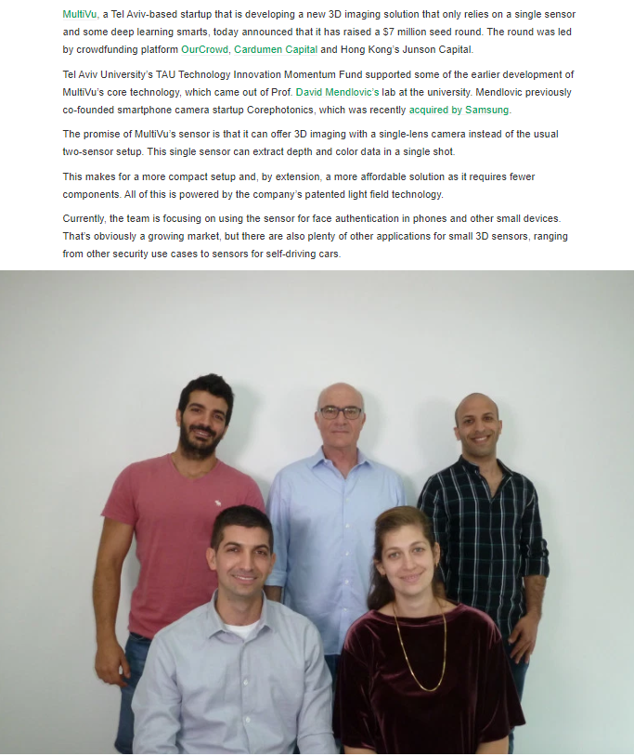
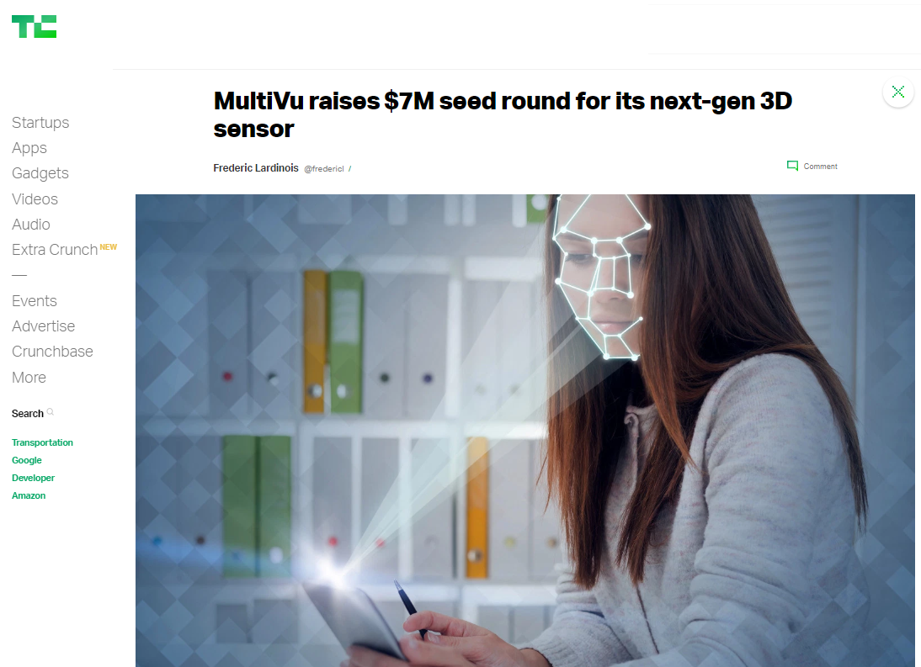
Case Study III at Ramot
16.05.2019
US9900562 - System and method for light-field imaging; Priority 2014; Filed in US, EP, CN
WO2019162938 - System and method for light field imaging; Priority 2018

Slide 40
BUDGET CONSIDERATIONS
1. Reduction of portfolio size (and related costs)
1.1 Cutting down filing of new cases
1.2 Re-consideration of non-commercialized patent families
1.3 Improving searching capabilities – to avoid unnecessary filing
2. Patent Reimbursement:
2.1 Assimilate agreements and active monitoring of patent reimbursement

Slide 41
shulamit.hirsch@wipa.co.il THANK YOU

