Slide 1
How is food produced?

Slide 2
Working on the project "Be the change... you want to be!", "Minija" progymnasium students visited Roshen Confectionery Corporation. The children watched how are candies produced and had the opportunity to make candies themselves.

Slide 3
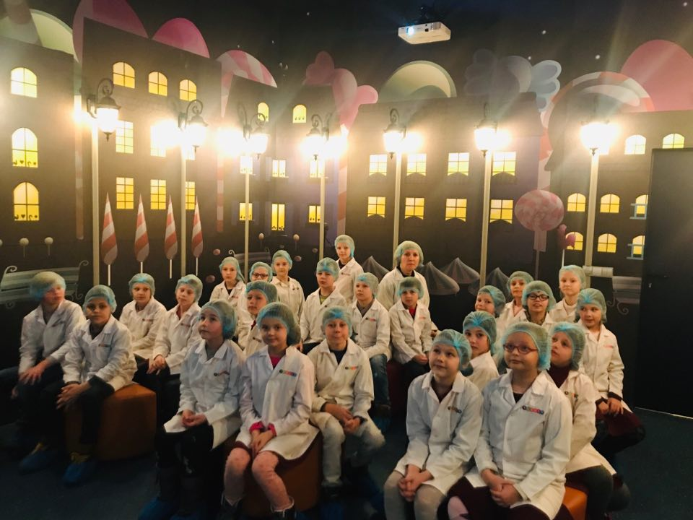
The tour begins at the factory’s entry. The tour guide greets the group and leads it further to the factory. Each of the participants receives special clothing for visiting production facilities (lab coat, cap, gloves and boot mitts). Then group moves to the Cinema Hall where after brief history of Roshen Confectionery Corporation they watch educative short film «Chocolate Factory», which shows the world of confectionery production.

Slide 4
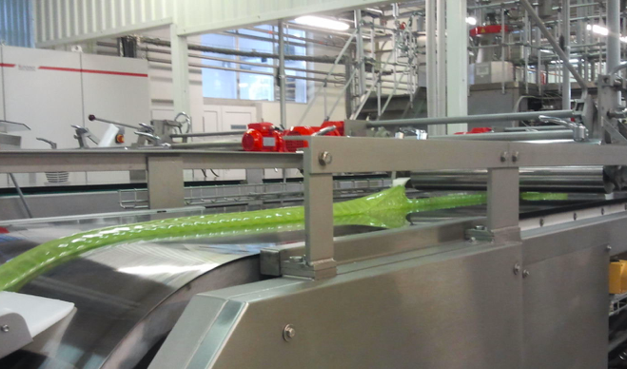
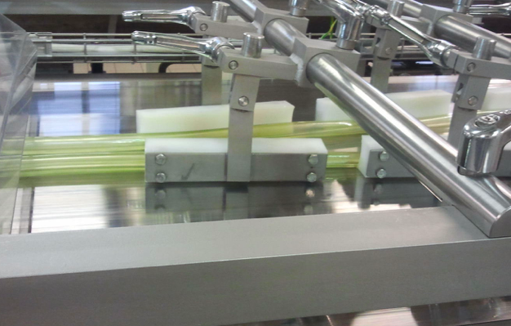
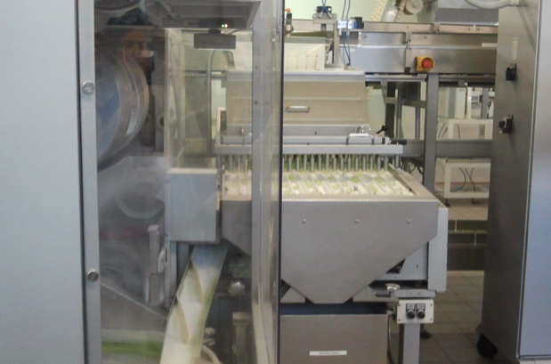
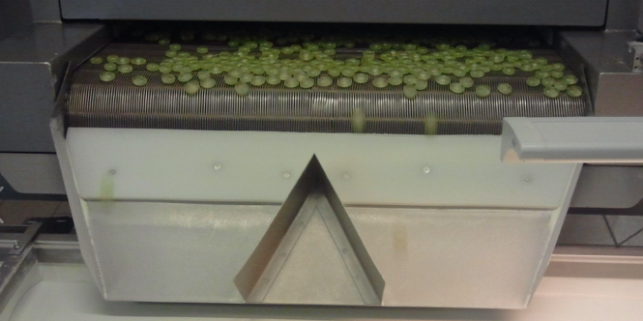
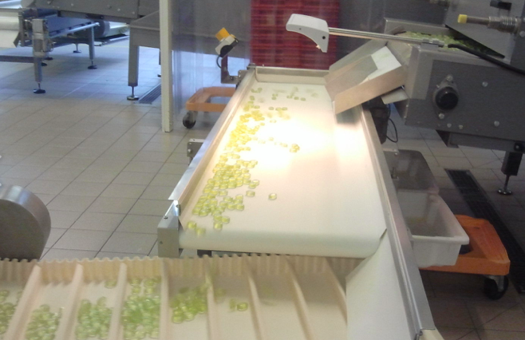
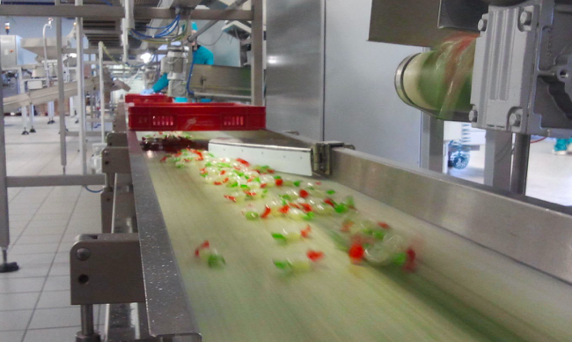
After that group follows the guide to the production unit to observe the full cycle of caramel sweets manufacturing.

Slide 5
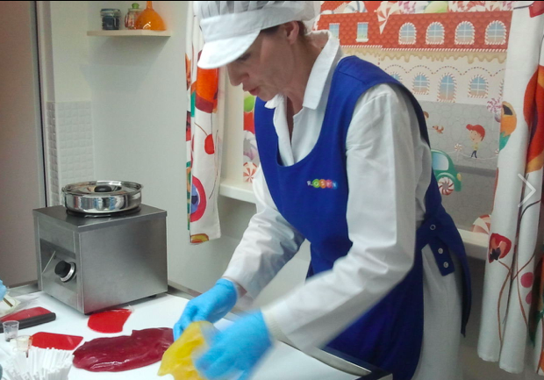
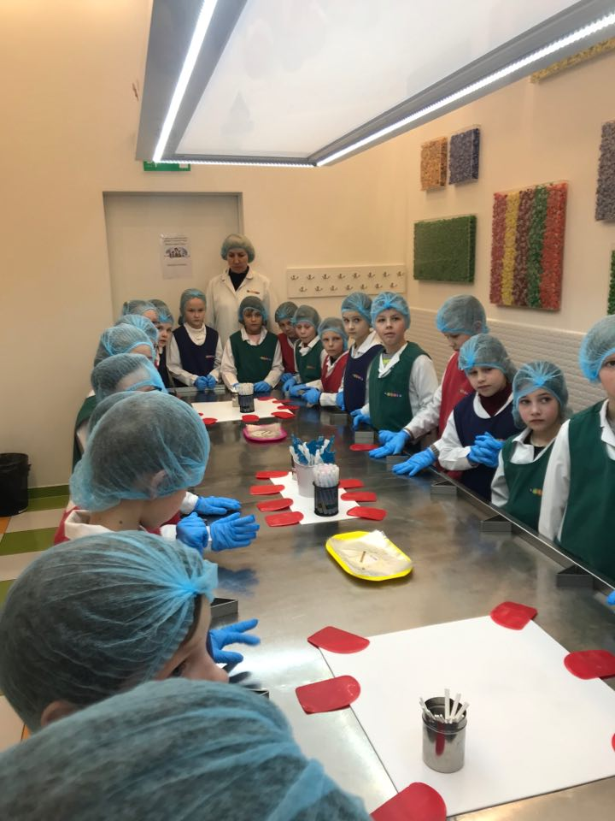
During the tour children had a chance not only to observe the production, but to ask the guide any question regarding work at the confectionery factory.

Slide 6
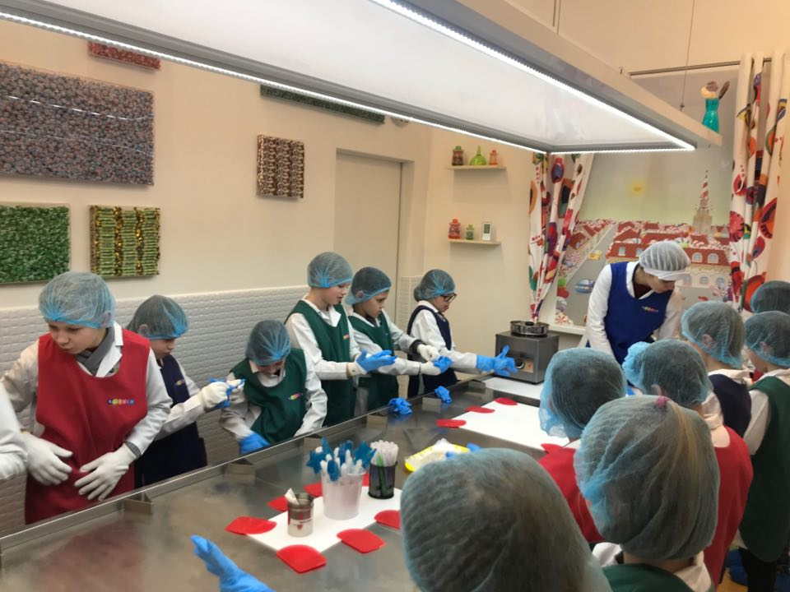
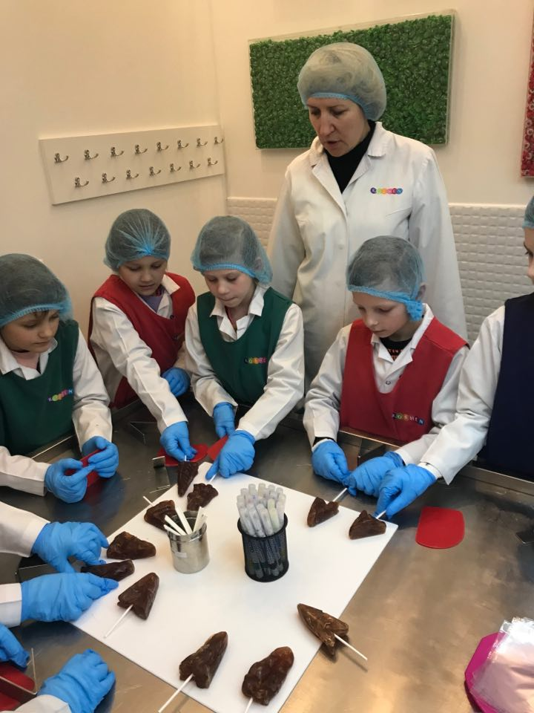
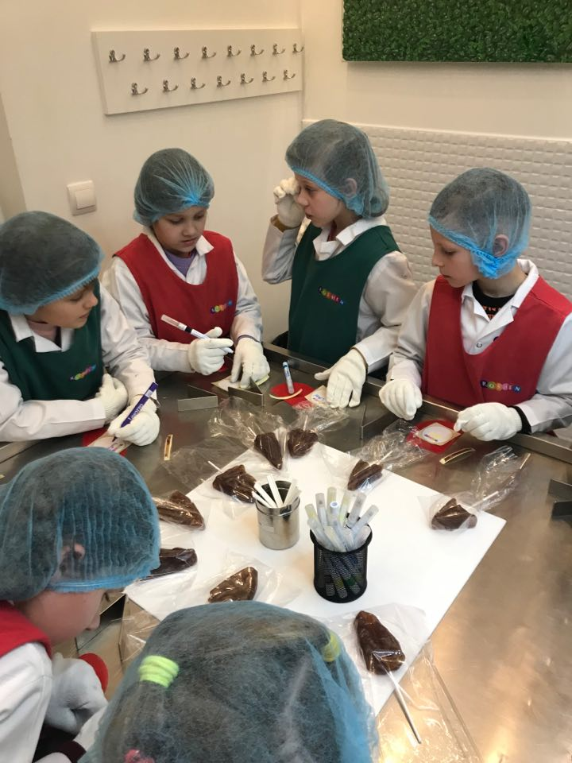
Finally, children tried to repeat the work of professional confectioners during the Lollipop Making Workshop.

Slide 7
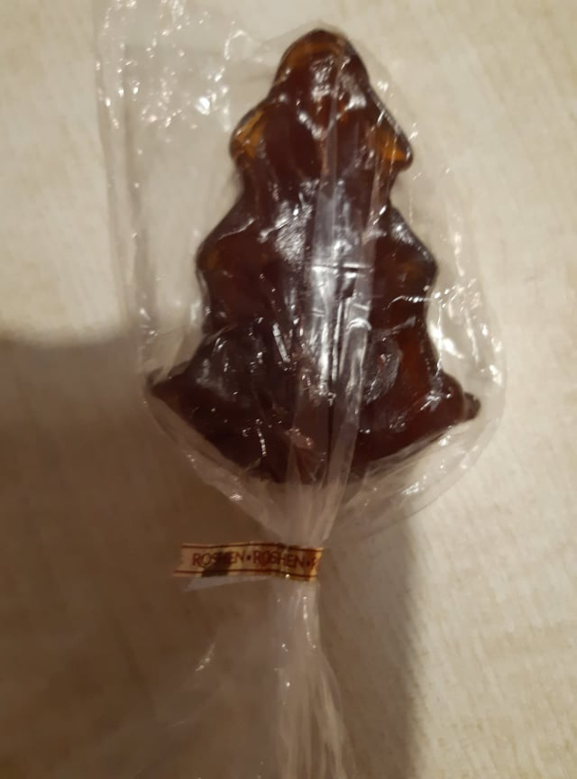
It’s for you ☺

Slide 8
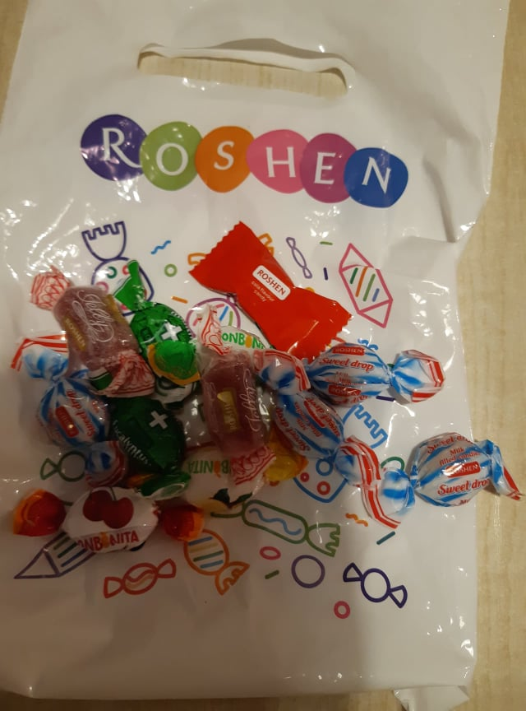
At the end of the tour children were presented with sweet souvenirs!

