Slide 1
How does the Healthcare System work in the UK? A Junior Doctors Guide

Slide 2
Objectives
Outline the structure, function and history of the NHS (Past, Present and Future)
Explore different types of healthcare services and providers
Consolidate your understanding using case-based examples of patient journeys within the healthcare system

Slide 3
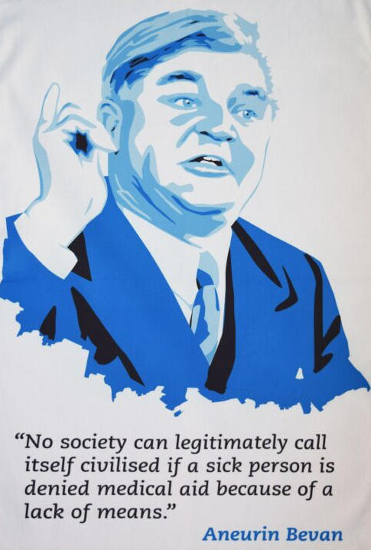
National Health Service
Founded in July 1948 as part of a major social reform post-WW2
5th Largest employer in the world (1.7 million people)

Slide 4
Core Principles
Comprehensive-offers a range of services
Universal for all those resident in the UK
Free at the point of care (except Dental and Optical)
Funded through tax contribution and national insurance

Slide 5
Past
Since 1991/Thatcher Reforms: Shift from market-based, competitive approach to a more collaborative approach
Health and Social Care Act 2012:
- Greater Autonomy for Trusts with increased regulation
- Increasing choice
- Focus on outcomes
- Patients: “No decision about me, without me”

Slide 6
Challenges
Successes
Ageing population
Budget cuts/Austerity
Postcode lottery
Social Care
Mental Health
Lifestyle diseases
Brexit
COVID-19
Cancer survival rates highest ever
Forefront of Research and Development
Greater patient involvement in care
Diversification of the workforce and population

Slide 7
Present
2014: Five Year Forward View: long term view, develop new care models, integration and reorganization of services
2016/17: Sustainability and Transformation Plans (STP)
Aim: reduce health gap, quality gap and financial gap. Sustainability through cooperation between local council and NHS organizations (GP’s, social care, hospitals)
Commission the needs of that area

Slide 8
Future
Integrated Care Systems (ICS)
- Place-based healthcare system
- Integration of primary and secondary care with physical/mental health services and social care
- Aim to replace STP’s by 2021
Urgent Care Networks
Enhanced healthcare in Care Homes
Modern Maternity Services (shift low risk deliveries to community)

Slide 9
NHS Values
Patient centered care
Respect and dignity
Commitment to quality of care (Clinical Governance)
Compassion
Improving lives
Everyone counts
Notes:
Patient centered care
Respect and dignity- respect their aspirations and commitments in life, and seek to understand their priorities, needs, abilities and limits (staff and patients)
Commitment to quality of care (Clinical Governance). We are responsible for maintaining and striving towards the highest quality of care for our patients
Compassion. Act in a kind, empathetic and professional manner at all times
Improving lives. We strive to improve health and wellbeing and people’s experiences of the NHS
Everyone counts. We maximise our resources for the benefit of the whole community, and make sure nobody is

Slide 10
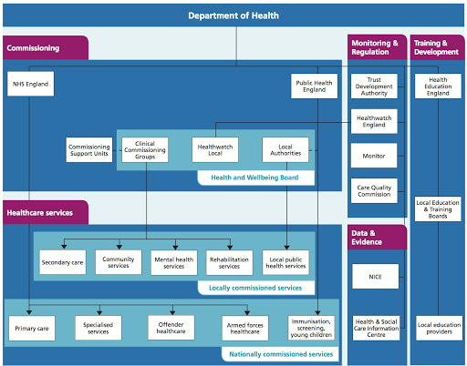
Healthcare System

Slide 11
Funding: Key Facts and Figures
Department of Health and Social Care spent £140 Billion in 2019/2020
Comprises 9.8% of GDP ( average for similar countries 10.1%)
Cost of an A&E attendance: £45-£450
Cost of a GP Appointment: £37.40
Cost of ambulance: £250
Cost of a ward bed: £400/night
Cost of an ITU Bed: £1932
Notes:
https://www.ficm.ac.uk/sites/default/files/economics-of-critical-care.pdf
https://www.kingsfund.org.uk/audio-video/key-facts-figures-nhs

Slide 12
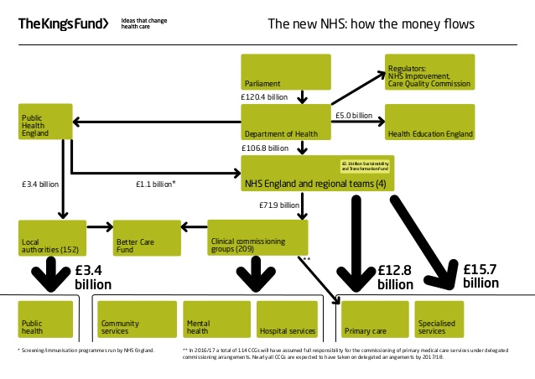

Slide 14
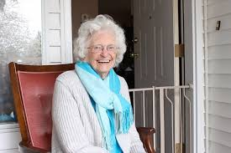
“Hello, my name is Gladys. I’m 90 years old and I live alone in a bungalow with no cares. Apart from being slightly unsteady on my feet, I’m in pretty good spirits.”

Slide 15
Gladys has a fall a home. Who could she call for help?
Unable to raise concern
NOK
Neighbor (Planned/incidental visit)
Carer
Pendant
OOGP
NHS 111
999 (Ambulance)

Slide 16
Admission
Triage (Nurse)
Ambulance Notes
ED Review ?Discharge if appropriate
Clerking (Medical/Surgical/other specialties)
Post Take if admitted (Consultant)

Slide 17
Hospital Stay
Admitted to Acute ward (AMU/SAU)
Transfer to specialty ward if appropriate
Daily Ward Round (typically but not always senior led)
MDT involvement
-Occupational Therapist
-Physiotherapist
-Social Worker
-Pharmacist

Slide 18
Discharge
Medically Fit?
Follow up (clinic/GP/other specialty)
Where?
Home, Relatives
Community hospital (supported discharge)
Residential Home
Nursing Home
Supported Living
Extra support required (OT/Physio)
Stair lift, railings etc
Mobility Aids
Package of Care
Meals on Wheels
District Nurse review (e.g catheter/dressings)

Slide 19
Happy Gladys

Slide 20
Further Reading
https://www.kingsfund.org.uk/
https://www.hee.nhs.uk/our-work/values-based-recruitment
https://www.england.nhs.uk/integratedcare/stps/faqs/#one

