Slide 1
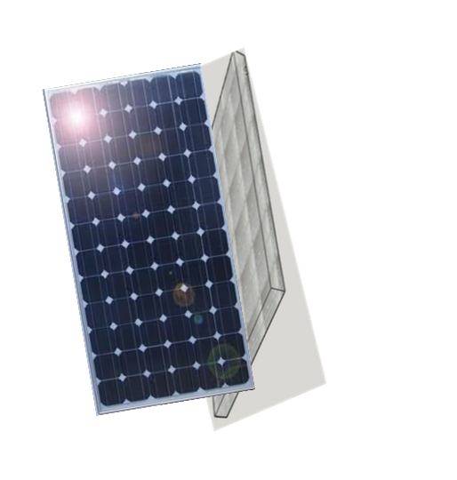
UPS
Ultra Photovoltaic Solar
Our Revolutionary HYBRID Dual-Faced PV Triple Sun Thermal new innovation
Several generations beyond Existing Hybrid PVT technology
45%+
15%
Increased
Electrical Power Generation
Increased
Electrical Energy
Efficiency
Generating Electricity &
Hot Water on the same platform

Slide 2
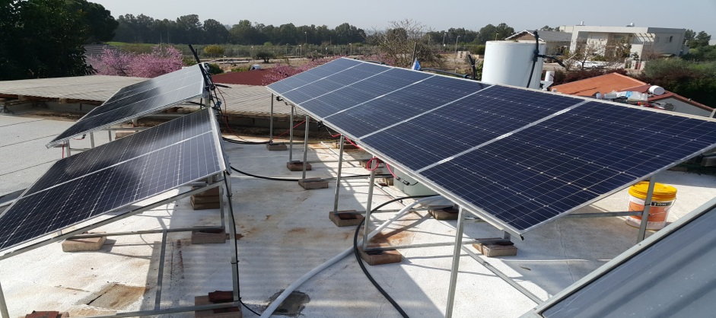
This newly patented and innovative Triple Boosting Thermal System, increases the production efficiency of both electrical power & hot water generation of the HYBRID BIFACIAL (two-faced) Black Monocrystalline PhotoVoltaic Panel (PVP) by at least 45%. This is much more Electric power generation than what is seen with a regular PhotoVoltaic Thermal Panel (PV+Th)
1
Our smart & revolutionary active differential hot water circulation system “Transparent Thermal KIT“, when integrated with a Bifacial Black monocrystalline PV Panel, leads to a dramatic improvement in feasibility with a much lower price than a stand alone
hot water collector panel !!!
(without the PVP).
Sponsored by the Israel Innovation Authority -Chief Scientist
this project was funded by a government grant with intent to implement this dramatic and new innovation into a number of selected different field installations-
pilots stage.
3
2

Slide 3
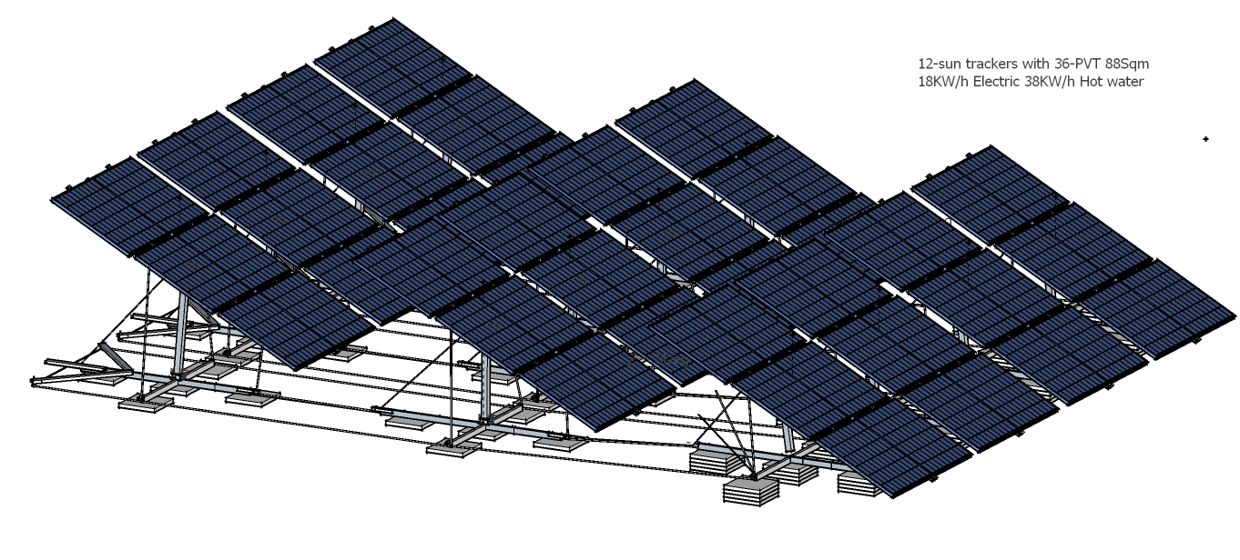
Coupled and retro-fitted with the newest version of UPS
Bifacial Black monocrystalline half-cut Photo-Voltaic Transparent Panel along with a Thermal ‘kit’ ( 2.1m² ) and more, Semi Transparent PV Panels approaching output of
550 Watts Wp
This in turn improves the Electric efficiency scale in active differential
full scale heat evacuation circulation (thermal)- generating hot water of
880 Watts Wp ( STC test)
A Differential Telescopic Elliptical Arcs Double Axis Multiple Sun Trackers
Coupled and retro-fitted with the newest version of UPS Bifacial Photovoltaic Panels
increases the effective hours of direct sun energy exposure by at least another 50%.
Enables an additional 33% of Bi-facial PV Thermal panels to be integrated in between the shadowed spaces.
Additional 80% which further accelerates the end user return of investment.

Slide 4
$
$
$
Stage 1
Stage 2
Stage 3
Stage 4
Same Time
& Space
Additional Bifacial PVP’s at no extra cost
Active Cooling of
PV Cells
Increases Electric production
Optimized
Hybrid Bifacial Thermal Panel By Triple Boosting Effect
Huge Annual Savings
Electric Power
and
Thermal Energy

Slide 5
$
UPS
Hybrid
Bifacial PV Thermal
Transparent Panel
UPS modules are connected to the differential water circulation system providing all the required sanitary hot water. This system can add anywhere from 60%-70% of all thermal energy requirements needed in the operation of domestic heating and Hybrid thermal air conditioner units
Regular
Photovoltaic
Panel

Slide 6
The basis of our technology is a Novel micro HYBRID electric solar system. Currently, water heaters/tanks are largely powered by natural Gas/Electric/fossil fuels, which are more expensive options then the HYBRID SOLAR powered ones
Hot water is currently heated by a HYBRID Single faced photo-voltaic/water combinaton utilizing technology which is 30%-40% less efficient then the P.G.Solar Greenergy patented technology alternative. This existing technology is far less economical in terms of scale of energy production which is installed on a much smaller physical footprint
Urban Facilities
Industrial facilities
No
Competition
Commercial properties
Green Houses

Slide 7
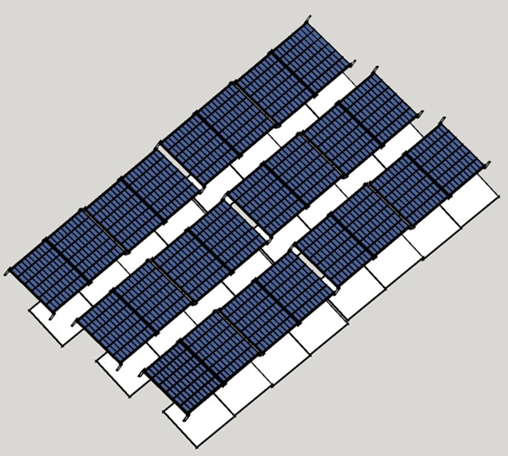
UPS
Ultra Photovoltaic Solar
The most incredible HYBRID Triple Boosting Solar Thermal innovation
Used as an alternative to roof tiles/roofing, greenhouse, and thermal insulation
Performance Guarantee on PGSolar Greenergy Integrated Bifacial PV Panels
Linear Power Output
8 years 94%
30 years 86%
Reduce aging of photovoltaic module
MORE USABLE ENERGY
within the
SAME PHYSICAL PLATFORM
Powerful and even in the event of a panel loss or interrupted water circulation, there is no possibility for the photovoltaic cells to overheat beyond the permissible and destroyed.

Slide 8
Patent 255843 PCT/IL2019050627
© 2018 All right reserved to Peter Graner
Mobil 00972547275551 petergreenerenergy@gmail.com

