Slide 1
Understanding Unity
A – Z
ZAID AL YASIRI

Slide 2
Major pieces for Unity Audio Visualizer
What are the component of unity Audio Visualizer?
Can we add more than one audio input?
Can we detect beats easily and even before they happen?
How will we use the beat to employ other object?

Slide 3
What are the component of unity Audio Visualizer?
1. Create Visual Effects.
2. Use multiple audio sources at once.
3. Pre-record tracks for optimized performance.
4. Use live microphone input, or other inputs.
5. Detect beats.
6. Fade between materials.
7. Be able to assign colors to beats based on their frequency.

Slide 4
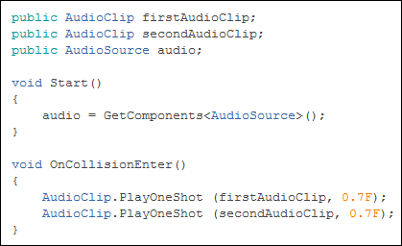
Can we add more than one audio input?
You can attach several Audio Sources to the same GameObject in the Inspector and get them to play at the same time by calling PlayOneShot(); in a script.
You need the Audio Source attached to your main GameObject and then attach a script to the Audio Source. You can call the script to play multiple AudioClips in the following way:

Slide 5
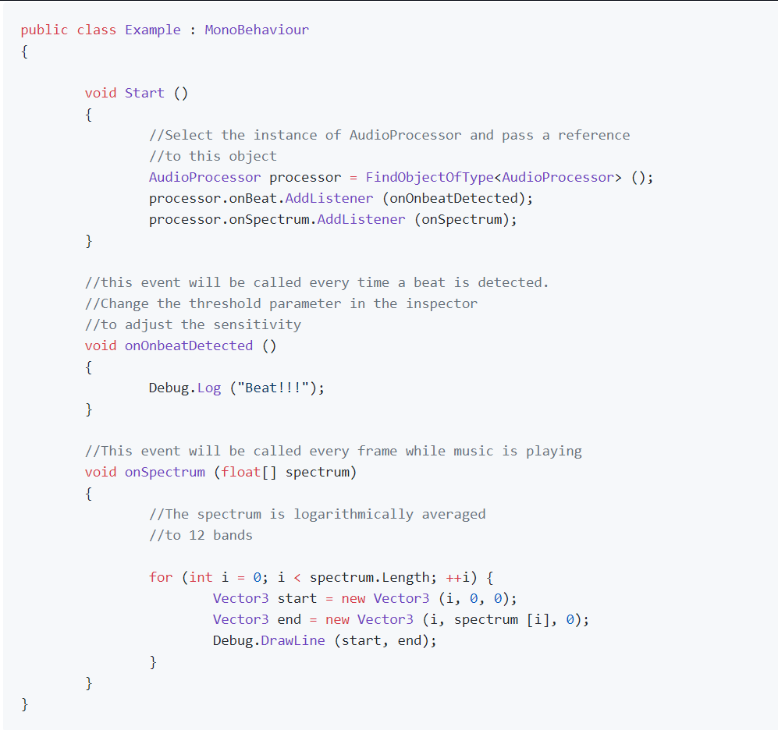
Can we detect beats easily and even before they happen?
Musical beat detection and audio spectrum analysis for use with the Unity game engine.
The AudioProcessor class contains an interface that can be implemented on your GameObject.
For playing back audio in Unity, we will always be using an AudioSource to play a file which is represented as an AudioClip. Once we’ve imported our audio files as AudioClips, we should set the load type to “Decompress on Load” to ensure that we have access to the audio sample data at runtime.
Attach an AudioSource component to a GameObject in your scene, drag your AudioClip into your AudioSource, make sure “Play on Awake” is selected, and press Play. You should now hear your audio file playing within Unity.
Once we have audio playing in Unity, the Unity API provides some very handy helpers for getting access to information about the audio that is currently playing. This makes our real-time analysis of the audio samples themselves very straightforward.

Slide 6
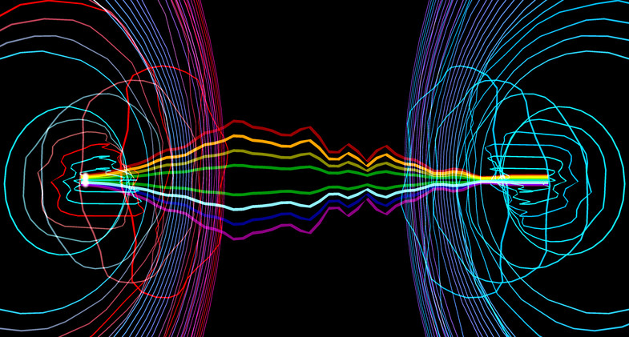
How will we use the beat to employ other object?
Use the beat to: - Call any custom event of your own! - Move objects back and forth. - Scale/shrink objects. - Fade between two materials. - Fade between two colors. - Change the color or intensity of lights. - Show audio waveforms. - Use Unity’s new UI system to display waveforms on panels.

Slide 7
Sources
https://medium.com/giant-scam/algorithmic-beat-mapping-in-unity-real-time-audio-analysis-using-the-unity-api-6e9595823ce4
https://support.unity3d.com/hc/en-us/articles/206116386-How-do-I-play-multiple-Audio-Sources-from-one-GameObject-
https://www.reddit.com/r/Unity3D/comments/30ejey/just_found_a_nice_beat_detection_wanted_to_share/
https://github.com/allanpichardo/Unity-Beat-Detection

