Slide 1
Thomas H. Wickenden Photos of Thomas Howard Wickenden From Childhood, through his career, to retirement
by Thomas H. Wickenden II
Notes:
Notes

Slide 2
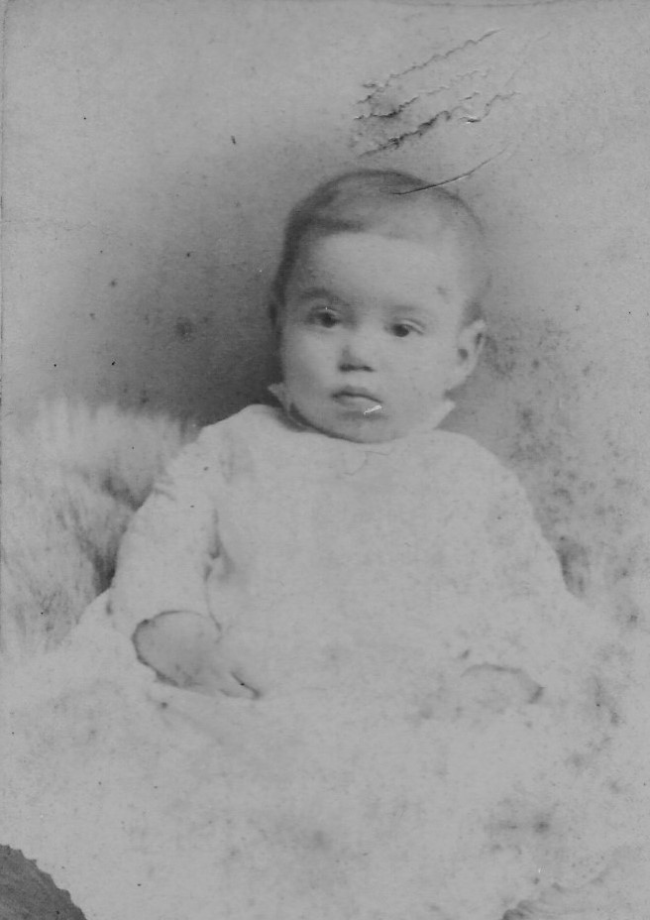

Slide 3
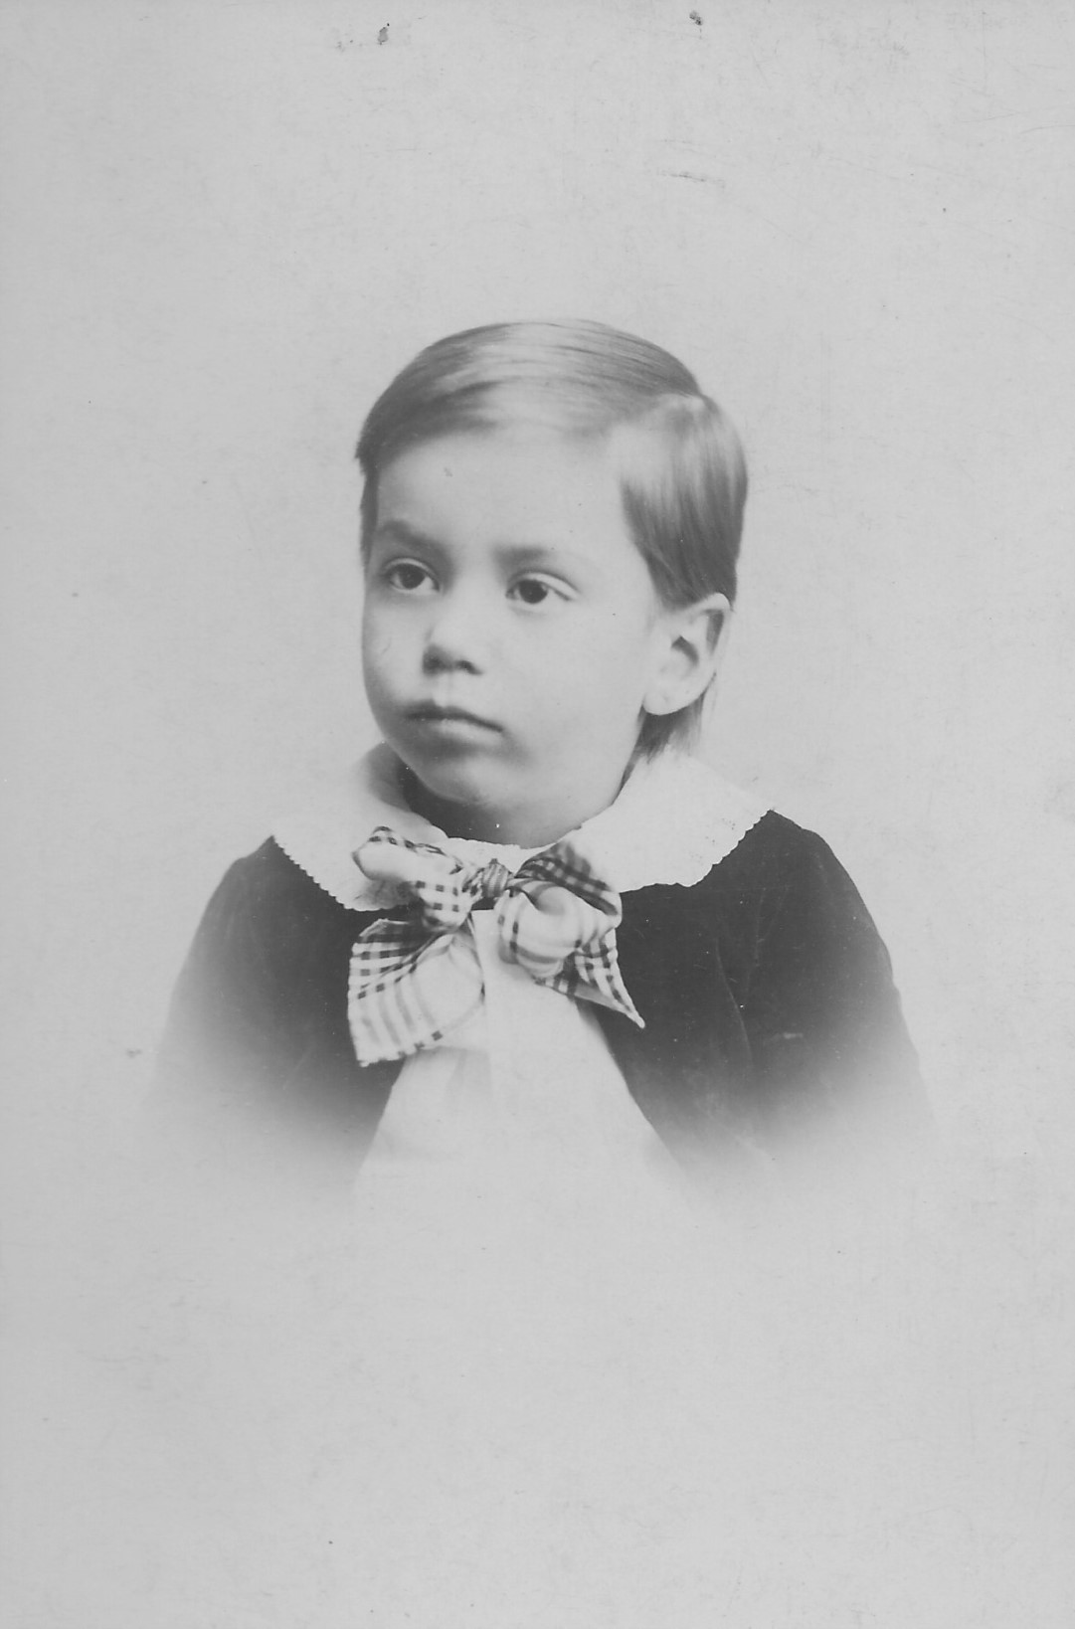

Slide 4
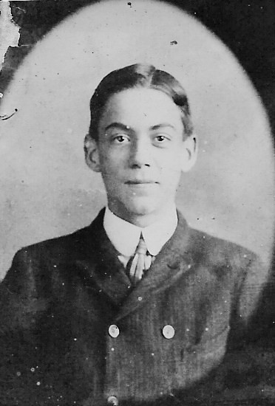

Slide 5
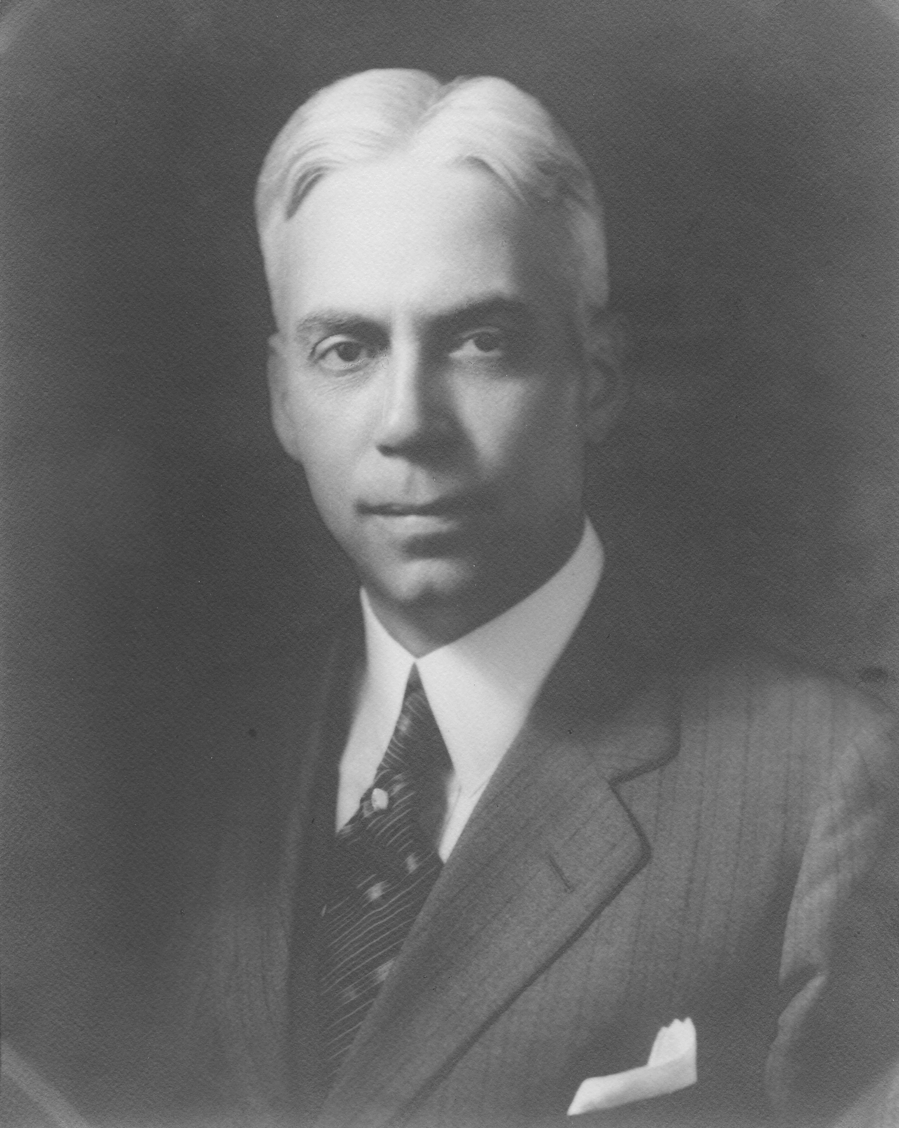

Slide 6
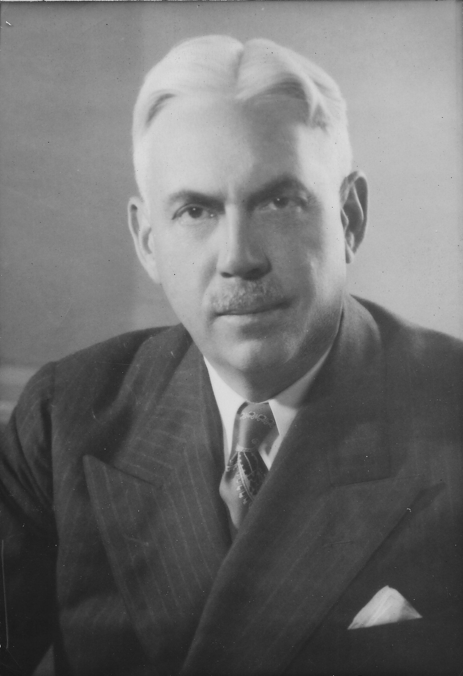

Slide 7
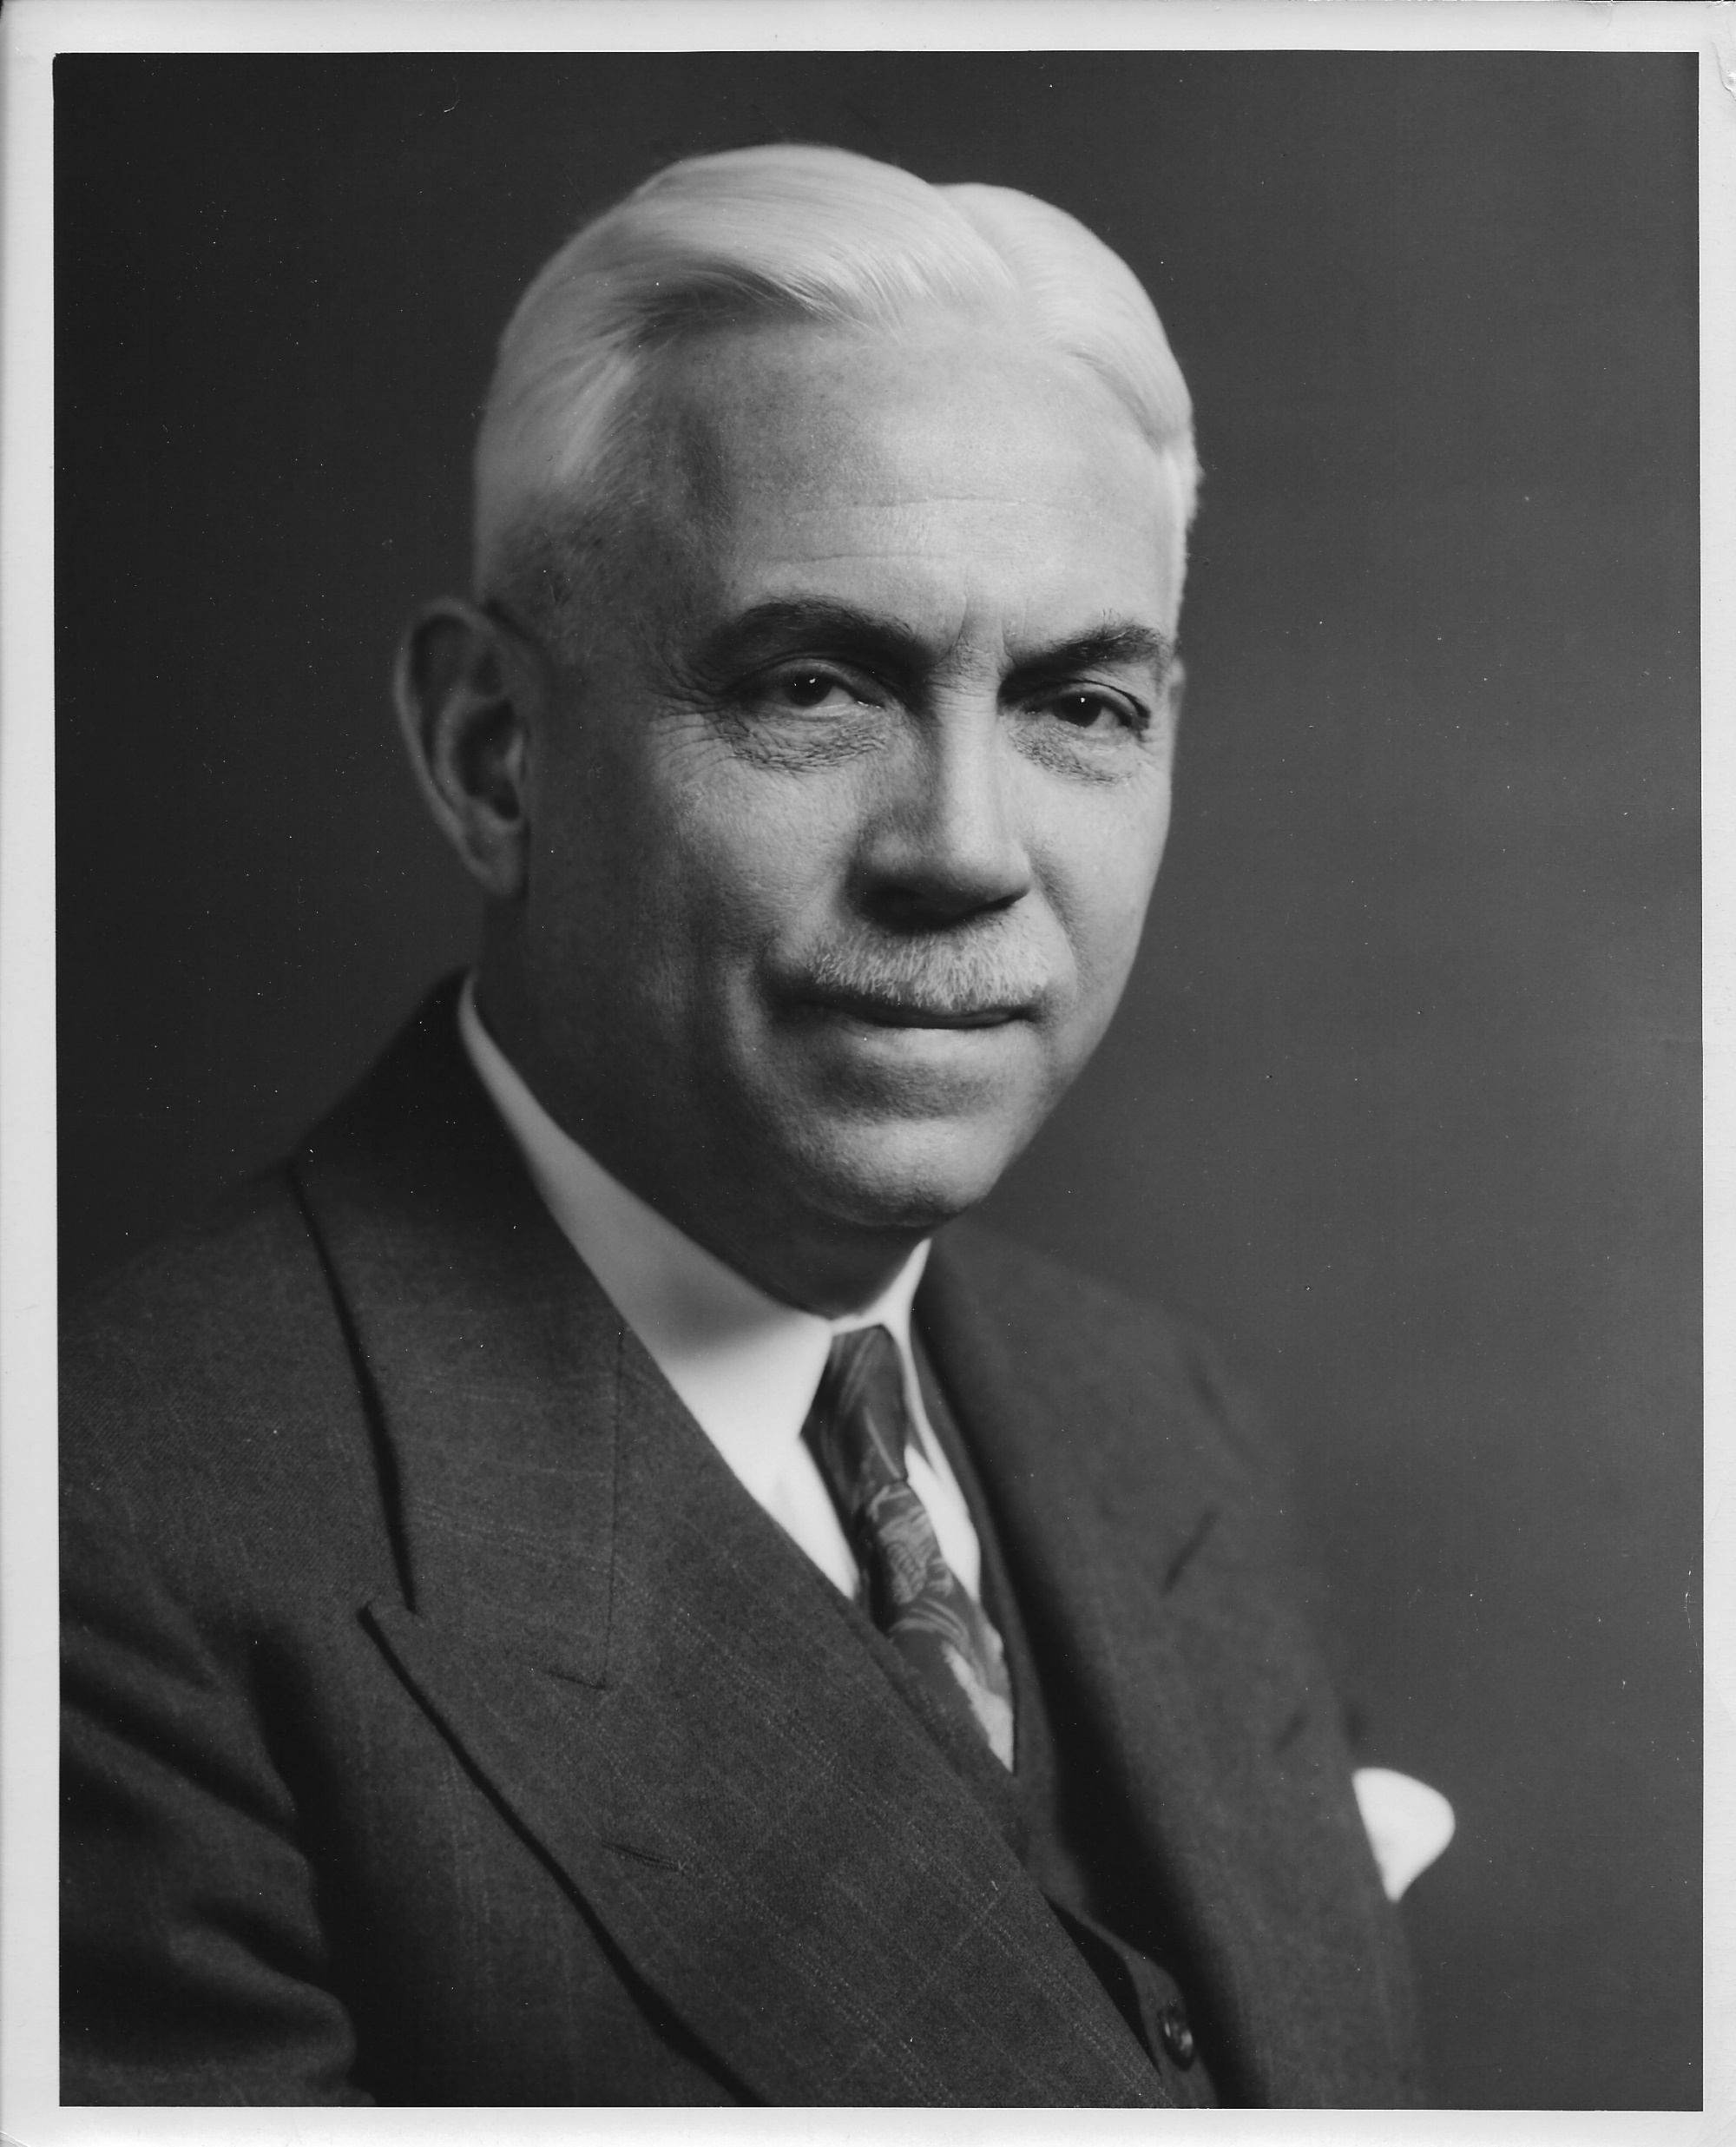

Slide 8
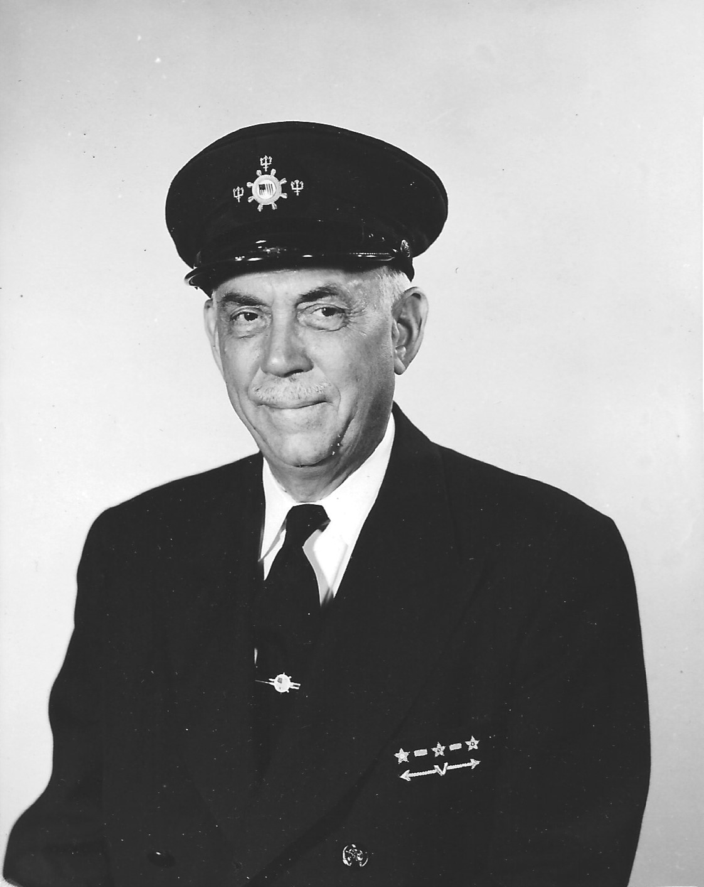

Slide 9
